Slide 1
SIAMS Framework Overview
4th December 2023
Paul Rusby

Slide 2
Welcome

Slide 3
‘Open our eyes to behold your presence
Strengthen our hands to do your will…’
(Morning Prayer 04 December 2023)

Slide 4
The light shines in the darkness, and the darkness has not overcome it. (John 1:5)

Slide 5
Session
4-5pm
Chat messages
Microphones off
Time at end Questions
Structure
What is SIAMS
2023 Framework
Practicalities
IQs
Questions

Slide 6
What is SIAMS?

Slide 7
SIAMS 2023
Statutory Inspection of Anglican and Methodist Schools
SIAMS-Inspection under s48
Every 5 years (Covid delay)
Report published (nationally)
No link to Ofsted
Documents on C of E website

Slide 8
The Church of England has set out a bold Church of England Vision for Education that is deeply Christian, serving the common good. Our purpose in education is to enable the children, young people and communities we serve to flourish as they experience education for wisdom, hope, community and dignity and discover life in all its fullness which Jesus offers.
Nigel Genders 2018

Slide 9
Flourish (verb)
‘to grow or develop in a healthy or vigorous way as the result of a particularly favourable environment.

Slide 10
What is SIAMS?
The 2023 SIAMS Framework shines a spotlight on these key elements – theology, school context, and vision. It allows inspectors and school leaders, together, to gather evidence to answer the Inspection Questions, in turn enabling inspectors to reach fair and accurate judgements. In doing so, it moves the Church of England and Methodist Church’s inspection practice forward, respecting the knowledge and expertise of school leaders, allowing them to tell their stories, and holding them to account.
Many Church schools are part of multi academy trusts. Where this is the case, the trusts have committed to enhance the Christian foundation of these schools. The 2023 SIAMS Framework rightly holds them to account for their work in this regard.
The Right Reverend Paul Butler | Lead Bishop for Education 2022

Slide 11
What is SIAMS?
Church schools come in all different shapes and sizes, and a one size fits all approach to inspection does not allow a school to have integrity in its Christian-vision-driven work. Therefore, the 2023 SIAMS Framework does not present schools with lists of criteria to meet. Instead, it asks a number of Inspection Questions about impact, and it allows leaders to explain the school’s context and the reasons for decisions and actions. In all things, the contextually-appropriate theologically rooted Christian vision is the driving force.
SIAMS inspectors will explore with school and trust leaders how they understand the specific context of the school, and whether they know how to respond to it theologically. Local, diocesan, and national expertise will help school and trust leaders to explore this, so that they can be confident in answering three key questions:
1. Who are we as a school?
2. What are we doing here?
3. How, then, shall we live and learn together?
Dr Margaret James | National Director of SIAMS 2022

Slide 12
Headlines
Judgements replace grades.
Each school needs to have a theologically rooted Christian vision.
High level inspection questions with a focus on impact replace exhaustive lists of criteria.
Each school’s specific context plays a greater role than at present.
Trust accountability is brought to the fore.

Slide 13
Judgements replace grades
Inspectors will make one of two judgements
These are coherent with the nature of the evidence that is collected as part of a SIAMS inspection - qualitative evidence leads to qualitative judgements.
The judgements are also coherent with the purpose of a SIAMS inspection that is, to contribute towards Church school improvement.
Reports will not state either ‘J1’ or ‘J2’ – instead the judgement itself will be written in a box after the inspection findings.
Inspectors simply need enough evidence to answer each of the IQs.
Having a theologically rooted Christian vision is central to an inspection.

Slide 14
Judgement J1
The inspection findings indicate that the school is living up to its foundation as a Church school and is enabling pupils and adults to flourish.

Slide 15
Judgement J1
Inspectors will award J1 if they can answer the IQ even if there are areas of relative weakness.
Remember – this judgement does not equate to perfection.
This might include, for example:
IQ1 – vision is not yet well-embedded
IQ2 – understanding of spirituality is there but is inconsistent across classes/year groups
IQ3 – monitoring of collective worship happens but is not providing sufficient evidence
IQ4 – people report that they are treated well; support is inconsistent for some groups
IQ5 – work on courageous advocacy is evident & has impact, but is at an early stage
IQ6 – the RE curriculum has areas of strength and weakness across different faiths
IQ7 – quality of teaching is mixed across classes/year groups but is generally good

Slide 16
Judgement J2
The inspection findings indicate that the school has strengths but that there are also issues that leaders need to address as a matter of priority. These are listed in the areas for development.

Slide 17
Judgement J2
Inspectors will award J2 if there are any IQs which they are unable to answer due to lack of compelling evidence.
This might be because, for example:
IQ1 – vision is not theologically rooted, or it is not enabling pupils/adults to flourish
IQ2 – there is no connection between vision and curriculum
IQ3 – collective worship does not enable spiritual flourishing
IQ4 – policies on wellbeing are not reflected in practice & people are not treated well
IQ5 – work on justice appears to be missing from the life of the school – no evidence
IQ6 – RE is not well-resourced & this has a negative impact on quality
IQ7 – teaching does not enable pupils to make good progress

Slide 18
Trust accountability is brought to the fore.
Trusts are the legally accountable body for all academies.
They make commitments to the DBE and the DfE before they are given permission to take on a Church school.
SIAMS will hold them to account for enhancing a school as a Church school.
This will be explored through each Inspection Question.
The trust board can delegate responsibility for action; they cannot delegate their accountability.
Trust leaders will be an integral part of every inspection of an academy.
SIAMS remains an inspection of the school, not of the trust.

Slide 19
What schools and trusts should do:
Schools and trusts must provide convincing evidence of how:
i. the school’s work is driven by a contextually-appropriate theologically rooted Christian vision for education that reflects its foundation as a Church school, meets the needs of the school community, and enables people to flourish
ii. the vision and practice of the trust resonate with those of the school
iii. leadership and governance are appropriate and effective
iv. collective worship reflects the school’s Anglican/Methodist foundation and enables the spiritual flourishing of those in the school community
v. the school offers a religious education curriculum that:
meets legal requirements
reflects the Church of England’s Statement of Entitlement for Religious Education
is effective

Slide 20
SIAMS Framework – September 2023
© The National Society (Church of England and Church in Wales) for the Promotion of Education 2021

Slide 21
Inspection Structure
Context of the school 1: Who are we? This factual information enables the inspector to understand the specific context of the school. No judgements are made on this information.
Context of the school 2: What are we doing here? This information enables the inspector to understand the theological underpinning of the school’s Christian vision, the school/trust’s governance structures, its arrangements for RE and collective worship, and its partnerships. This information informs the inspection judgements that the inspector makes.
Inspection Questions (IQ): How then shall we live and learn together? This information is central to the evidence-based judgements that the inspector makes. The subquestions ensure that the inspector and school leaders have enough evidence to answer the main IQs.

Slide 22
Context of the school 1: Who are we?
Is the school a Church of England, Methodist or joint denomination school?
Is the school voluntary controlled or formerly voluntary controlled; voluntary aided or formerly voluntary aided; or does it have another designation?
If a former voluntary controlled school does it, as an academy, provide denominational religious education?
What phase is the school – first/infant, junior, primary, middle, secondary, high, all-through? What is the number of pupils on roll?
Is the school an academy or a maintained school? Is the school part of a federation?

Slide 23
Context of the school 1: Who are we?
How is school and trust leadership structured and organised? If part of a trust, what authority is delegated locally?
What characterises the school’s pupil profile, and the community within which it is situated and/or that it serves? For example, how ethnically, culturally, and socially diverse is the community? And what are the educational needs of pupils?
What church and DBE/MAST partnerships does the school have?
Does the school have any other links or partnerships?

Slide 24
Context of the school 2: What are we doing here?
Considering the answers under ‘Who are we?’, what is the vision of the school and of the trust?
How is the school’s vision a clearly-articulated, theologically rooted Christian vision? How does the trust’s vision resonate with this?
How do the specific needs of the school community inform the theologically rooted Christian vision? In other words, do leaders understand the school’s context, and do they know how to respond to it theologically?

Slide 25
Context of the school 2: What are we doing here?
Why have school leaders decided that the school should be a maintained school/an academy? How does this status enhance the effectiveness of the school as a Church school?
As a result of the school’s Christian vision, original foundation, and current context, why are school and trust structures of governance as they are?
How do governance accountability and delegated authority in the school and trust enhance the work of the school as a Church school? How do leaders know this?

Slide 26
Context of the school 2: What are we doing here?
What are the school’s arrangements for collective worship? Why are these arrangements in place?
How is religious education structured and organised? Why have these decisions been made?
What is the relationship between the school/trust and the DBE and/or MAST? How do these relationships enhance the school’s ability to live out its Christian vision and to live up to its foundation as a Church school, enabling people to flourish?
What is the relationship between the school/trust and local church/es? How do these relationships enhance the school’s ability to live out its Christian vision and to live up to its foundation as a Church school, enabling people to flourish?

Slide 27
Theologically Rooted Christian Vision

Slide 28
Is it relevant-context? (legacy)
Is it lived?
Is it understood?
Is it move than values?
Is it rooted theologically?

Slide 29
Does it refer to all members of the school community?
Does it reflect the context of the school?
Our Vision
Is it future-focused?
Does it sit in the context of a Christian vision?
Is it inclusive and aspirational?

Slide 30
SIAMS Framework – September 2023
© The National Society (Church of England and Church in Wales) for the Promotion of Education 2021

Slide 31
Practicalities

Slide 32
SIAMS-2023
Day -5 Notification (prior to notification…)
Day-5 Phone call
Day -5 Send information to inspector
Day -2 PIP/timetable
Day 0 Inspection (LoE)
Day +10 draft inspection report

Slide 33
SIAMS-2023-Structure of Day
SLT
Groups of staff
Parents
Governors
Pupils
Clergy/members of local church
Diocese/MAT…

Slide 34
Inspection Questions (IQs)

Slide 35
Inspection Questions (IQ)
How then shall we live and learn together?
(This information is central to the evidence-based judgements that the inspector makes. The subquestions ensure that the inspector and school leaders have enough evidence to answer the main IQs.)

Slide 36
IQ1
How does the school’s theologically rooted Christian vision enable pupils and adults to flourish?

Slide 37
IQ1 How does the school’s theologically rooted Christian vision enable pupils and adults to flourish?
How is the Christian vision expressed? For example, is it through values that are faithful to the Anglican/Methodist foundation of the school?
What other strategies do leaders employ to ensure that the theologically rooted Christian vision is a living reality that enables pupils and adults to flourish?
How do leaders know that the theologically rooted Christian vision is enabling people to flourish?
How does the vision of the trust resonate with the school’s theologically rooted Christian vision in a way that enhances the work of the school and its Christian foundation?

Slide 38
IQ2
How does the curriculum reflect the school’s theologically rooted Christian vision?
Notes:
No notes.

Slide 39
IQ2 How does the curriculum reflect the theologically rooted Christian vision?
In what ways does the theologically rooted Christian vision shape the curriculum, including the extra-curricular offer?
How is spiritual development an intrinsic part of the curriculum?
How do leaders know that the curriculum is having the intended effect for pupils?
How, specifically, does the Christian vision shape the learning experience for pupils who are deemed to be vulnerable and/or disadvantaged?
How does being part of the trust enhance the school’s curriculum?

Slide 40
IQ3
How is collective worship enabling pupils and adults to flourish spiritually?
Notes:
No notes.

Slide 41
IQ3 How is collective worship enabling pupils and adults to flourish spiritually?
How do the theologically rooted Christian vision and the Anglican/Methodist foundation of the school shape worship and spirituality in the school?
How do partnerships with the DBE and/or MAST, and partnerships with parish/local church/es enhance this?
In what ways is the worship life of the school inclusive, invitational, and inspirational?
In the context of the school as a Church school, what do pupils and adults understand to be the meaning of spirituality? How does this enhance and enrich collective worship and individuals’ spiritual development?
How does the trust contribute to and enhance the school’s worship and spiritual life?

Slide 42
IQ4
How does the school’s theologically rooted Christian vision create a culture in which pupils and adults are treated well?
Notes:
No notes.

Slide 43
IQ4 How does the school’s theologically rooted Christian vision create a culture in which pupils and adults are treated well?
How does the theologically rooted Christian vision enable all to live well together in an inclusive, dignifying, and equitable culture?
How do school policies and practice create a culture in which people’s wellbeing is enhanced?
How is enabling good mental health for all central to the school’s work?
As a result of the theologically rooted Christian vision, what effective strategies are in place that help pupils and adults, including those deemed to be vulnerable and/or disadvantaged, at difficult times?
How does the trust contribute to and enhance the inclusion and wellbeing of pupils and adults, ensuring that all are treated well?

Slide 44
IQ5
How does the school’s theologically rooted Christian vision create an active culture of justice and responsibility?
Notes:
No notes.

Slide 45
IQ5 How does the school’s theologically rooted Christian vision create an active culture of justice and responsibility?
How does the theologically rooted Christian vision enable positive relationships that balance individual freedom and rights, with responsibility towards others?
How does this culture encourage justice and courageous advocacy, enabling pupils to make ethical choices and to be agents of change?
As an outworking of the theologically rooted Christian vision, what partnerships are important to the school? How do they impact positively and reciprocally on people’s lives?
How does the trust make a positive impact on the culture of the school?

Slide 46
IQ6 Is the religious education curriculum effective? (with reference to the expectations set out in the Church of England Statement of Entitlement for Religious Education)

Slide 47
IQ6 Is the religious education curriculum effective? (with reference to the expectations set out in the Church of England Statement of Entitlement for Religious Education)
How do school and trust leaders ensure that the provision, profile, and priority of religious education in all key stages reflects its place on the curriculum of a Church school?
How do school and trust leaders ensure that the religious education curriculum is challenging, accurate, well-sequenced, well-balanced, relevant, and diverse?
How do school and trust leaders ensure that religious education is well-resourced, and that continuing professional development for staff has an impact on the effectiveness of the curriculum?

Slide 48
IQ7 What is the quality of religious education in voluntary aided and former voluntary aided schools, and in former voluntary controlled schools in which denominational religious education is taught?

Slide 49
IQ7 What is the quality of religious education in voluntary aided and former voluntary aided schools, and in former voluntary controlled schools in which denominational religious education is taught?
What is the quality of teaching?
How well do pupils make progress in their learning as a result of a balanced and well-structured religious education curriculum?
How does assessment inform teaching and learning?

Slide 50
SIAMS Annual Report 2022-23

Slide 51
Vision, values, and leadership
Areas to consider:
Schools’ true understanding of the purpose of their vision, given the overwhelming amount of time in the school day that is devoted to the taught curriculum
Governor vacancies, including foundation governors
Some governors do not have a clear understanding of the purpose of their role. This particularly relates to monitoring and evaluating the impact of schools’ vision
Some confusion and/or a lack of understanding about whether schools should have or need to have a Bible verse ‘attached’ to their vision A Bible verse can provide a tangible, visible ‘hook’ that enables the school community to understand the vision, but only when included as part of a deeper strategic and theological discussion amongst leaders
The need for strong leaders who understand what it means to lead a Church school. It is essential that all those involved in recruitment and development take note of this finding, and devise recruitment campaigns and leadership and development strategies accordingly.
https://www.churchofengland.org/sites/default/files/2023-09/siams-annual-report-2022-2023.pdf

Slide 52
Spirituality and spiritual development
Strengths identified:
In the schools that have a shared understanding of spirituality and a planned approach to spiritual development, there is a valuable language for expressing spirituality.
Areas to consider:
Work to do in general terms in ensuring that spirituality is playing an integral role in the education offered by Church schools
The curriculum in the majority of Church schools, whilst increasingly reflecting the vision, does not include spirituality as a matter of routine
https://www.churchofengland.org/sites/default/files/2023-09/siams-annual-report-2022-2023.pdf

Slide 53
Collective Worship
Strengths identified:
Collective worship is frequently described as being the ‘heartbeat’ of schools
Areas to consider:
The positive impact of worship and an understanding of needs to consistently break through from acts of worship into the rest of school life
Governors’ monitoring and evaluation activity needs to extend to the impact of collective worship
Confusion relating to the ‘requirements’ and benefits of different models of leadership of collective worship, with some schools believing that they must insist on pupils leading acts of worship. Schools would benefit from being empowered to make contextually-appropriate decisions on this issue, including a consideration of whether and how leadership of worship universally enhances pupils’ and adults’ spiritual flourishing. They should then make decisions accordingly.
https://www.churchofengland.org/sites/default/files/2023-09/siams-annual-report-2022-2023.pdf

Slide 54
School culture, relationships, and inclusion
Strengths identified:
Church schools appear to be characterised by qualities such as love, forgiveness, dignity, respect, care, and kindness. Pastoral support and mental health and wellbeing are taken seriously and provision for pupils and adults is prioritised
What it means to enable pupils to grow as active agents of change is an improving picture
Obvious desire across Church schools to be welcoming communities, accepting of diversity and difference
Areas to consider:
In addressing matters of injustice and empowerment, it is important that school staff and leaders understand not only the notion of courageous advocacy, but also that of political impartiality
Inconsistency in practice is largely due to limited understanding (of diversity and difference), as well as the lack of availability of appropriate resources
Improving understanding of the diversity that is inherent within, and a fundamental defining characteristic of, humankind made in the image of God
https://www.churchofengland.org/sites/default/files/2023-09/siams-annual-report-2022-2023.pdf

Slide 55
Religious Education
Strengths identified:
Standards in RE appear to be improving, likely aided by teachers’ improving subject knowledge. Diocesan training in RE appears to be having a consistently positive impact for schools
Areas to consider:
Whilst balance in RE teaching (theology, philosophy, human science) is improving, homogenisation within faiths occurs too frequently (Christians believe…SOME)
There are a number of areas in RE that require further attention:
Whilst teaching and learning in Christianity is generally strong, knowledge and understanding of Christianity as a global faith remains a relative weakness. This aspect of Christianity appears to be under-resourced for teachers.
Evidence in relation to the teaching and learning of a range of worldviews and faiths other than Christianity indicates a gradually improving picture, but one in which there remains a good amount of work to be done. It is possible that lack of resources is also a factor here.
Teaching of RE in KS5 is inconsistent, both in quality and in availability.
https://www.churchofengland.org/sites/default/files/2023-09/siams-annual-report-2022-2023.pdf

Slide 56
Partnerships
Strengths identified:
Schools that invest time and energy in partnerships benefit holistically from them
Church schools’ partnership with the diocese is of particular value in terms of having a positive impact on Christian vision, RE, collective worship, spirituality and spiritual development, and the work of governors
Schools’ partnerships with churches are also of comprehensive and wide-ranging benefit
When a school is part of a multi academy trust that understands the specific character of Church schools, the school benefits from appropriate support.
https://www.churchofengland.org/sites/default/files/2023-09/siams-annual-report-2022-2023.pdf

Slide 57
General observations
Evidence indicates three interesting and frequently occurring valuable principles across Church schools.
Intentionality – where action, vision, monitoring and evaluation, spirituality and most other elements of Church school life are approached and carried out with determination, deliberateness, and clear meaning and purpose, they appear to be of greater worth to the school community.
Explicitness – building on the benefits of intentionality, when leaders are explicit with others about the fact that the school is a Church school and all that this entails, there appear to be more tangible benefits to the school community when compared with schools where this is regarded as being implicit. The ability for leaders to be explicit requires them, firstly, to have a deep and meaningful understanding of what a Church school is, what it does, and why it does it.
Understanding why – unfortunately yet understandably, compliance remains a key feature of Church school leadership, and it often seems to take precedence over an understanding of why actions are being taken. If the answer to the question ‘why?’ is ‘because of inspection’, then leaders should feel empowered to think again and to determine the true purpose and worth of their actions.
https://www.churchofengland.org/sites/default/files/2023-09/siams-annual-report-2022-2023.pdf

Slide 58
Resources and Support

Slide 59
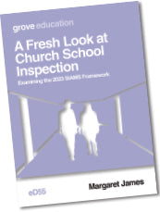
A Fresh Look at Inspection
groveeducation
eD 55 A Fresh Look at Church School Inspection: Examining the 2023 SIAMS
Framework
The 2023 SIAMS Framework marks a significant break with previous approaches to the inspection of church schools. It is radically different in its use of qualitative evidence to reach judgments rather than grades. Yet it is radically the same inasmuch as it does not reimagine what it means to be a church school.
This essential guide examines and explains the key changes and explores how schools can demonstrate their theologically rooted Christian vision and practice.

Slide 60
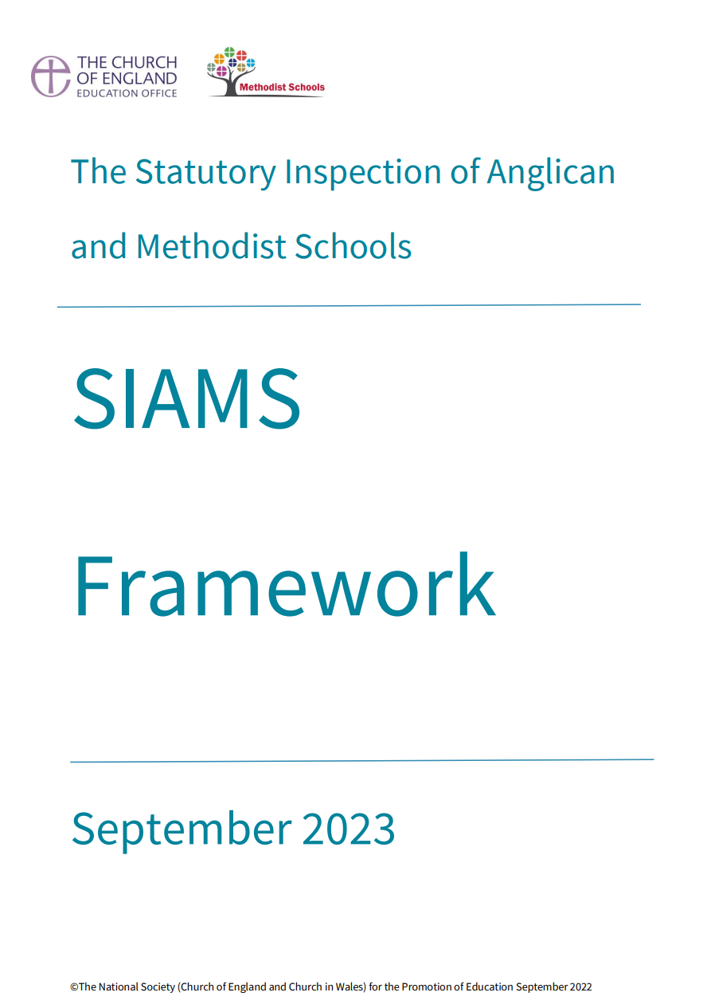
Reading
Church of England Vision for Education (2016)
Our Hope for a Flourishing Schools System: Deeply Christian, Serving the Common Good (2023)
Statutory Inspection of Anglican and Methodist Schools: SIAMS Framework (2023)
SIAMS Information for Schools
The Statement of Entitlement for RE (2019)
Valuing All God’s Children (Updated 2019)
Courageous Advocacy (2021)
Collective Worship Guidance (2021)
The Fruits of the Spirit - A Church of England Discussion Paper on Character Education (2015)
Spiritual Development Interpretations of spiritual development in the classroom (2019)

Slide 61
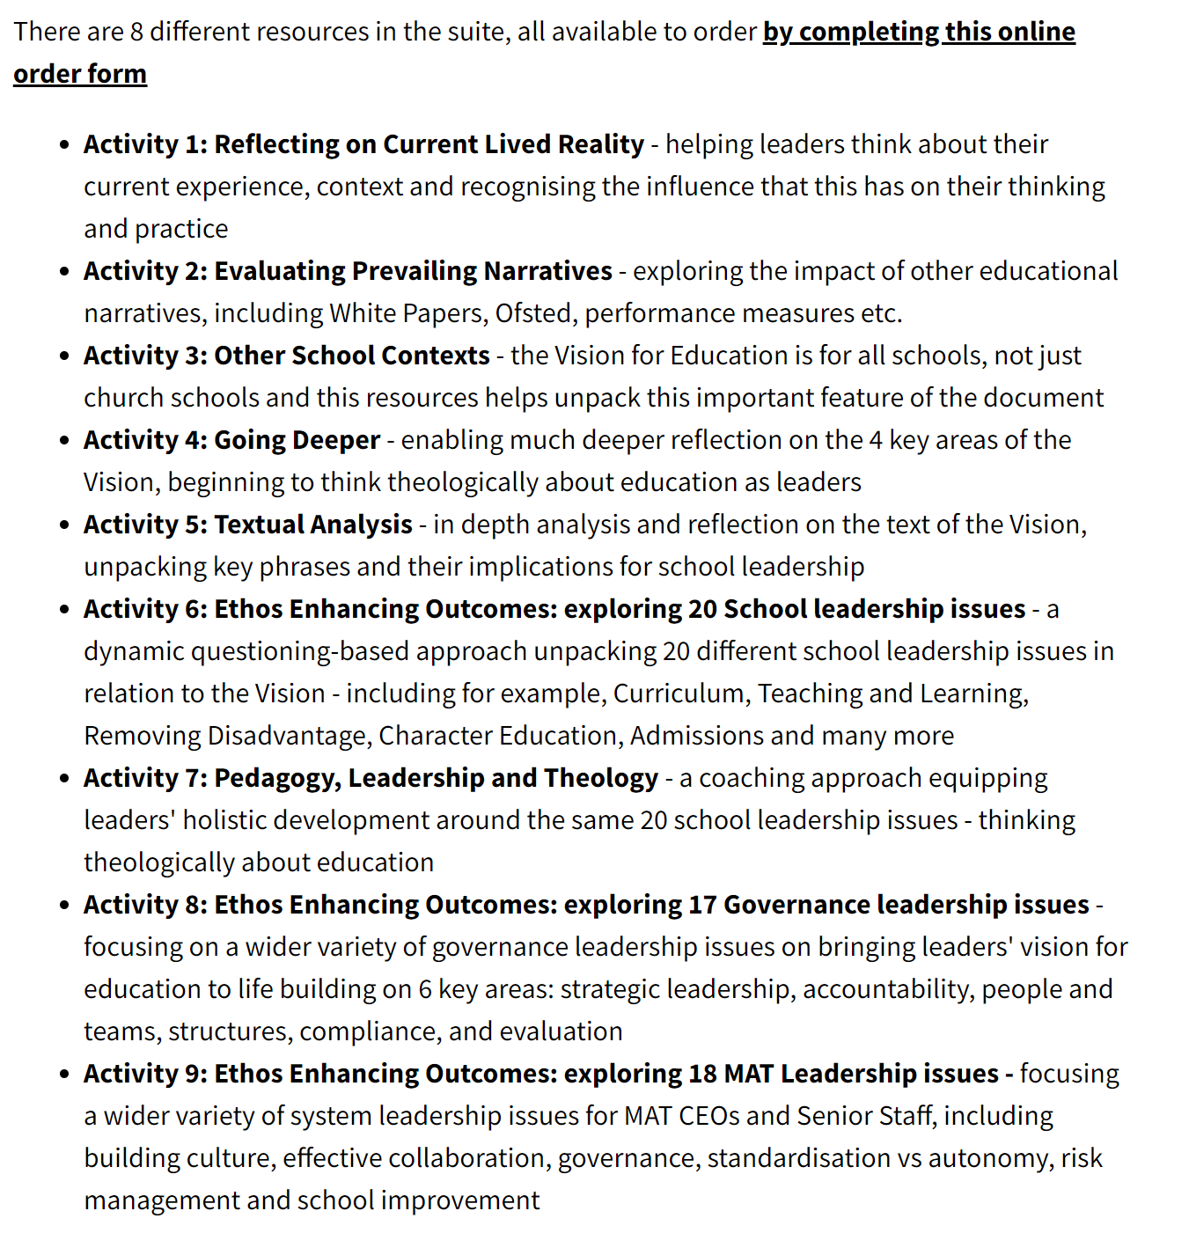
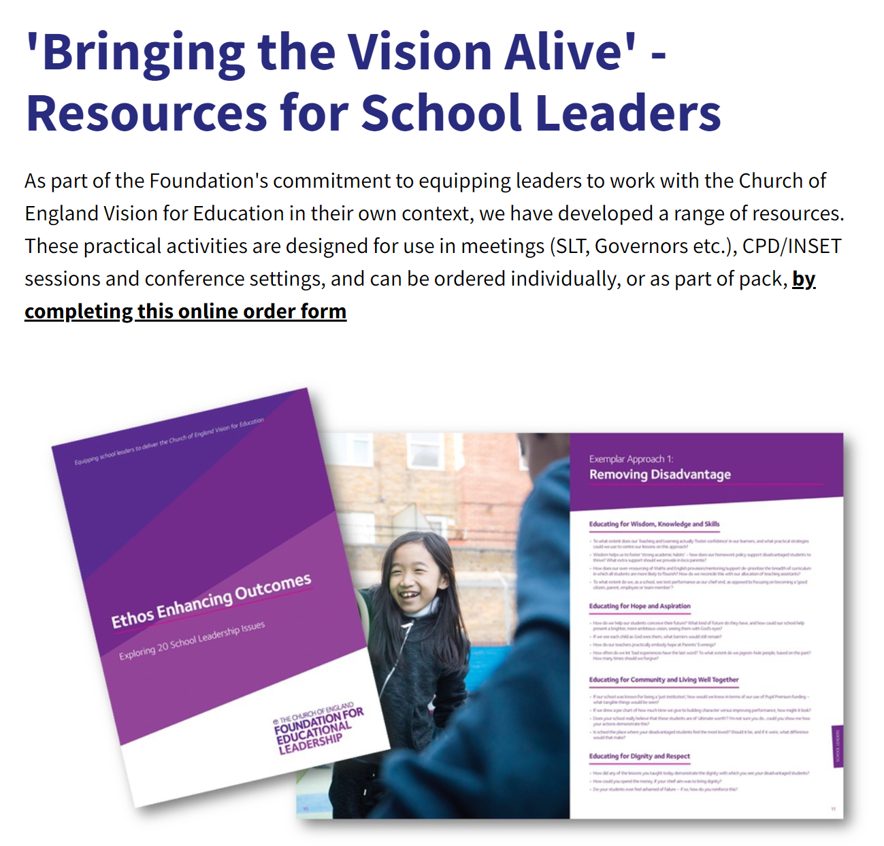
Resources from The Church of England Foundation for Educational Leadership – 'Bringing the Vision Alive’
Order Vision Resources - Foundation For Educational Leadership (cefel.org.uk)

Slide 62
Session
4-5pm
Chat messages
Microphones off
Questions
Structure
What is SIAMS
Practicalities
IQs
Questions

Slide 63
‘Open our eyes to behold your presence
Strengthen our hands to do your will…’
(Morning Prayer 04 December 2023)

