Slide 1


Giving Review Options
Nathan Bruce
Parish Giving Champion

Slide 2

Giving in Grace
www.givingingrace.org
Launched in 2005 by Liverpool Diocese
Can assist with a traditional stewardship programme
Full range of materials available on the GIG website
There are three options for churches:
  Stewardship Programme
  Stewardship Tasks
  Annual Review

Slide 3
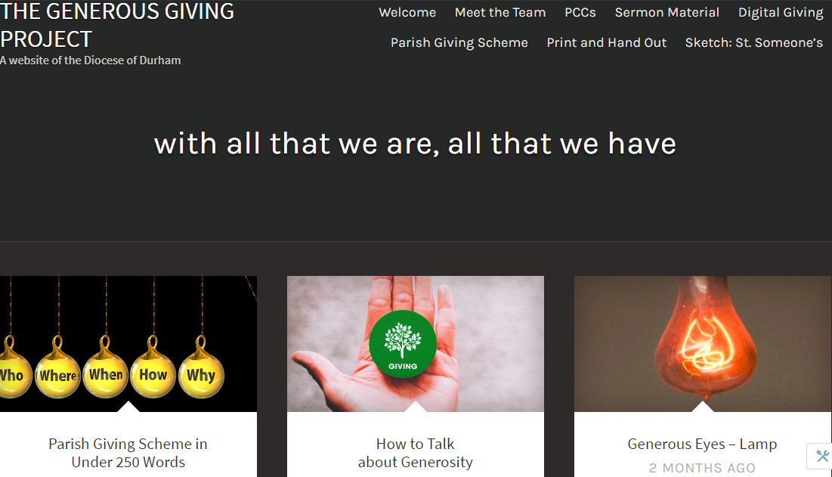
The Generous Giving Project
www.thegenerousgivingproject.com
Launched in April 2016
Provides a range of resources
Specific focus on building a culture of generosity
Now being considered as a resource for national church

Slide 4
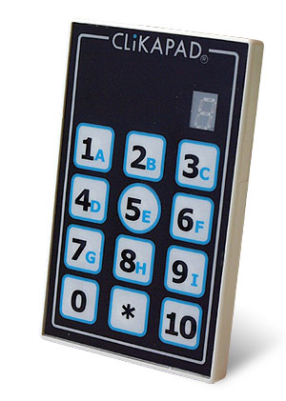
Ask the Audience
Have you ever wondered what your PCC really thinks?
Highly interactive
Explore the subject of financial giving together
Everyone can answer anonymously but
still have their say
External facilitation provided
Provides the foundation for moving
forward together in unity

Slide 5
How to Get Started
Samantha Lee
Finance Resources Co-ordinator

Slide 6

Step one - register
PCC to pass a Resolution to join
PGS lead appointed and working group agreed
Decide on a giving review
Complete Registration form and send to Cuthbert House

Slide 7
Step two- plan launch
Church is designated a unique code and gift packs are provided
Sign up PCC members
Customise gift packs ready for launch

Slide 8
Step three – launch PGS
Deliver Giving Review
Offer PGS as the preferred method of giving and provide gift packs
Hold a celebration service when people give in their completed forms

Slide 9
Step four – ongoing…
Statement receiver gets login details to access monthly statements from PGS
Provide a permanent display
Ask non PGS church members to join the scheme
Remember to say thank you

Slide 10
Top Tips
Appoint a respected person to lead
Establish a group to support and encourage
Explain the vision, what can be achieved if giving increases
Make time for individual discussions
Celebrate and share success

Slide 11
Support Materials
Full implementation details in the Parish Handbook
PGS Poster
Leaflet
Letter template
Offertory tokens

Slide 12
Thank you!

