Slide 1


An Introduction
Diocese of Durham
John Preston
Chair of Trustees &
National Stewardship Officer

Slide 2
What is the PGS?
The Parish Giving Scheme (PGS) is a direct-debit facility originally developed by the Diocese of Gloucester to provide a professional, effective donation management system to support parishes in funding their mission and ministry.
Donations made through this scheme use a Direct Debit.
This can be made on a monthly, quarterly or annual basis.
Each donation is restricted to the intended church.
Gift Aid is reclaimed and passed onto the church directly.
Notes:
Separate Charitable Organisation, Company Limited by guarantee (In British and Irish company law, a company limited by guarantee (LBG) is an alternative type of corporation used primarily for non-profit organisations that require legal personality. A company limited by guarantee does not usually have a share capital or shareholders, but instead has members who act as guarantors.)
Been going for 9 years now, not a new scheme

Slide 3

Committed Christian Giving
Regular & One off Gifts
Serves the Church Family
GA & Non GA Donors
S,M,L Churches & Gifts
Replace the Volunteer
Process all Giving
GASDS (not yet…)
Solve all your Problems
Won’t be for Everyone

Slide 4
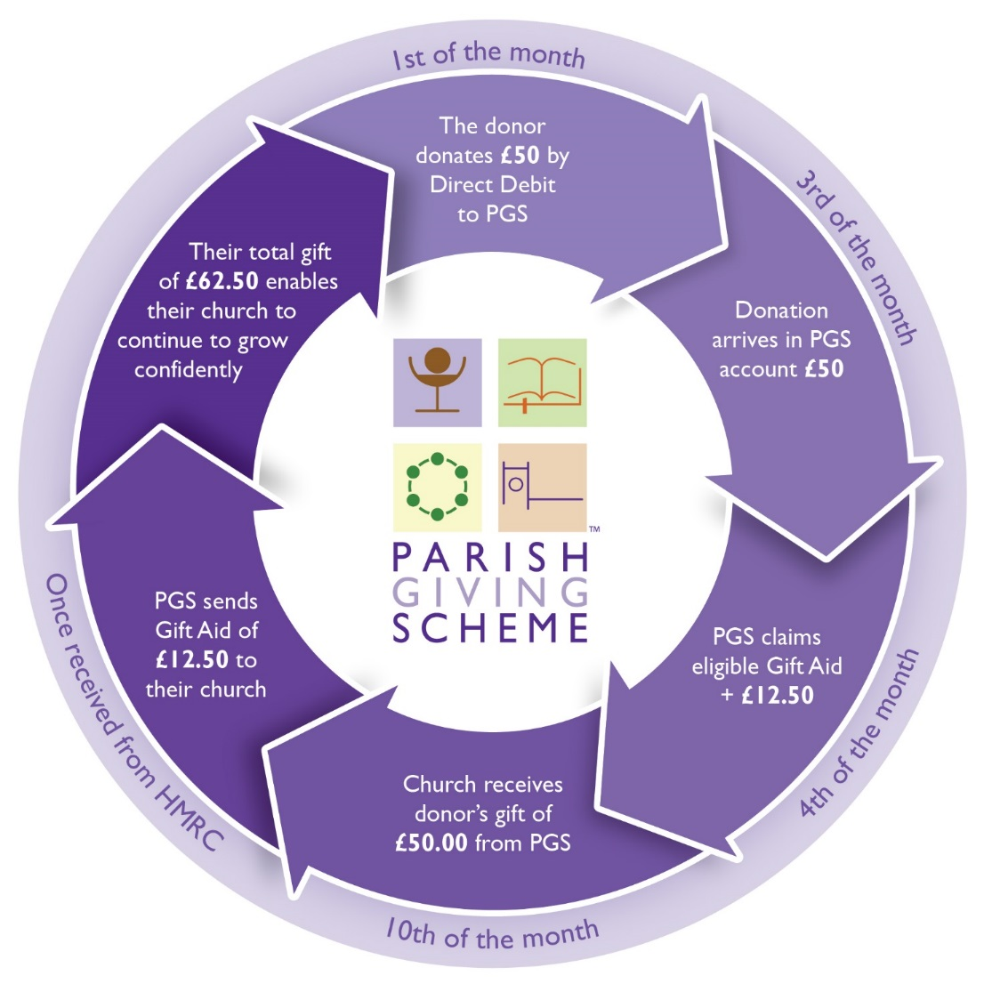


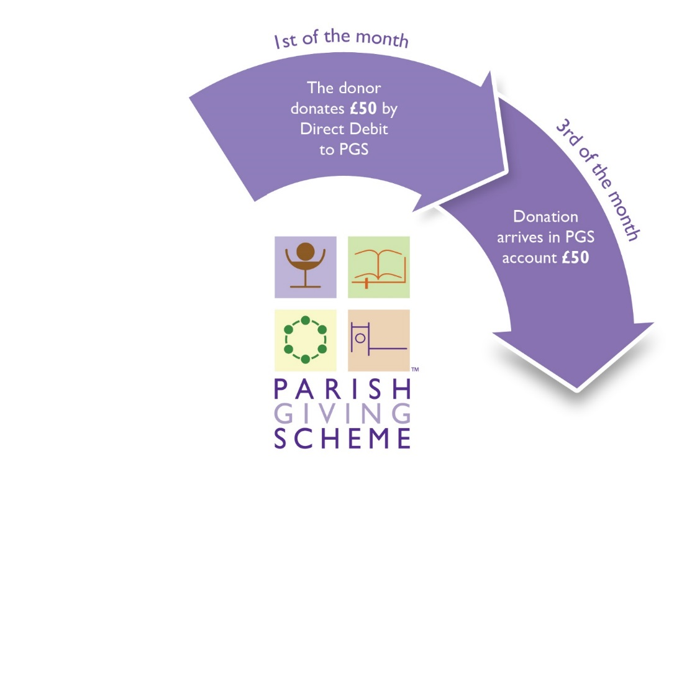
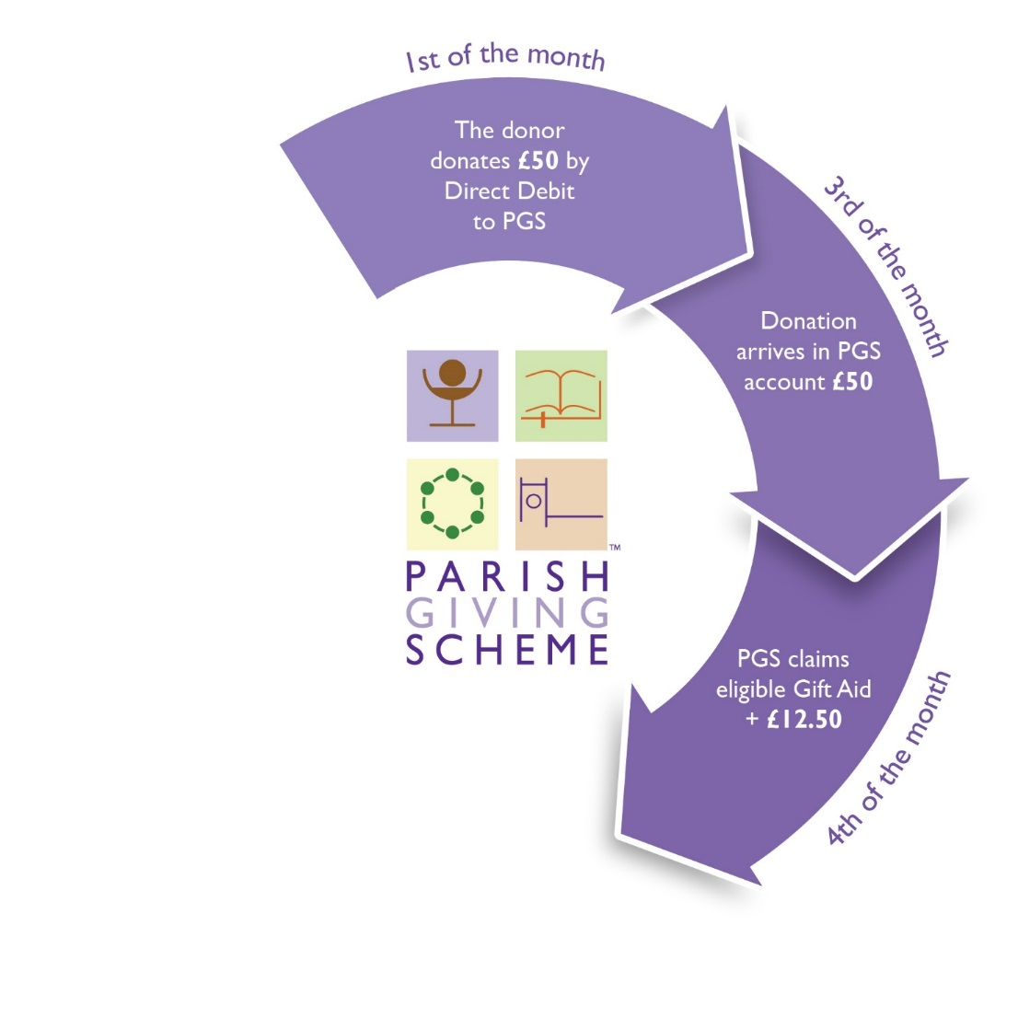
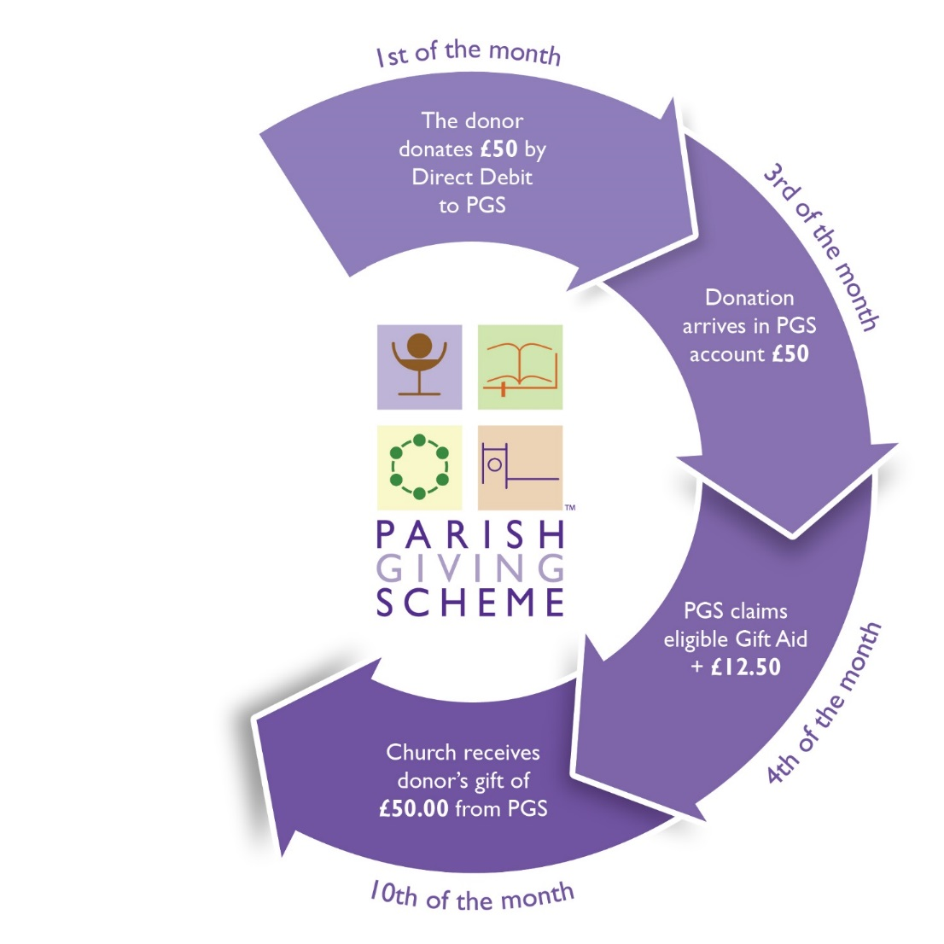
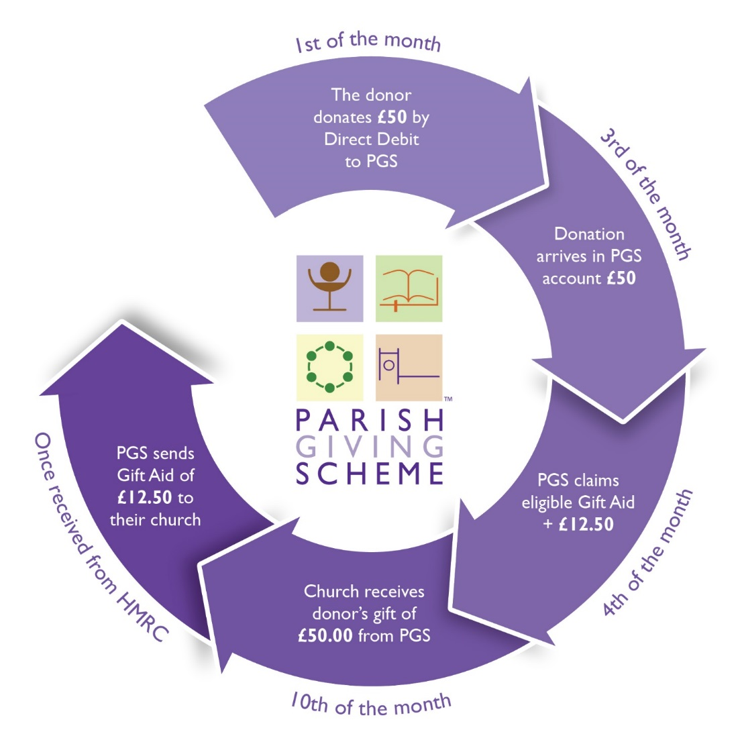
How does it work?

Slide 5

May 2018
• Received over £2.07m gifts
• Claimed £491k Gift Aid in addition
• Received from over 27,600 donors
• Forwarded to 1,531 parishes

Slide 6
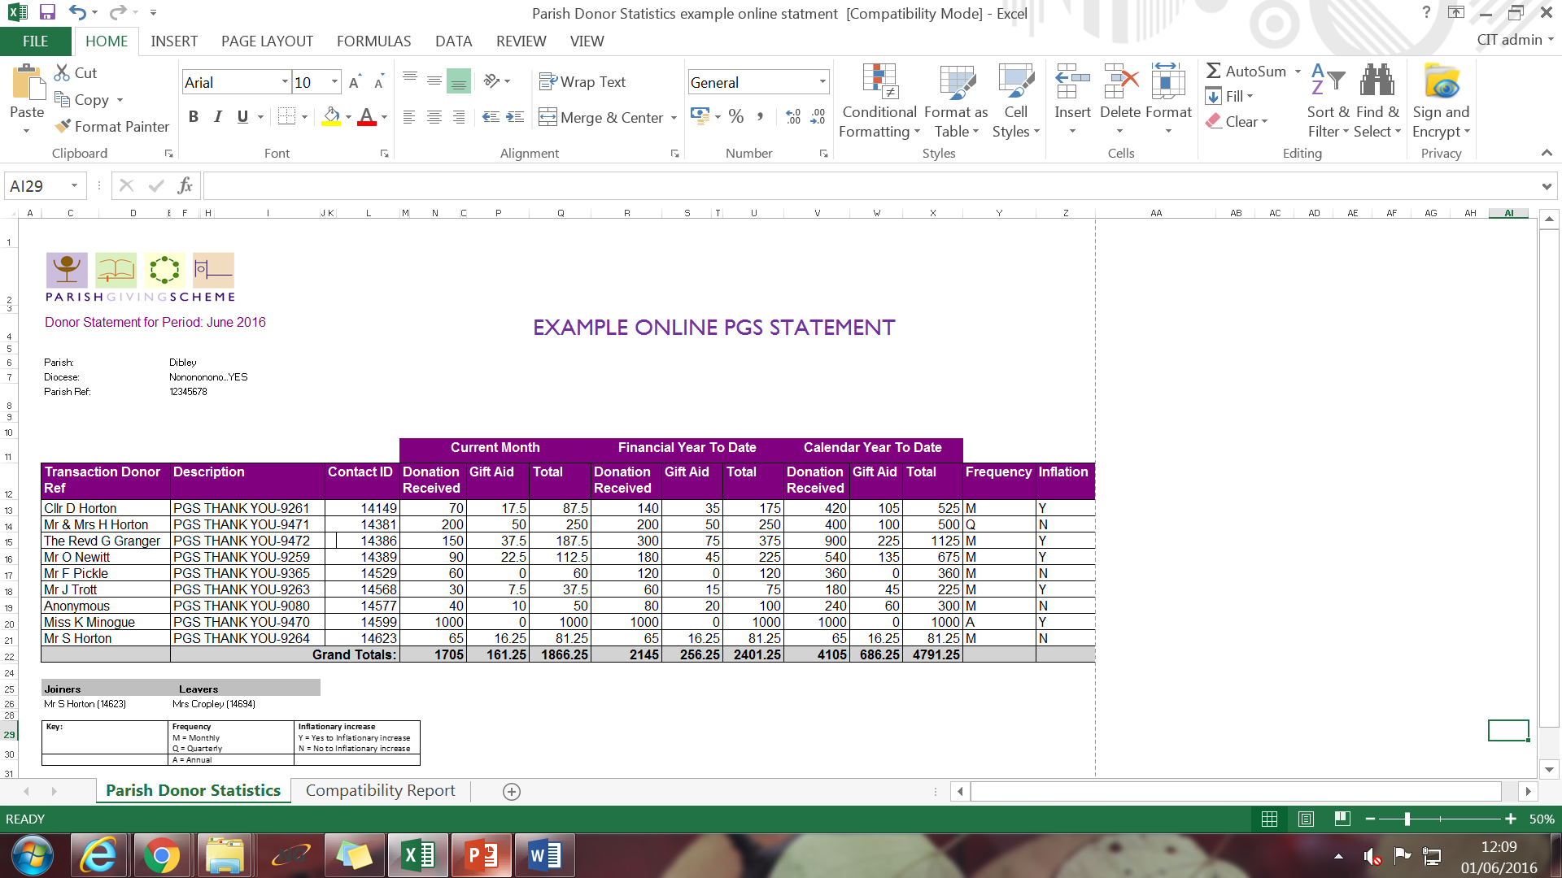
PGS Statement

Slide 7
Why we developed the PGS
Keep pace with the Charity Sector
Improve and Engage with the Donor Journey
To Grow our Mission and Ministry
Lighten the Burden Locally (Recruiting Successor)

Slide 8
Unique Benefit 1
Combats Static Giving
  Giving to rise in line with inflation annually

Slide 9
Why is this Important?
In 2017
£50 + £12.50 Gift Aid = £62.50
Gift increases in line with Retail Price Index
By 2027
£68.51 + £17.30 Gift Aid = £85.64
Extra £277.68 a year

Slide 10
How many?
55% of donors
tick the inflationary increase box (opt in)
Annual Review
SUPER INFLATION!!!

Slide 11
Unique Benefit 2
Increases the Level of Giving
  How we give influences
  How much we give

Slide 12

Every Monday Morning…
….across all the parishes in Church of England how much cash (collected at the Sunday services) is taken to the bank?
£4 MILLION

Slide 13
Koinonia:
Fellowship, communion together – giving in community.
Coin in ‘ere!

Slide 14
Examples:
 | Portsmouth | Liverpool | Newcastle
Average Weekly Giving (Diocese) | £10.91 | £9.98 | £8.12
Average Weekly Giving (PGS) | £15.50 +42% | £15.11 +51% | £17.27* +113%
Source: 2016 Parish Finance Returns,
PGS data for 2018
Newcastle – currently only c200 givers
Notes:
Also because it is launched alongside a giving initiative

Slide 15
Unique Benefit 3
Delivered Locally
Administered Centrally

Slide 16
Live prior to 2018
Launching in 2018
Conversations
30 out of 40 Mainland Dioceses

Slide 17
Who are we?
Members
Participating
Dioceses who:
Have ultimate
responsibility
Sign off accounts
Elect trustees
Trustees
John Preston, Chair and National Stewardship Officer
Victoria James, Stewardship Advisor – Portsmouth
Benjamin Preece Smith, Diocesan Secretary: Gloucester
Rebecca Evans, Stewardship Advisor – Truro
John Sherlock, Strategy & Resources – Chichester
David Brooke, Lead Mission Support Partner – Durham
Neil Williams, Finance Director – Exeter
Adrian Beney, Fundraising Consultant – More Partnership
Company limited by guarantee
Registered England No.8824540.
Registered Charity No.1156606

Slide 18
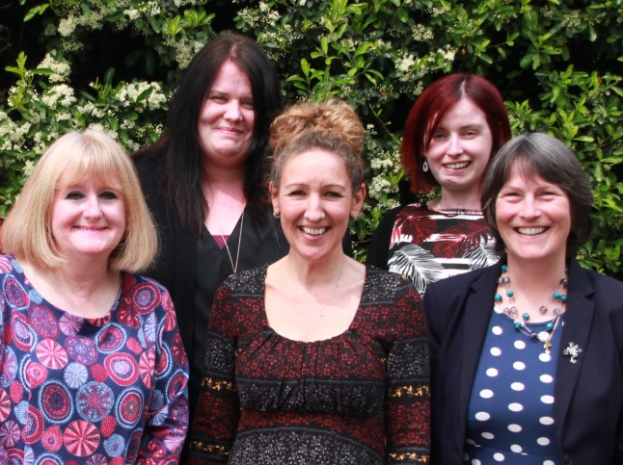
Who are we? PGS Team
Notes:
Helen Richardson, Chief Executive
Helen Taylor, Head of Operations
Gail, Steph, Kim & Sue
Team of 4 Administrators / Customer Services

Slide 19

Is it Secure?
Restricted Donations
Direct Debit Guarantee
Industry Standard Database (CARE)
Fidelity Insurance in Place
3. Full adherence to Data Protection Act (+ incoming GDPR)
Active Policies in Place (Data, Security, Privacy, Acceptable Use)
Notes:
As a a data controller we take data processing incredibly seriously
Personal and Sensitive data
No direct marketing
Only contact for a genuine purpose
Externally audited once a year

Slide 20
How is the PGS financed?
Diocesan Membership Fee = £15,000
Annual Services Contribution = £12,000
After 3 years linked to % of donors on scheme
10,586 planned givers =
£1.13 per donor per year
Notes:
Free at the point of service for parishes
Equivalent to 4 hours of paid volunteer time
Cost of envelope scheme is approx. £60 - £80)

Slide 21
