Slide 1
‘Embracing Change’
Rural and Small Schools Conference
Dioceses of Durham & Newcastle
29 April 2019

Slide 2
Welcome & Introductions
Paul Rickeard
Director of Education
Dioceses of Durham & Newcastle

Slide 3
#1 Opening Reflection: Resilience in 2 Corinthians

Slide 4
“…we had no rest, but we were harassed at every turn – conflicts on the outside, fears within.” (7.5)
“Therefore, since we have such a hope, we are very bold” (3.12)
““But we have this treasure in jars of clay to show that this all-surpassing power is from God and not from us. We are hard pressed on every side, but not crushed; perplexed but not in despair; persecuted but not abandoned; struck down but not destroyed.” (4.7-9)
“We were under pressure, far beyond our ability to endure” (1.8)
Rethinking Resilience
“But since you excel in everything – in faith, in speech, in knowledge, in complete earnestness and in the love we have kindled in you – see that you also excel in this grace of giving.” (8.7)
“Therefore since through God’s mercy we have this ministry, we do not lose heart.” (4.1)

Slide 5
EIF 2019 – Curriculum Design in Rural and Small Schools
Mark Evans
HMI, Ofsted

Slide 6
Coffee and Networking

Slide 7
Embracing Change
Leadership Development
Community Engagement & Social Action
Teaching & Learning

Slide 8
Lunch and Networking

Slide 9
Local Context and Priorities for Partnerships
Paul Rickeard
Director of Education
Dioceses of Durham & Newcastle

Slide 10
Purpose
Our purpose in Education is to enable the children, young people and communities we serve to flourish as they experience education for wisdom, hope, community and dignity and discover life in all its fullness which Jesus offers.
Such an education is about people and not structures and is fundamentally about people in community.
Nigel Genders
Chief Education Officer

Slide 11
Current positon in Newcastle and Durham
Newcastle:
Number of schools with less than 200 and ‘Rural’ = 27
Number of schools with less than 100 and ‘Rural’ = 21*
Number of schools with less than 50 and ‘Rural’ = 12
(*six of these schools are in MATs or Hard Federations)
Durham:
Number of schools with less than 200 and ‘Rural’ = 14
Number of schools with less than 100 and ‘Rural’ = 6*
Number of schools with less than 50 and ‘Rural’ = 0
(*five of these schools are in MATs or Hard Federations)

Slide 12
What are we trying to achieve?
Both Diocesan Boards of Education want to encourage ‘small rural schools’ to work in some form of partnership.
Neither Diocese has a ‘preferred’ structure although the latest report from DFE strongly points towards MATs being the answer.

Slide 13
What are our challenges?
Challenging budgets
A shortfall in governors
A new Ofsted Framework – Curriculum…
Capacity at middle leadership due to budgets
CPD – cost of supply
Ageing buildings
However, in Durham 100% of our Rural schools are Good or better and in Newcastle the percentage is 92%.

Slide 14
Commitment to Rural Education
Newcastle Board of Education NDBE and Durham Board DDBE have made a commitment to support Rural Schools.
Bishop Christine and Bishop Paul have both expressed how important it is that we continue to serve our Rural communities in the most effective ways possible encouraging communities to work together.
The JET working with DDMAT (Durham Diocesan Multi Academy Trust) will be investing £30,000 of resource over the coming twelve months to all C of E Schools to support schools to develop their own curriculum which is effective to their local community – this includes rural schools.

Slide 15
Hard Federations / Multi Academy Trusts / Local Authorities
The Church of England in the North East now supports the education of 33,000 children in its 103 schools and 4 mixed multi academy trusts.
Between us we have a network of Teaching Schools; NLE’s; LLE’s and access to a number of consultants.
Strong relationships with our LA’s where they are supportive of our work.
Huge opportunities for real collaboration with not just ourselves but others.

Slide 16
What next?
Curriculum work over the coming twelve months
Support for schools who wish to explore ‘structures’
Pilots supported by the JET for working together
Support for middle leadership – access to CPD
Growing Faith – renewed links between parish; school and home
National Networks to learn from others

Slide 17
Theology of small:
God consistently raises up the small and places the outsider in the centre of the narrative of salvation.
The youngest son is called to be king, the smallest town is the setting for the greatest of events.
God chooses the small, the little, the despised and the humble and reveals them to be more significant than the things that the world praises for being great and mighty.

Slide 18
2019-2021 funded for 2 years
Rural Schools Networking
2019-2021 Funded Opportunities:
1. Curriculum/Teaching and Learning/Leadership Development
2. Social Action and Community Engagement
Partnership between CEFEL, CCT, #iwill, Apple Education
4 x 0.5 day facilitated in-school network sessions per year
Expert webinars & national connections with other rural settings
Individual schools and MATs,
Church and Community schools

Slide 19
Network Stream #1
Curriculum/Teaching & Learning/Leadership Development

Slide 20
The Church of England Foundation
for Educational Leadership’s mission is:
“To develop inspirational leaders who are called, connected and committed to delivering the Church of England’s vision for education”

Slide 21
Called:
“Leaders who are called can articulate a strong sense of personal vocation to their role, and demonstrate this through their words, actions and decision making, exemplifying a strong moral purpose, confident vision, and ambitious trajectory of improvement. For some, this sense of vocation will be driven by an established or developing faith commitment. They show integrity, honesty and a deep sense of resilience, underpinned by their personal sense of vocation as a leader.”
Notes:
5 minutes
BEFORE GOING TO LUNCH, lets go back to our starting point.
Take a moment on your own to note down:
What has struck you during this morning’s session.
What actions will you take as a consequence
Share with a partner.

Slide 22
Connected:
“Leaders who are connected operate deliberately within communities of practice, positioning themselves within positive relationships that sustain and encourage all parties. They embrace interdependence, demonstrate compassion and embody service to others humbly. They create shared identity within their teams and draw colleagues around a common purpose.”
Notes:
5 minutes
BEFORE GOING TO LUNCH, lets go back to our starting point.
Take a moment on your own to note down:
What has struck you during this morning’s session.
What actions will you take as a consequence
Share with a partner.

Slide 23
Committed:
“Leaders who are committed exude energy and passion in all they do, inspiring confidence and faithfulness in their teams. They are clear about their purpose and resilient in the face of challenge. They take long-term decisions and not easily swayed by short-term changes of policy or procedure. They articulate a sense of mission in their approach to education to which they draw others, and are committed to the flourishing of their pupils and colleagues.”
Notes:
5 minutes
BEFORE GOING TO LUNCH, lets go back to our starting point.
Take a moment on your own to note down:
What has struck you during this morning’s session.
What actions will you take as a consequence
Share with a partner.

Slide 24
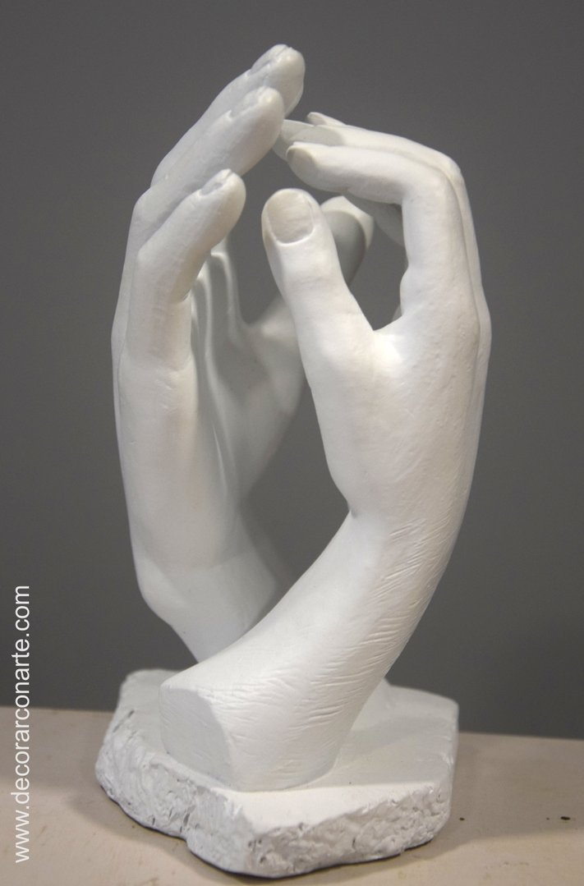
“Vision is a picture of the future that produces passion.”

Slide 25
‘Deeply Christian, Serving the Common Good’ – published Autumn 2016
Leadership, Pedagogy and Theology brought together
Clear vision for education for all schools, not just church schools
Educating for life in all its fullness

Slide 26
‘Life in all its fullness’
Educating for Wisdom, Knowledge and Skills
Educating for
Hope and Aspiration
Educating for Community and Living Well Together
Educating for Dignity and Respect

Slide 27
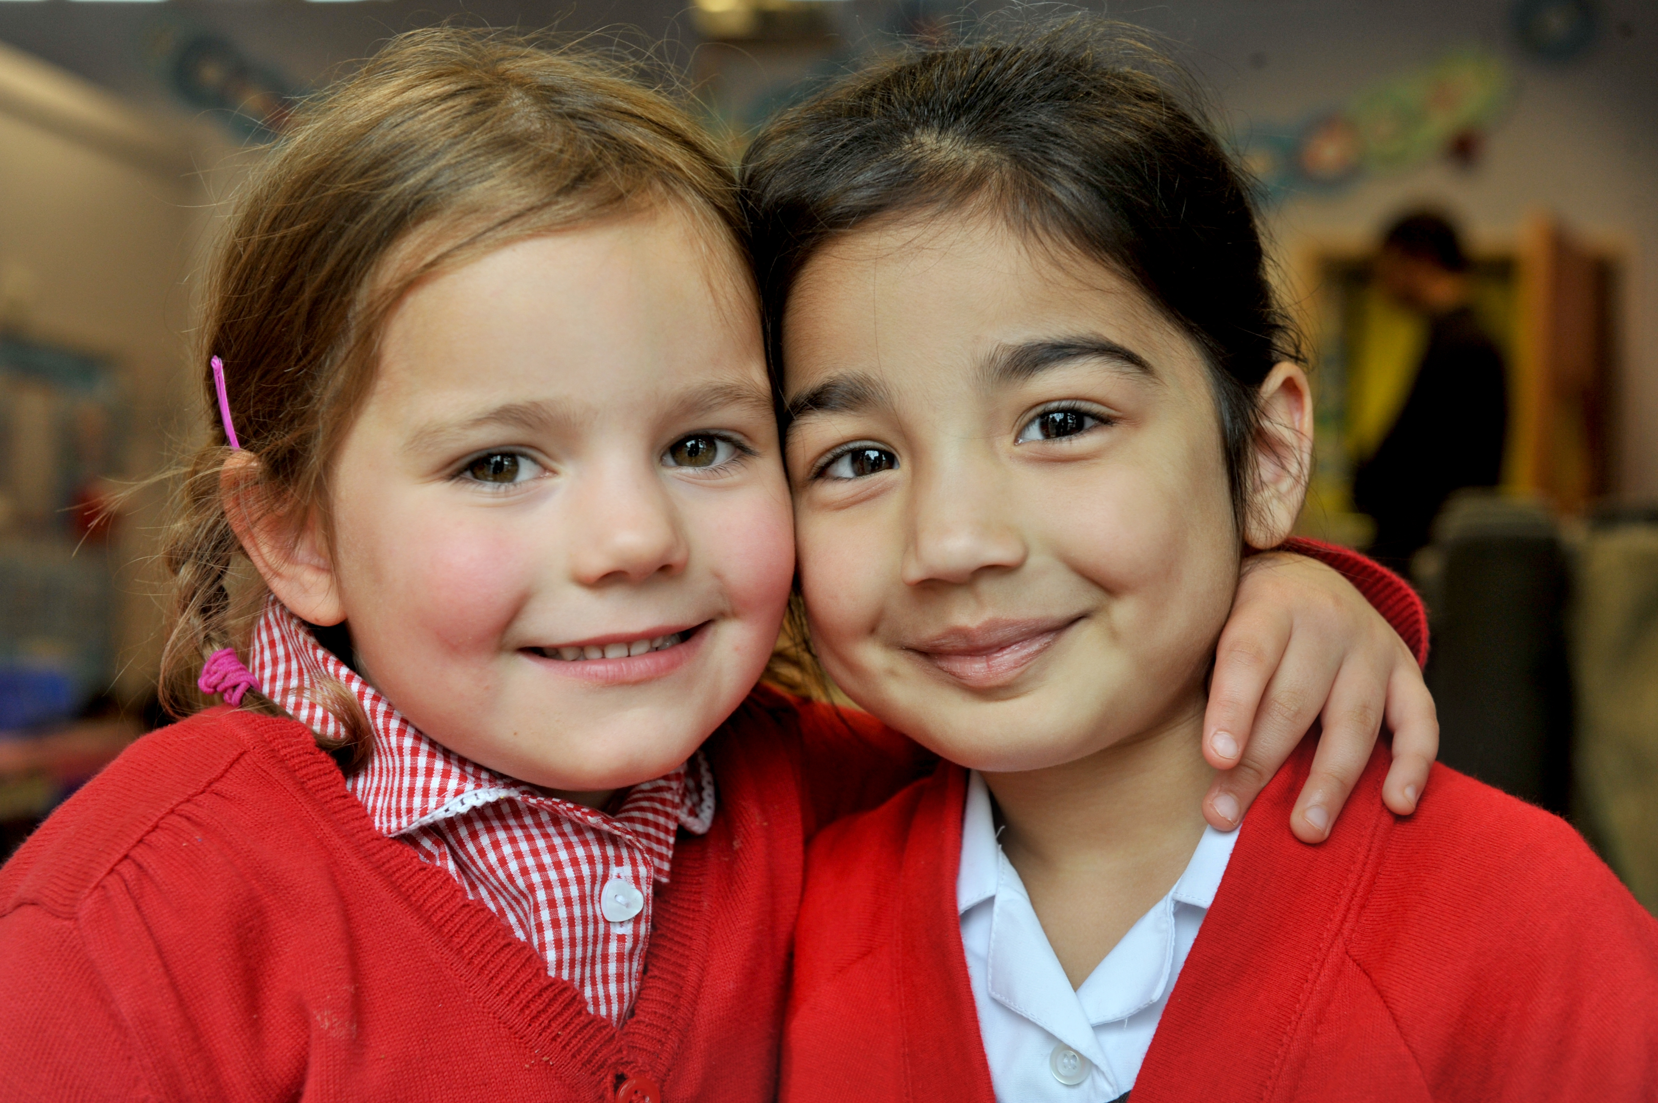
Educating for Wisdom, Knowledge and Skills:
Fostering discipline, confidence and delight in seeking wisdom and knowledge, and fully developing talents in all areas of life.

Slide 28
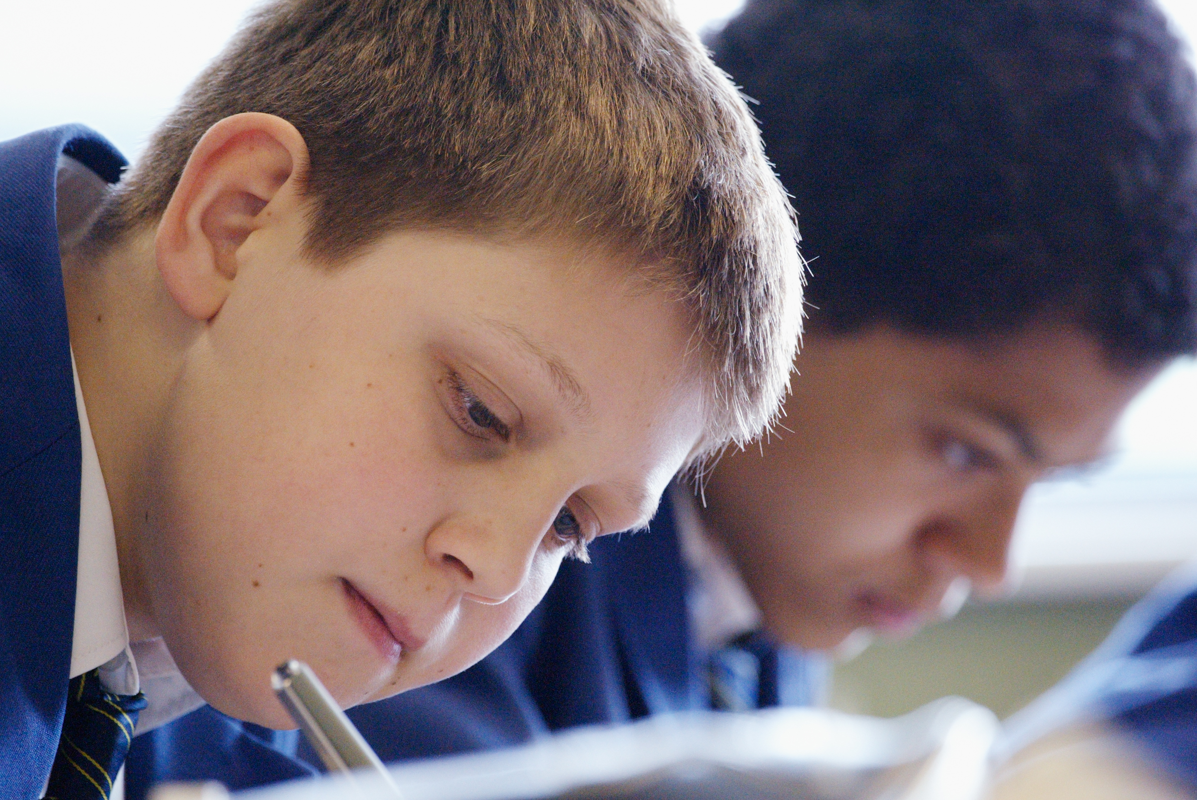
Educating for Hope and Aspiration:
Seeking healing, repair and renewal, coping wisely with things and people going wrong, opening horizons and guiding people into ways of fulfilling them.

Slide 29
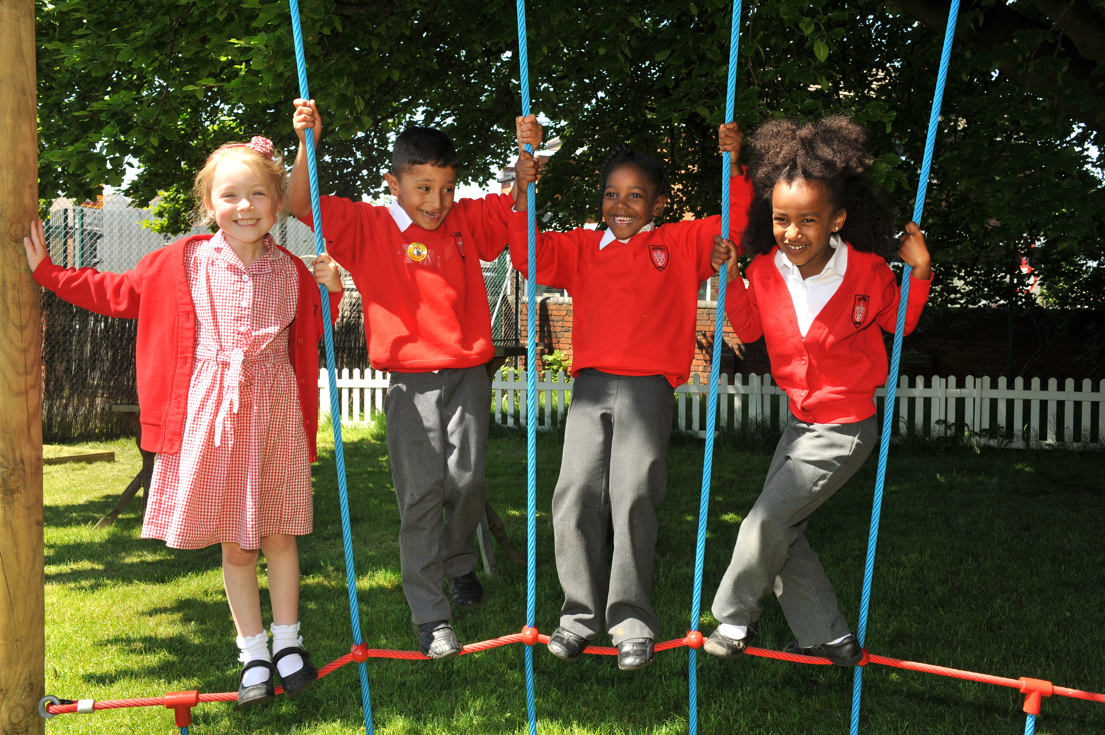
Educating for Community and Living Well Together:
Ensuring a core focus on relationships, participation in communities and the qualities of character that enable people to flourish together.

Slide 30
Educating for
Dignity and Respect:
Ensuring the basic principle of respect for the value and preciousness of each person, treating each person as a unique individual of inherent worth.

Slide 31
“If the Vision for Education fails to make and sustain meaningful connections between a school’s ethos and its outcomes, it will become nothing more than a deeply eloquent and well-meaning piece of writing…”

Slide 32
“..It must come off the shelf and be brought to life through leaders evaluating its potential impact on every area of day-to-day school life…”

Slide 33
“…This dynamic and enhancing connection between ethos and outcomes is what we mean by ‘Bringing the Vision Alive.’”

Slide 34
My hope is that the lessons of the Foundation will resonate not just within Anglican schools, but also beyond, supporting improvement right across the system.
One of those lessons, that I certainly hope echoes in schools of all faiths and none, is the Foundation’s affirmation that there should not, indeed cannot, be a trade-off between school ethos and school outcomes.
Amanda Spielman, HMCI, Feb 2018

Slide 35
What outcomes are you trying to improve?
What are the pressures and challenges?
Who defines this journey?
What help could the Vision offer you?
ethos
enhancing
outcomes
How do you define this for your school?
(in a sentence…)
Where does your ethos come from?
What are the commonalities and differences between us?
What difference does it make to your lived reality?

Slide 36
Activity A: Ethos Enhancing Outcomes

Slide 37
Network Stream #2
Social Action and Community Engagement

Slide 38
We flourish because of our diversity and relationships
Flourishing Teams
Flourishing Adults
Flourishing Children

Slide 39
What could this look like for Teaching and Learning?

Slide 40
Learning Plantation | Learning Rainforest
‘A right way to do things’ – set routines – e.g. L.O. on the board every lesson | Nourishing individual talents - high trust/high challenge
Leaders driven by compliance to external voices | Great variety in pedagogy and OK to try new things all the time
T+L focused on what can be examined | If creative approaches deliver, there is high level of autonomy
Data has very high status | Data is part of the picture of learning
Interventions heavily focused on short-term gains | T+L structures are dynamic/organic, aligning T+L to stated school values
Creativity becomes rules – e.g. standardised homework format etc. | Highly personalised CPD

Slide 41
We flourish because of our diversity and relationships
We flourish at different times and different speeds
Flourishing Teams
Flourishing Adults
Flourishing Children

Slide 42
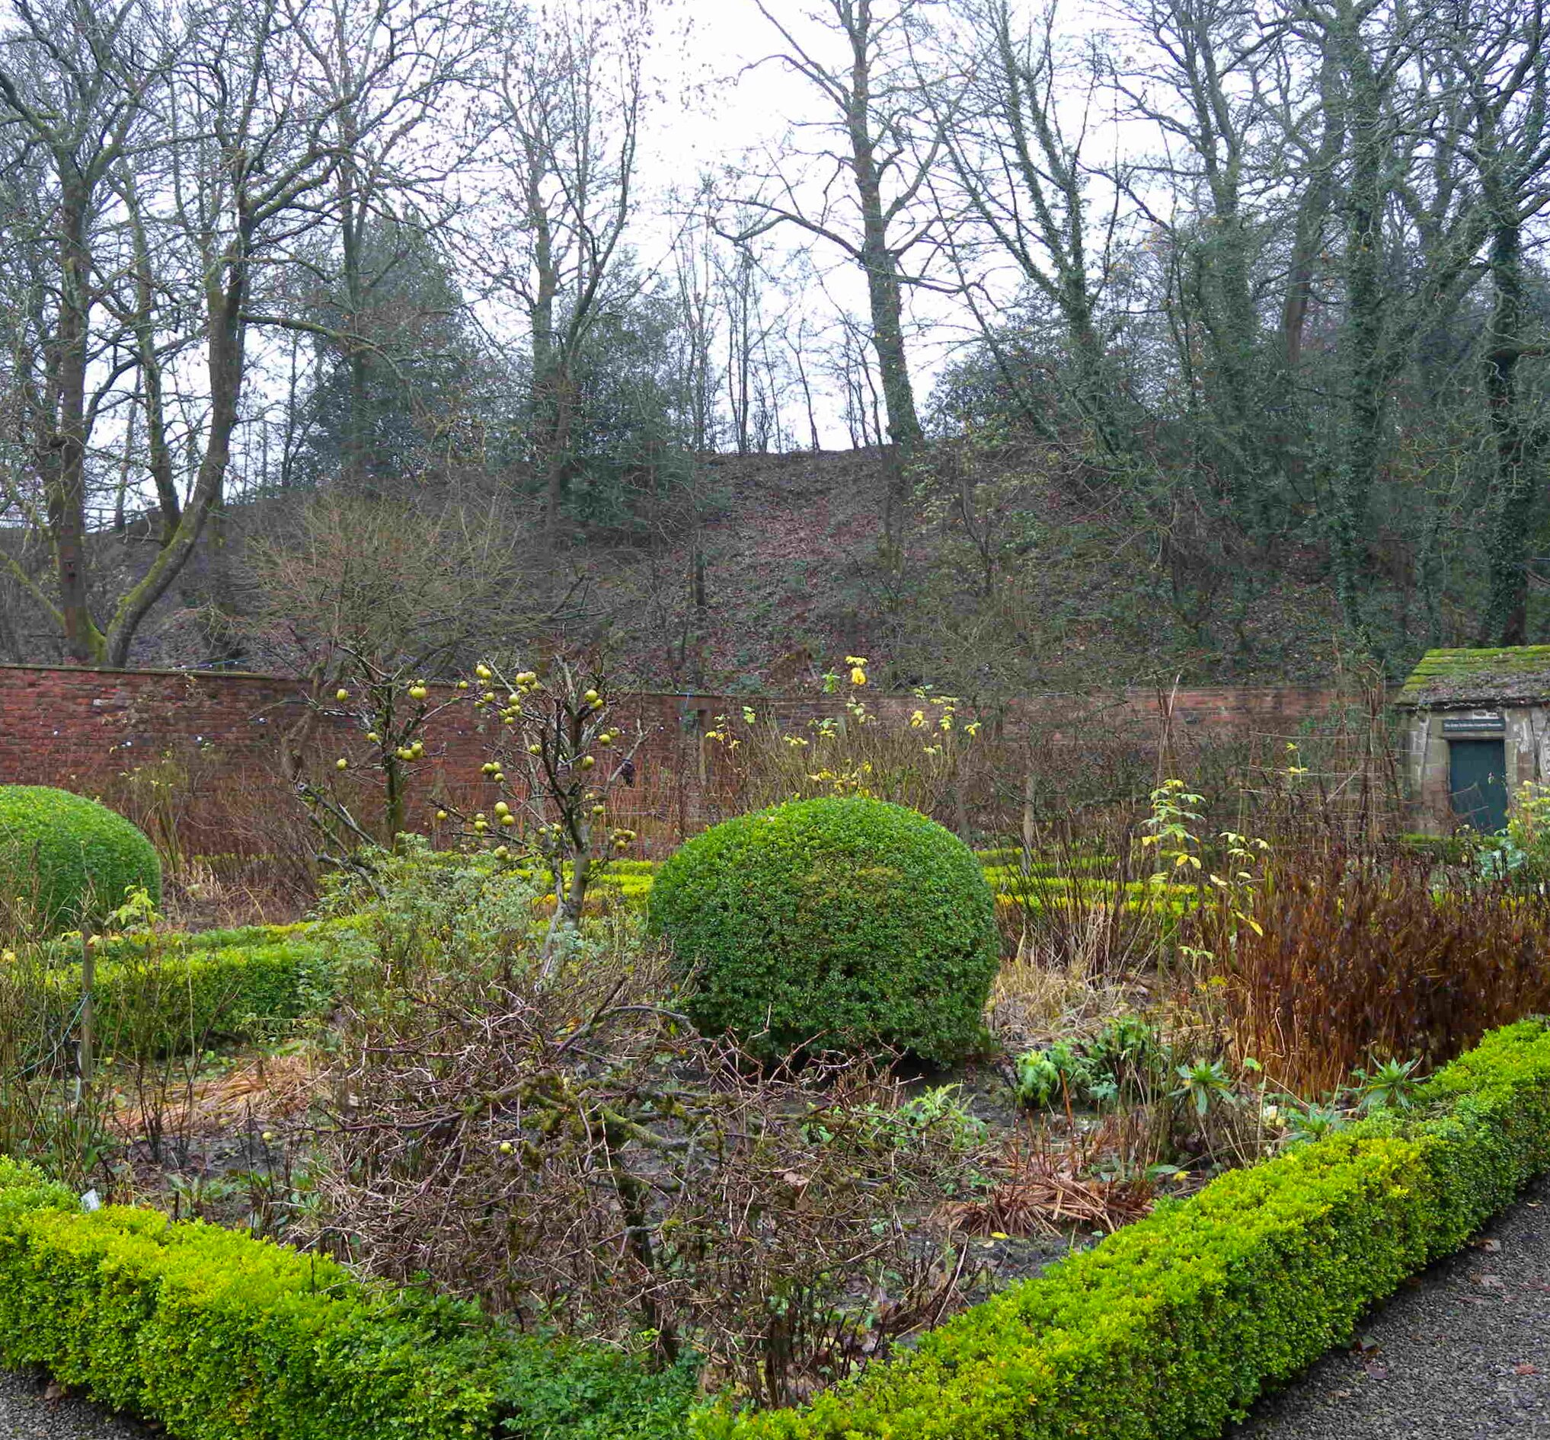
A garden that’s bursting into life…?

Slide 43
We flourish because of our diversity and relationships
We flourish at different times and different speeds
Flourishing Teams
Flourishing Adults
Flourishing Children
We flourish when we stop doing things

Slide 44
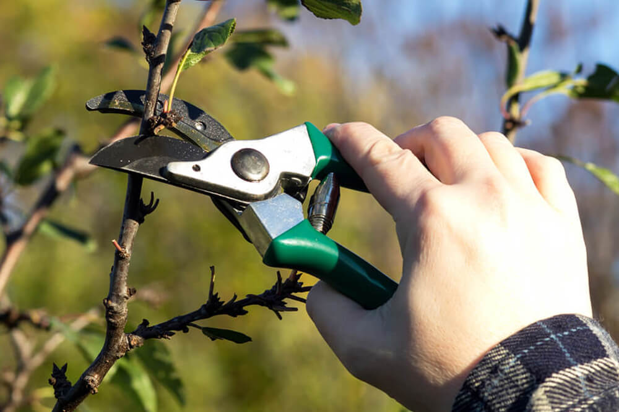
What should we stop doing?

Slide 45
We flourish because of our diversity and relationships
We flourish at different times and different speeds
Flourishing Teams
Flourishing Adults
We flourish so we can look outwards and give
Flourishing Children
We flourish when we stop doing things

Slide 46
“But since you excel in everything – in faith, in speech, in knowledge, in complete earnestness and in the love we have kindled in you – see that you also excel in this grace of giving.”
(2 Corinthians 8.7)

Slide 47
We flourish because of our diversity and relationships
We flourish at different times and different speeds
Flourishing Teams
Flourishing Adults
We flourish so we can look outwards and give
Flourishing Children
We flourish when we stop doing things

Slide 48
Leadership of Character Education: Developing Virtues and Celebrating Human Flourishing in Schools (2017)
Available to download free at www.cefel.org.uk/character

Slide 49
seeks to develop and celebrate the flourishing of individuals, communities, families and societies
is fundamental to the pursuit of academic excellence
is central to a Christian vision for education for ‘life in all its fullness’
Character Education
is caught implicitly through role-modelling and relationship, and the deliberate embedding of leadership virtues in staff teams
invests in a legacy far beyond the school gates, impacting young people as friends, neighbours, parents, team members and employees

Slide 50
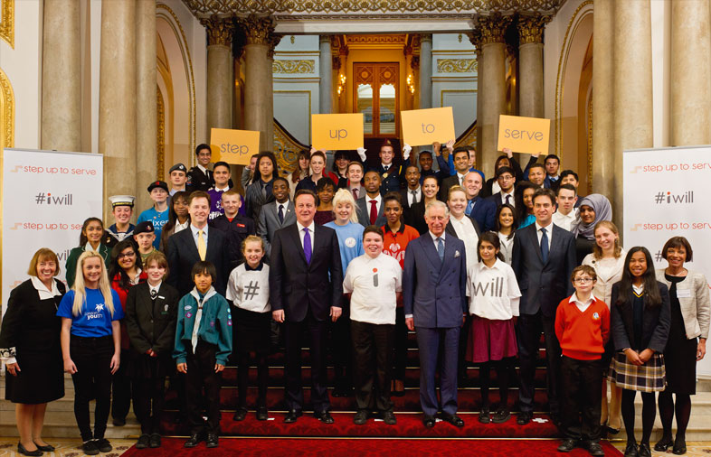
#iwill is a UK-wide campaign that aims to make social action part of life for as many young people as possible by the year 2020. It is spreading the word about the benefits of youth social action, working to embed it in the journey of young people and create fresh opportunities for participation.
Social action means ‘practical action in the service of others that creates positive change‘. This benefit is to the young people themselves and the communities in which they live.

Slide 51
To make social action part of life
To embed it in the journey of young people
Schools at the heart of rural community
Practical action in the service of others that creates positive change

Slide 52
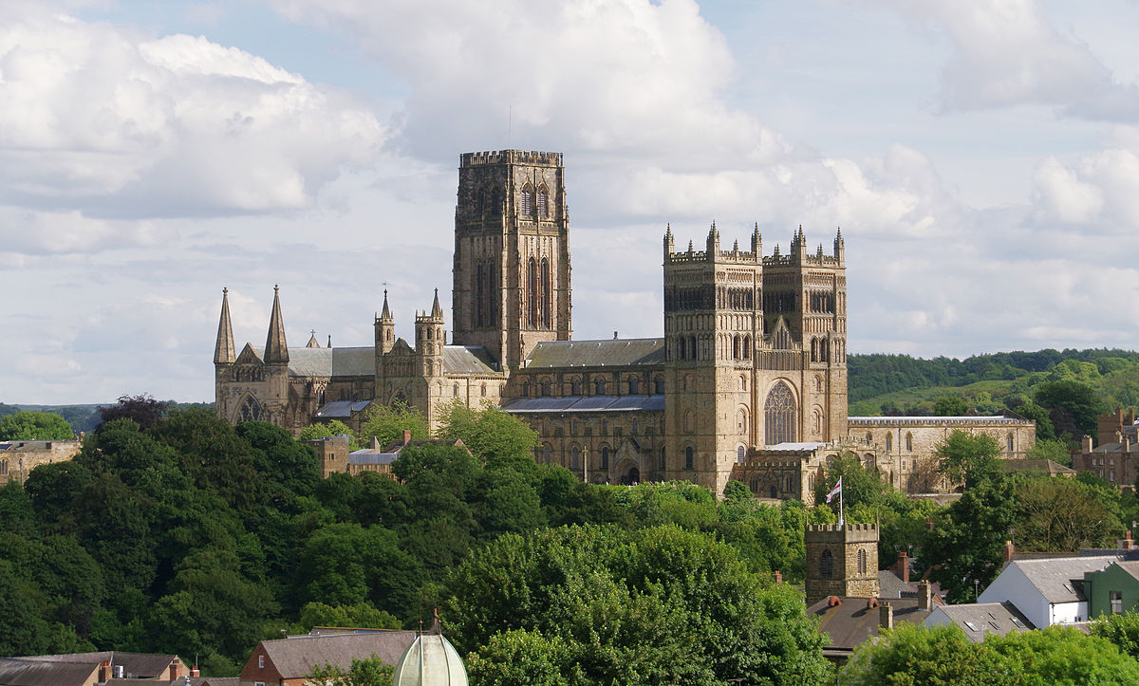
Still build the cathedral…

Slide 53
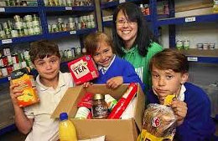
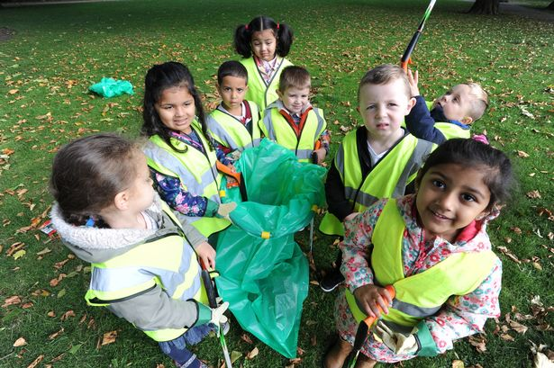
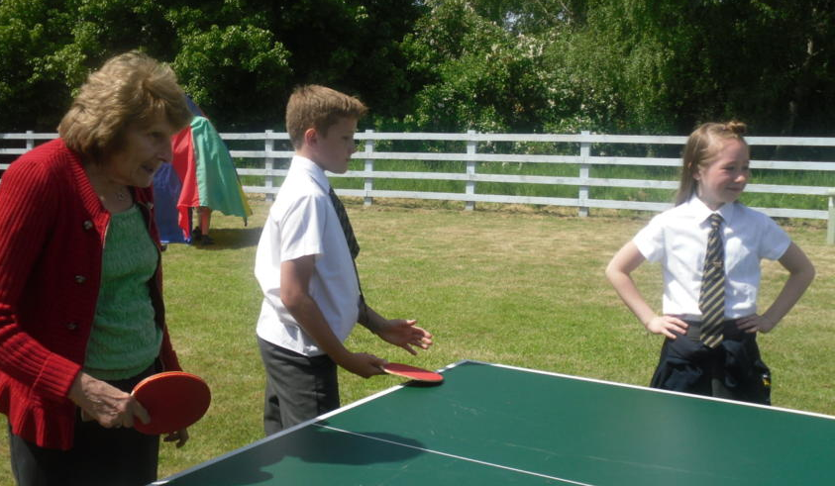
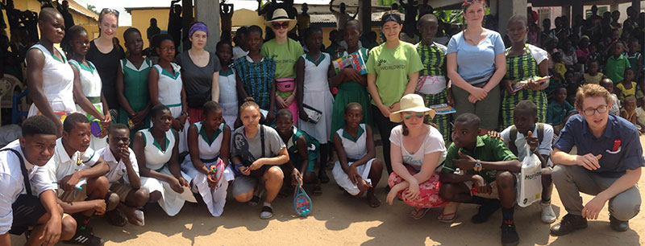
“Your vocation in life is where your greatest joy meets the world’s deepest need.”
Frederick Buechner

Slide 54
1. What kind of pupils do we seek to send out? How could social action help ‘build the cathedral’?
2. Where does your ‘deepest passion meet the world’s greatest need’? What is your community’s greatest need?

Slide 55
Activity B: Pedagogy Leadership Theology

Slide 56
2019-2021 funded for 2 years
Rural Schools Networking
2019-2021 Funded Opportunities:
1. Curriculum/Teaching and Learning/Leadership Development
2. Social Action and Community Engagement
Partnership between CEFEL, CCT, #iwill, Apple Education
4 x 0.5 day facilitated in-school network sessions per year
Expert webinars & national connections with other rural settings
Individual schools and MATs,
Church and Community schools

Slide 57
Planning Networking Activities

Slide 58
1. Express interest today
2. Funded spaces for up to 30 schools/academies
3. First networking sessions – WHEN?

Slide 59
Reflection – 1 Corinthians 13
If I tirelessly teach five outstanding lessons a day, and see my students make excellent progress against their targets, but have not love, I am only a broken window or a wall covered in graffiti. If I create a perfect climate for learning, have excellent meetings with parents and resolve all the problems of the day through focused toil, but have not love, I am only an uneaten school dinner or a messy office. If I give all I have to my school and work a 70 hour week, marking, planning, preparing and evaluating and have the most perfect
colour-coded action plan to guide my path, but have not love, I gain nothing.

Slide 60
Reflection – 1 Corinthians 13
Love is patient. Love is kind. It does not envy, it does not boast, it is not proud. It is not rude, it is not self-seeking, it is not easily angered, it keeps no record of wrongs. Love does not delight in evil but rejoices with the truth. It always protects, always trusts, always hopes, always perseveres. Love never fails.

