Slide 1
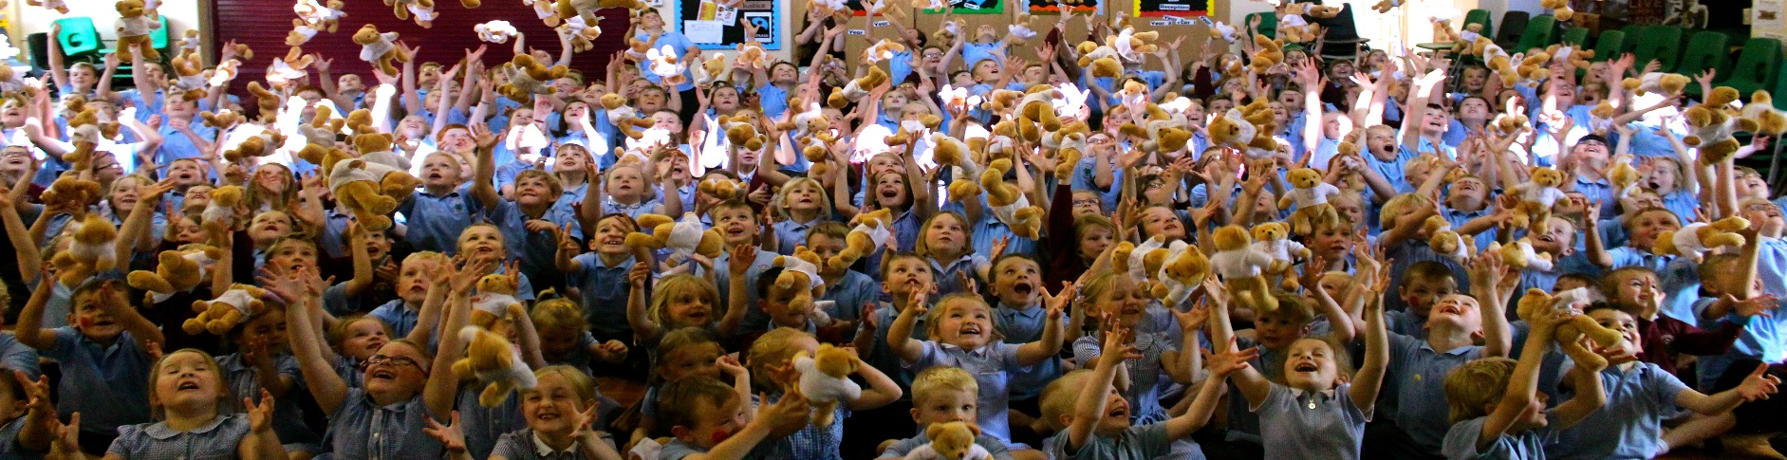
St Anne’s CE Primary School
Bishop Auckland County Durham
Lynne Sixsmith – Head Teacher
Catherine Simpson – School Chaplain

Slide 2
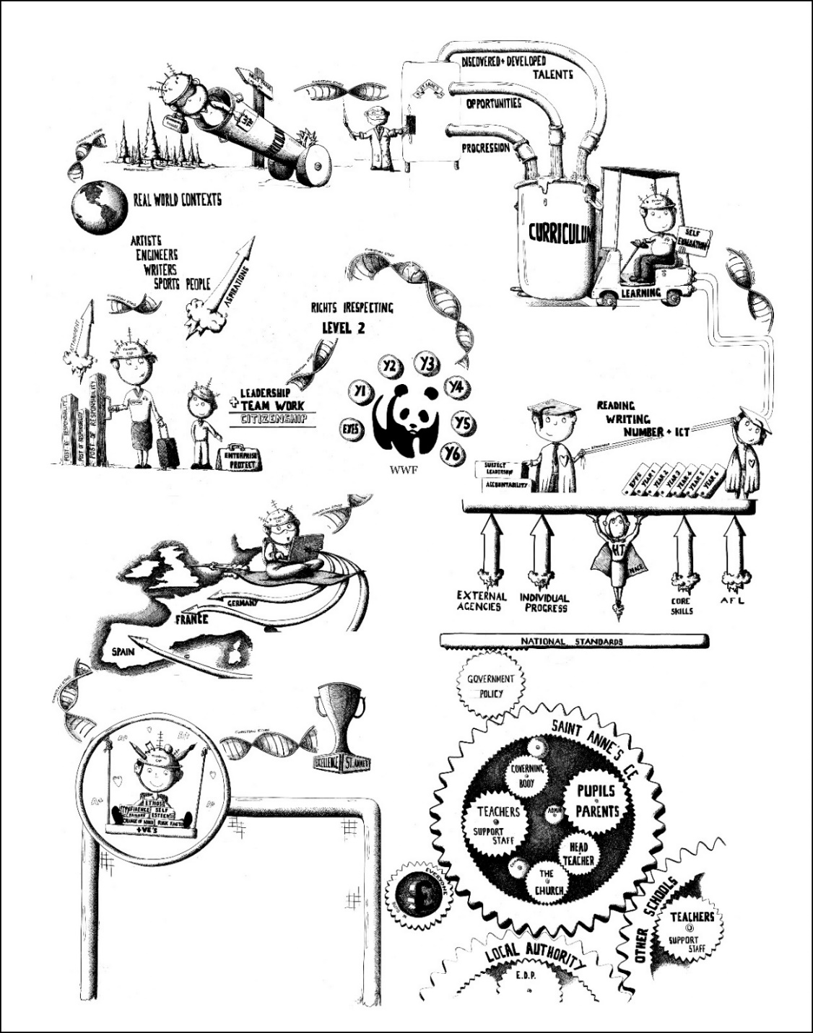
Headteacher’s Vision
Mission Statement
‘Minds to learn, hearts to care’
Learning is at the heart of what we do here; we offer a rich, stimulating environment to develop the whole child, fulfilling academic potential whilst building moral character. We encourage creative, unique, open-minded, independent individuals, respectful of themselves and of others. Inspired by Christian faith and practice, our school provides a caring pastoral base, in which each child feels loved, valued and accepted. Through nurturing them on their educational journey, our pupils will be confident in their ability to meet the opportunities and challenges of a changing world, taking happy memories of St. Anne’s with them into their future life.’

Slide 3
Our school values
Peace
Service
Justice
Trust
Thankfulness
Forgiveness
Courage
Friendship
Endurance
Wisdom

Slide 4
Pupil Voice Groups
Junior Management Team
Young Church Leaders
Wheelie 360 Crew
Right2B
E-Safety
Chaplaincy & Charities Team
ECO
Fairtrade
Anti-Bullying
Interest Group
JRSO/JPACT

Slide 5
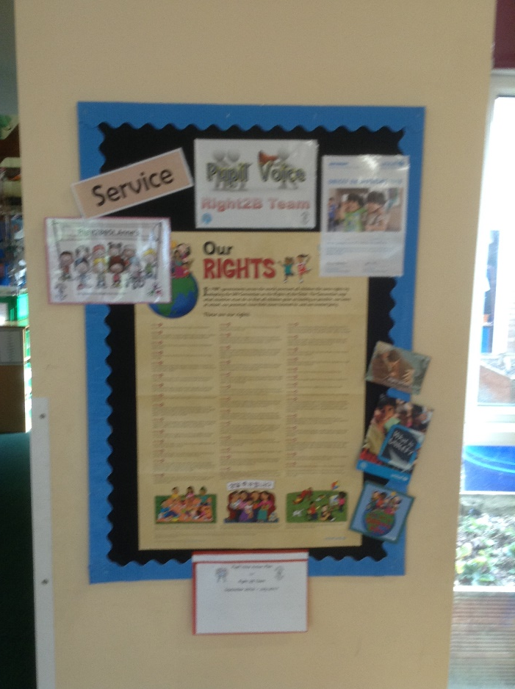
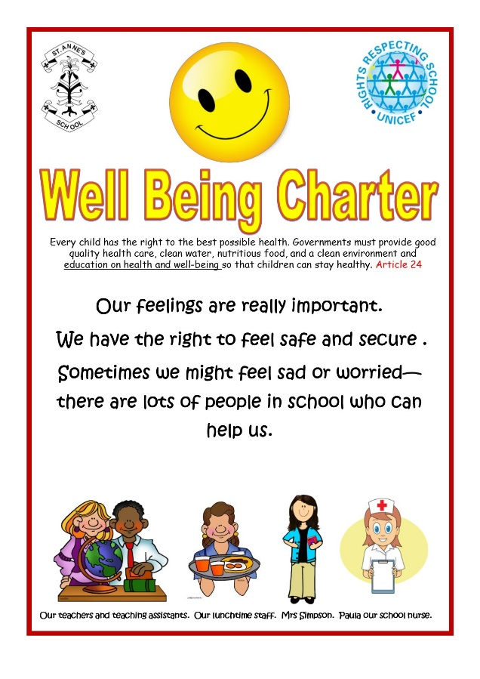
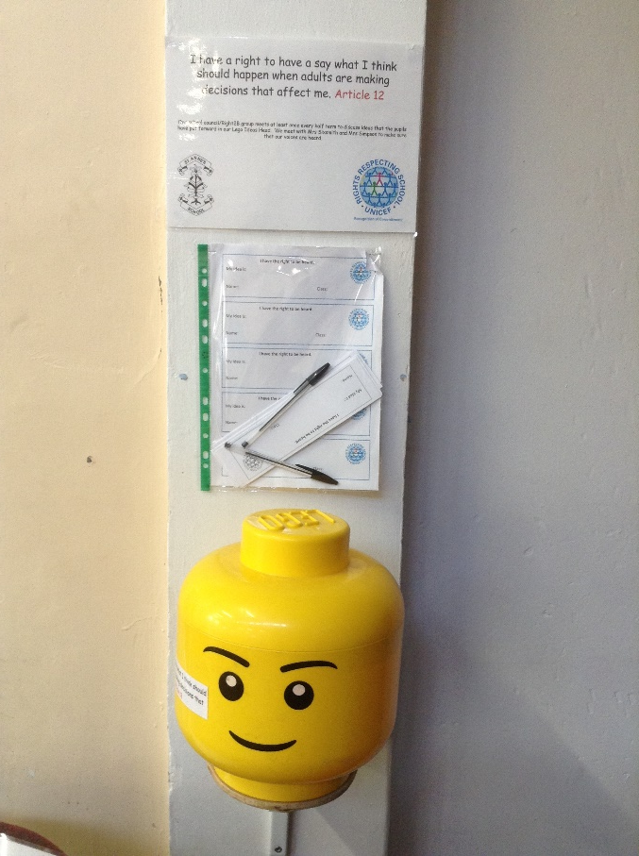
Pupil Voice Groups

Slide 6
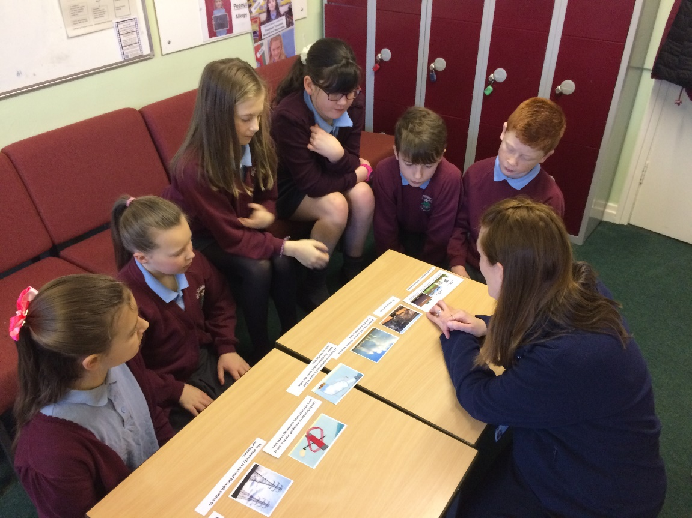
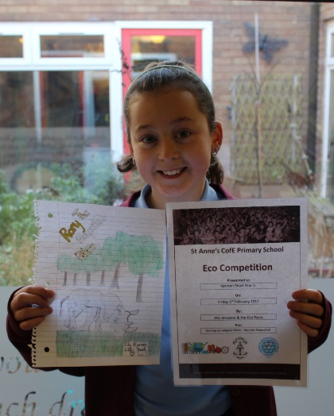
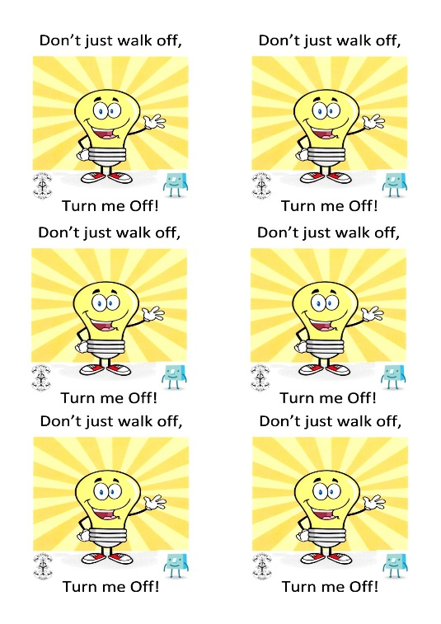
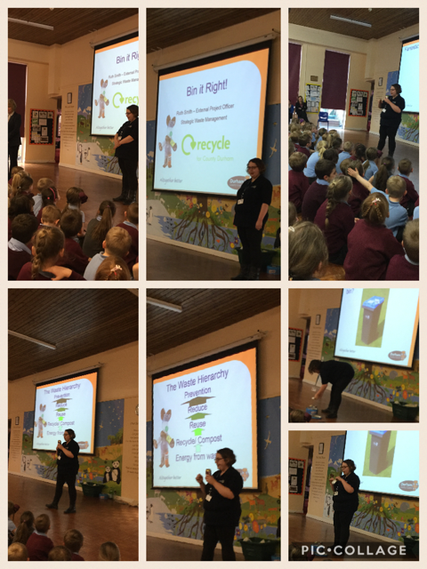
ECO
Thankfulness

Slide 7
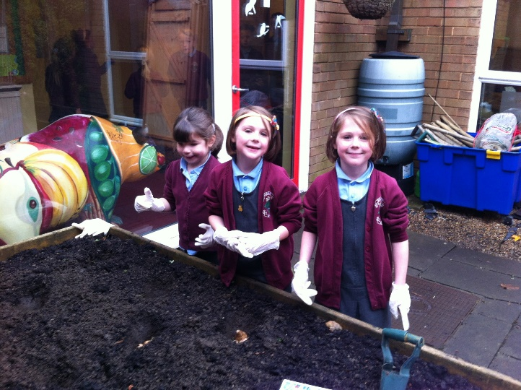
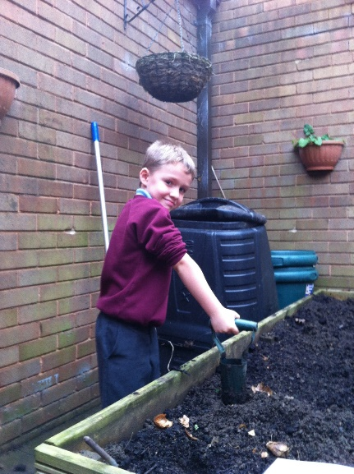
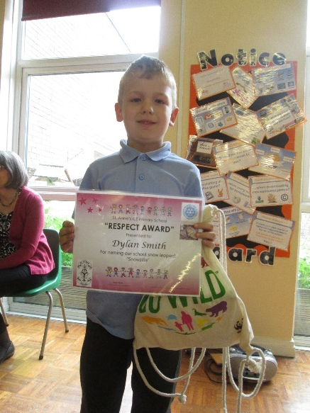
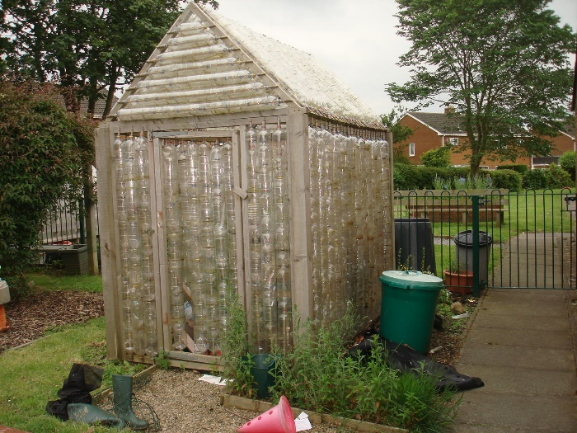

Slide 8
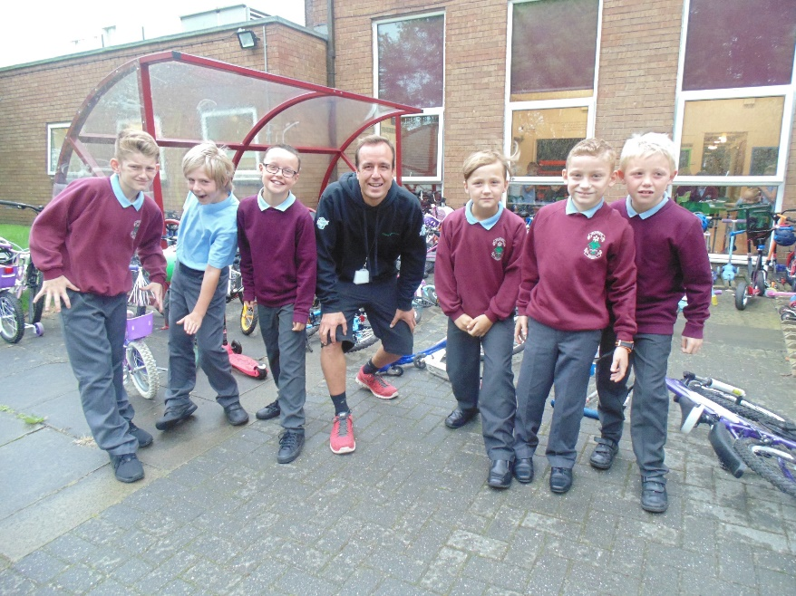
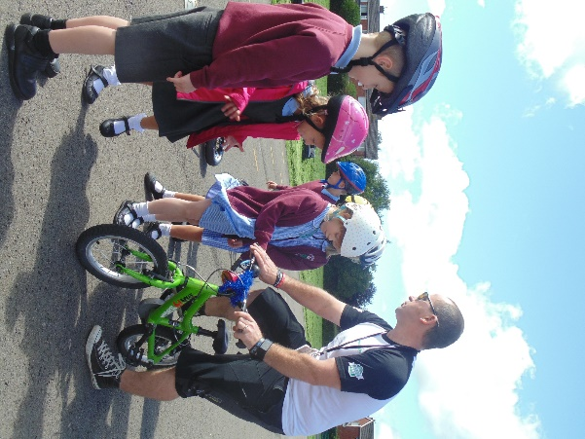
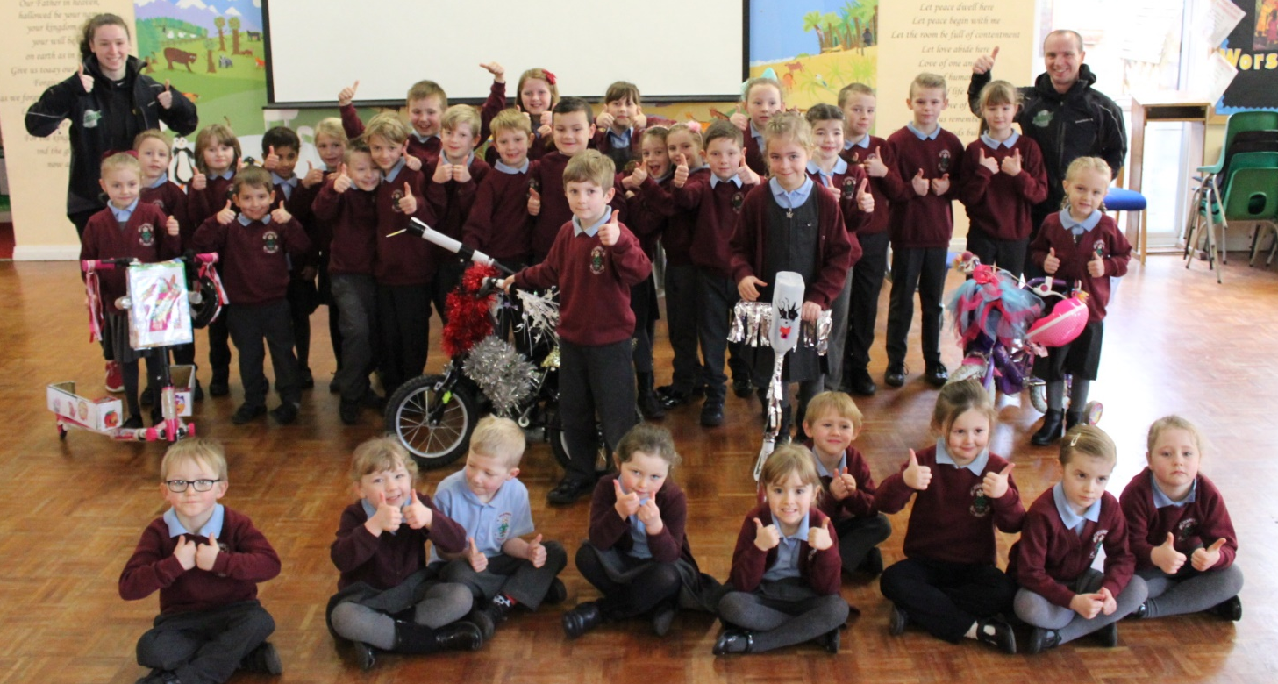
Wheelie 360 Crew
Wisdom

Slide 9
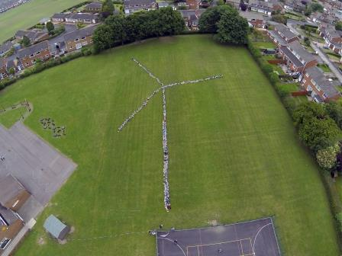
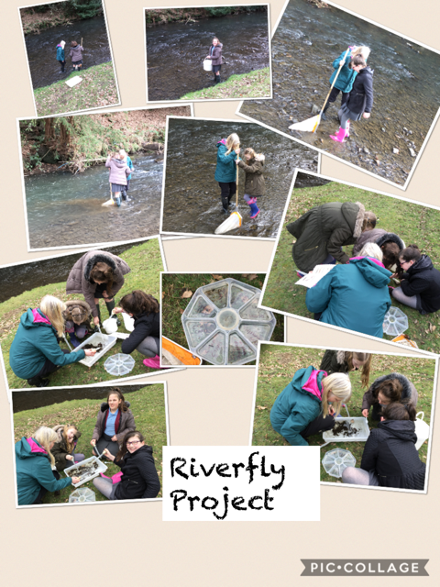

Slide 10
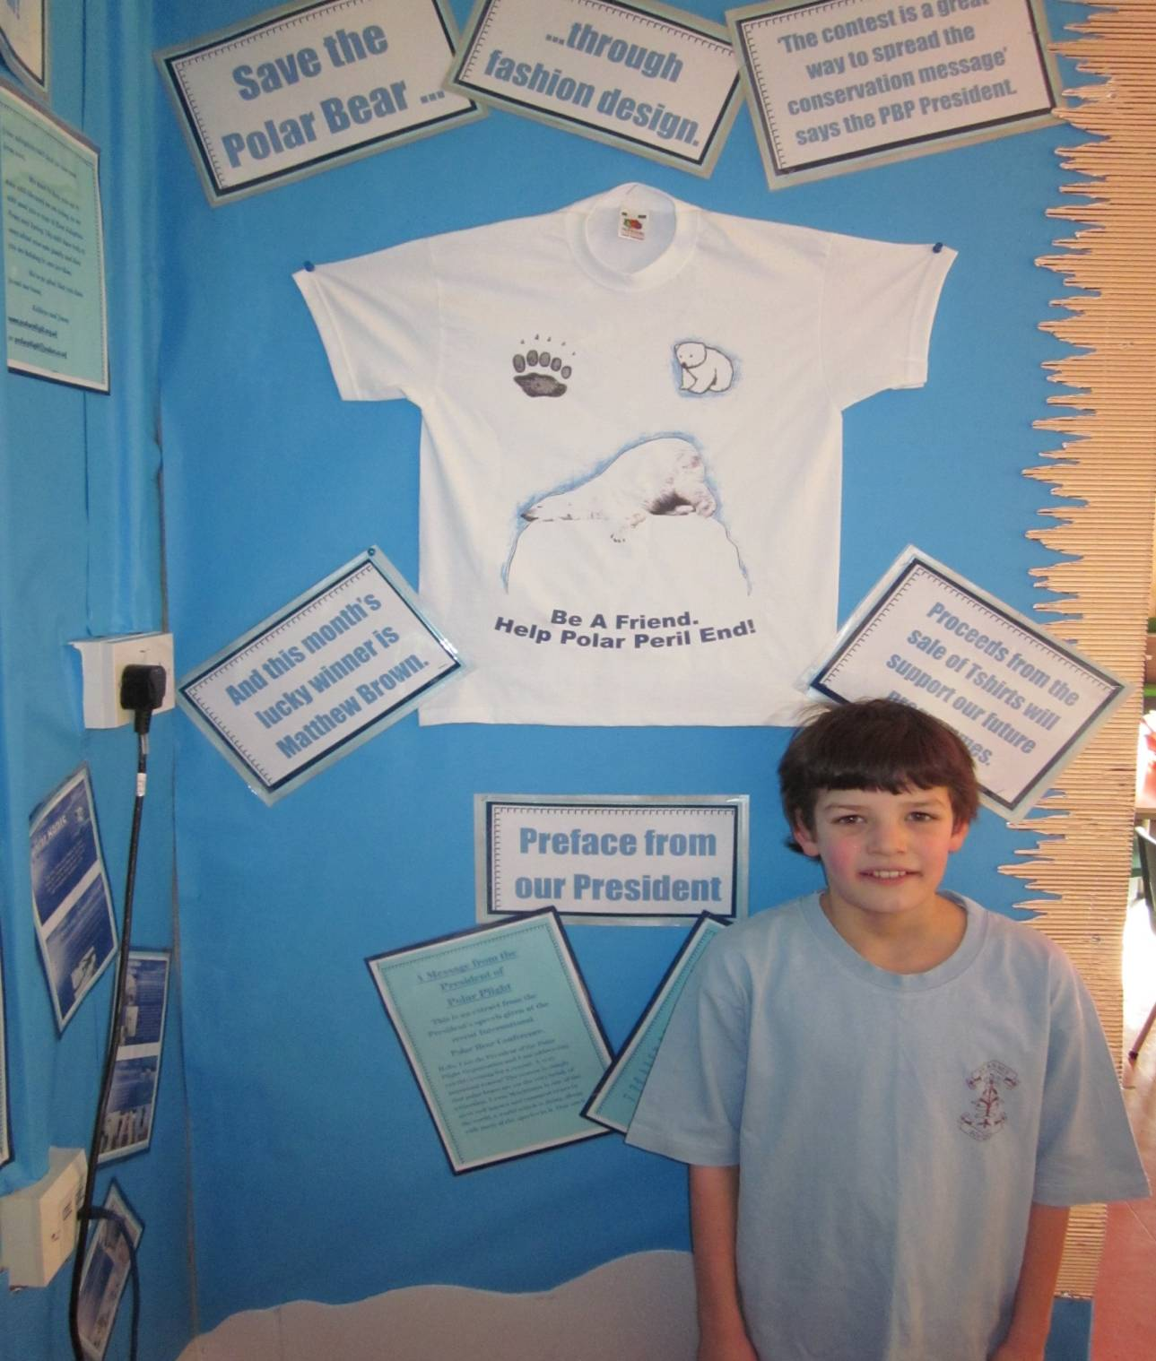
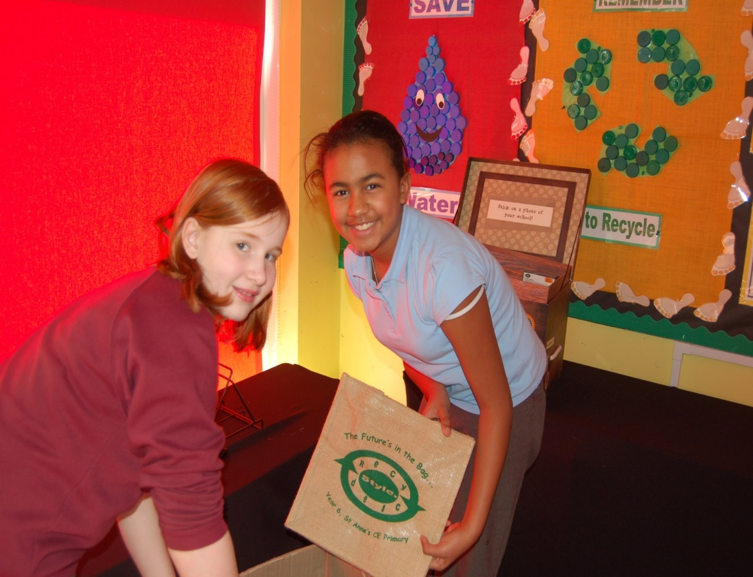
e
c
R
y
Style.
c
d
e
l
Enterprise

Slide 11
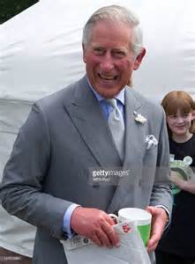
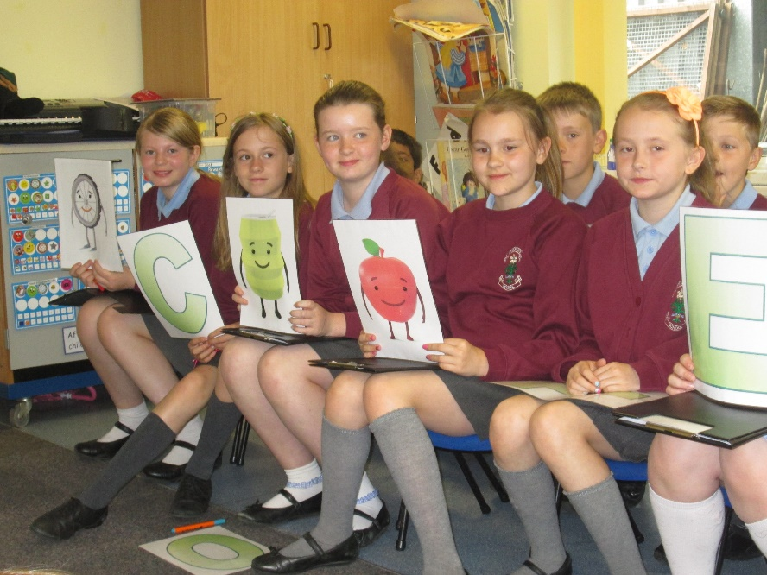
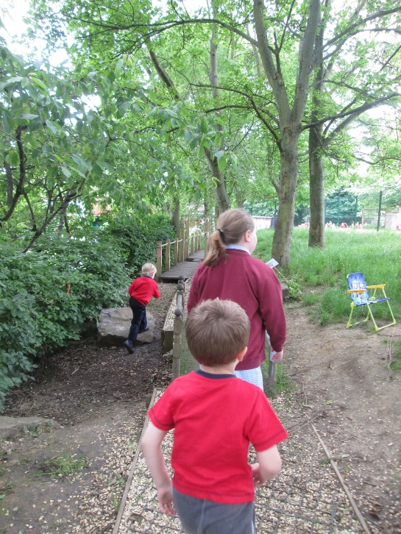
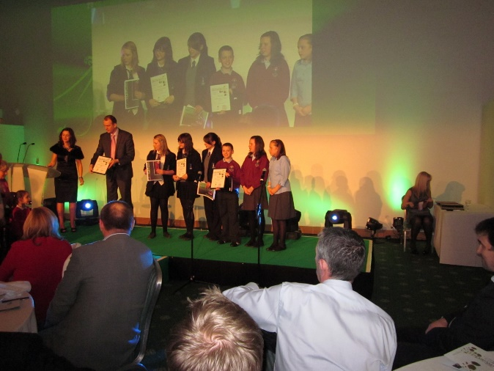
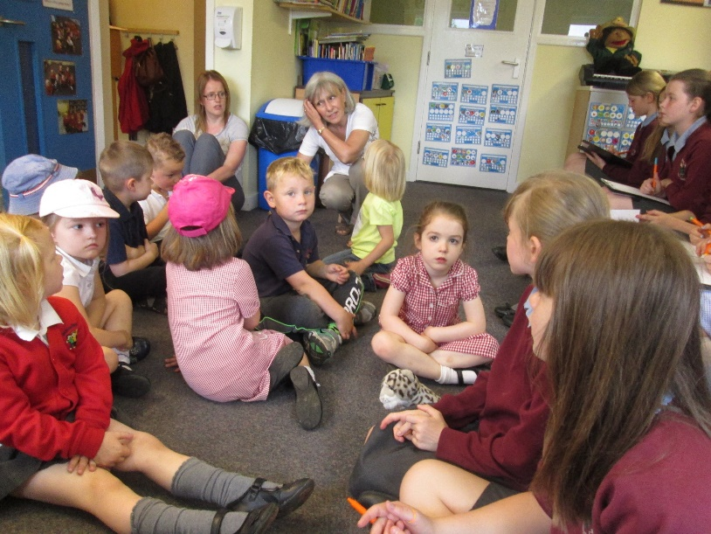
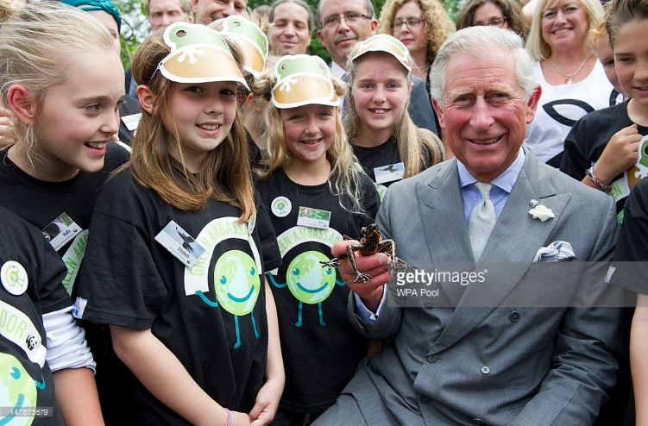
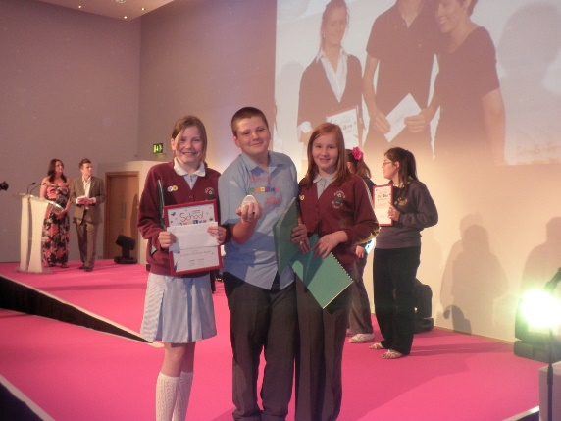
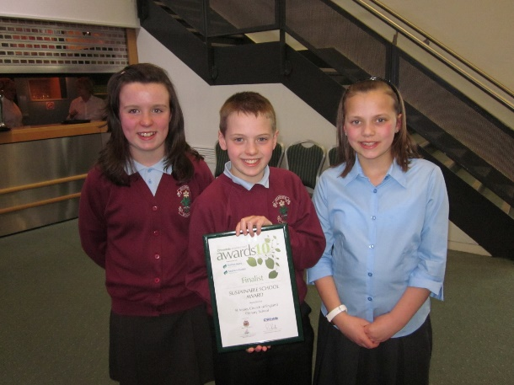

Slide 12
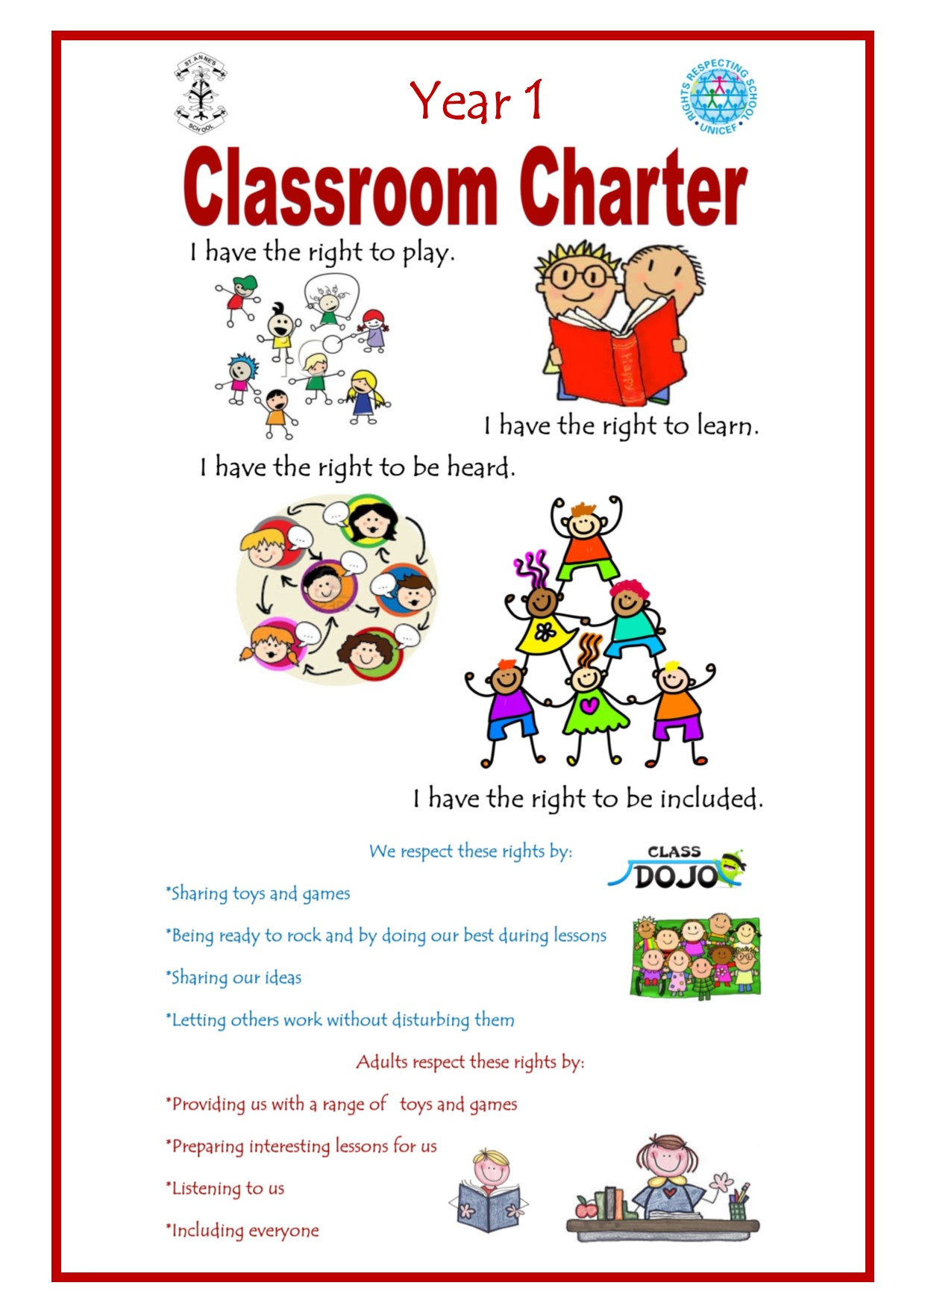
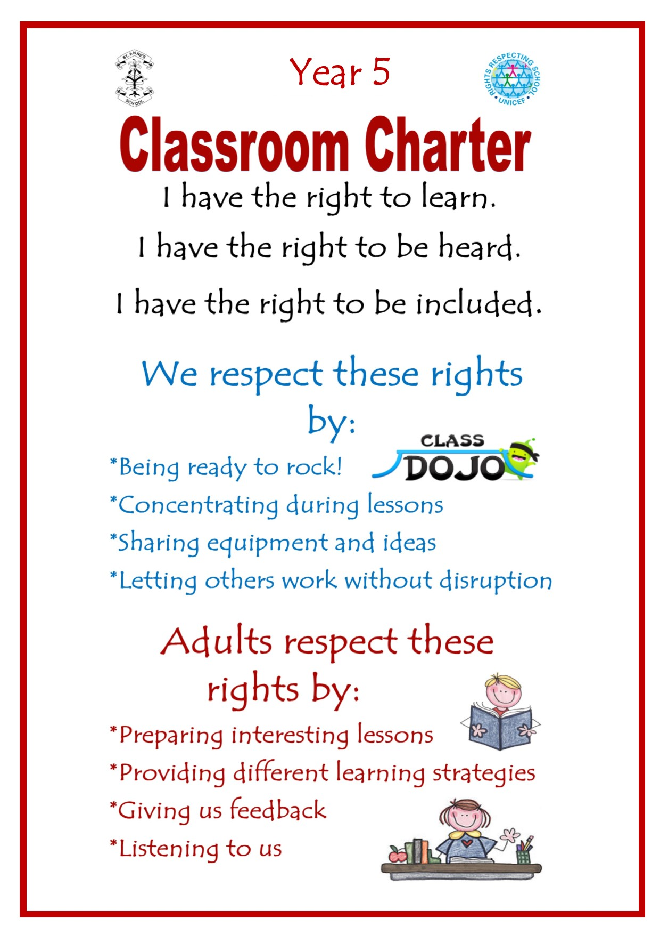

Slide 13
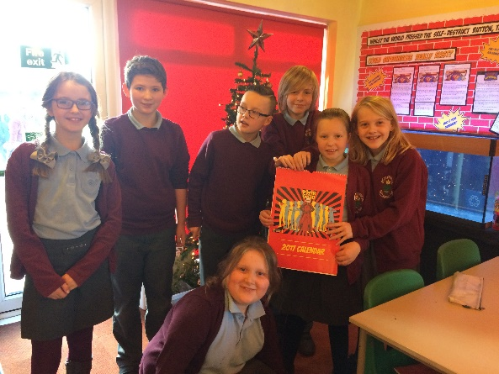
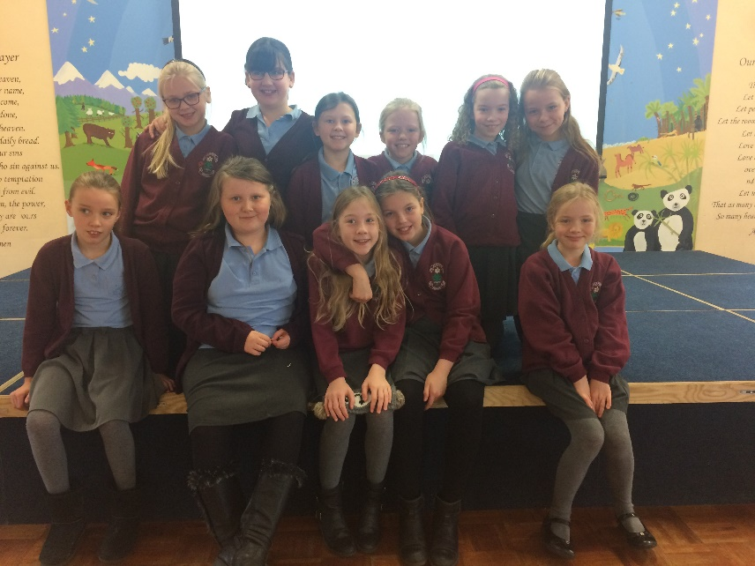
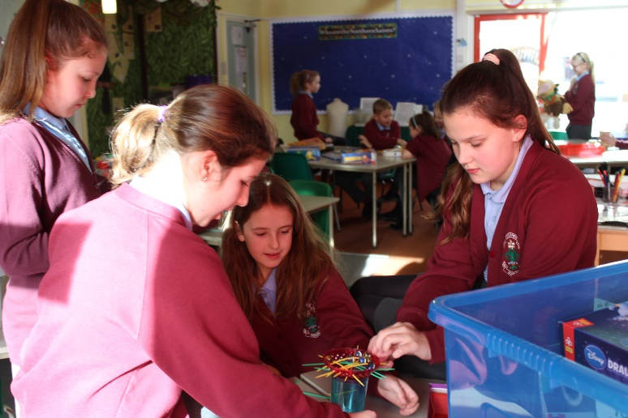
Anti-Bullying
Interest Group
Friendship

Slide 14
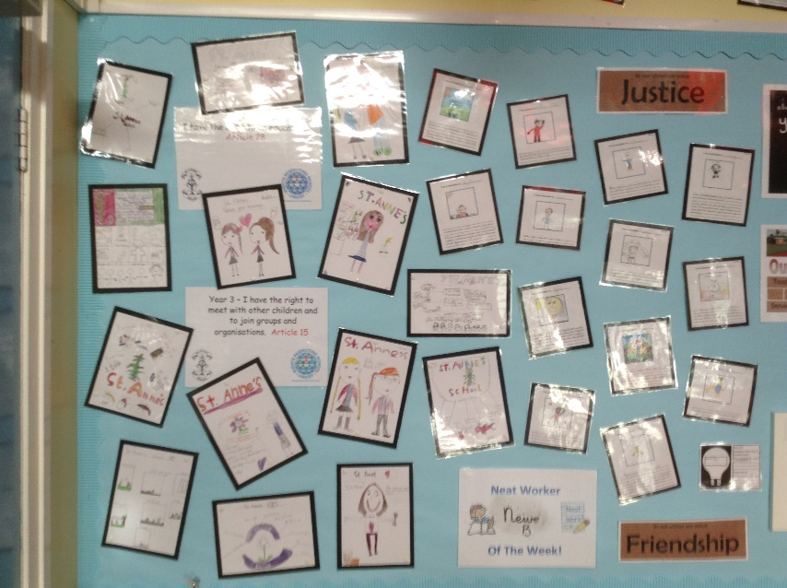
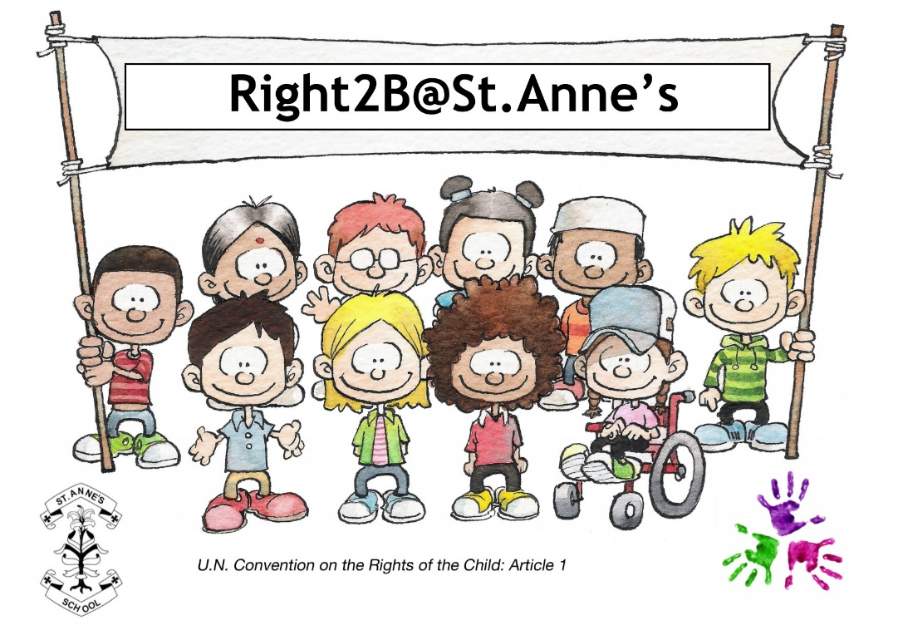
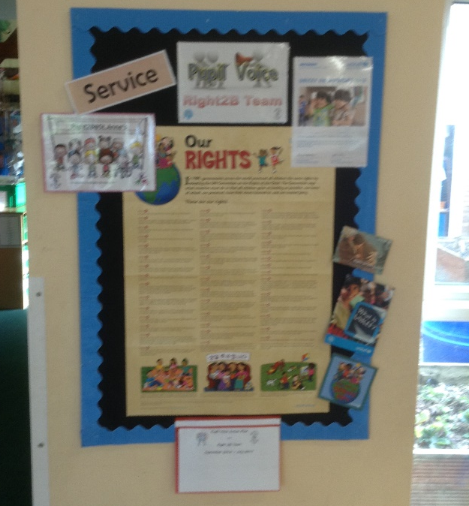
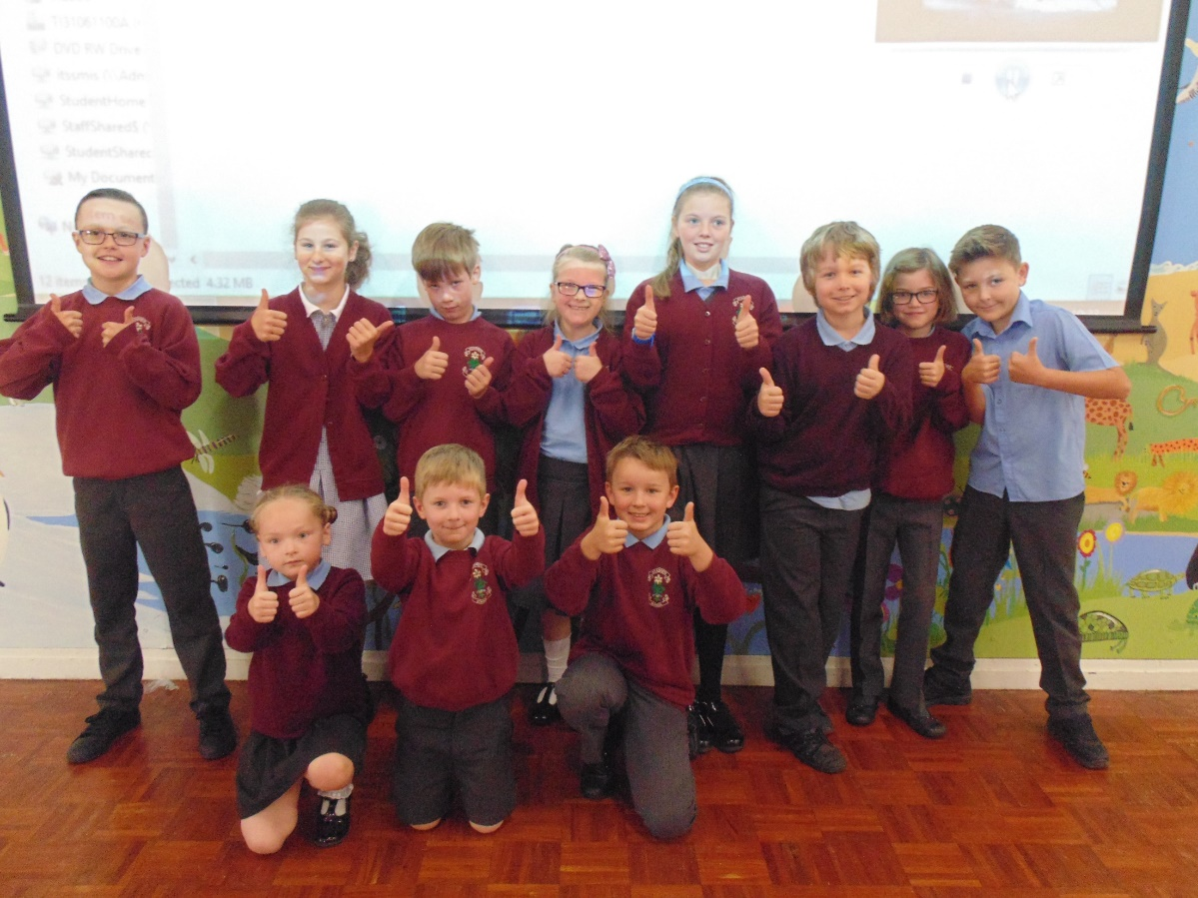
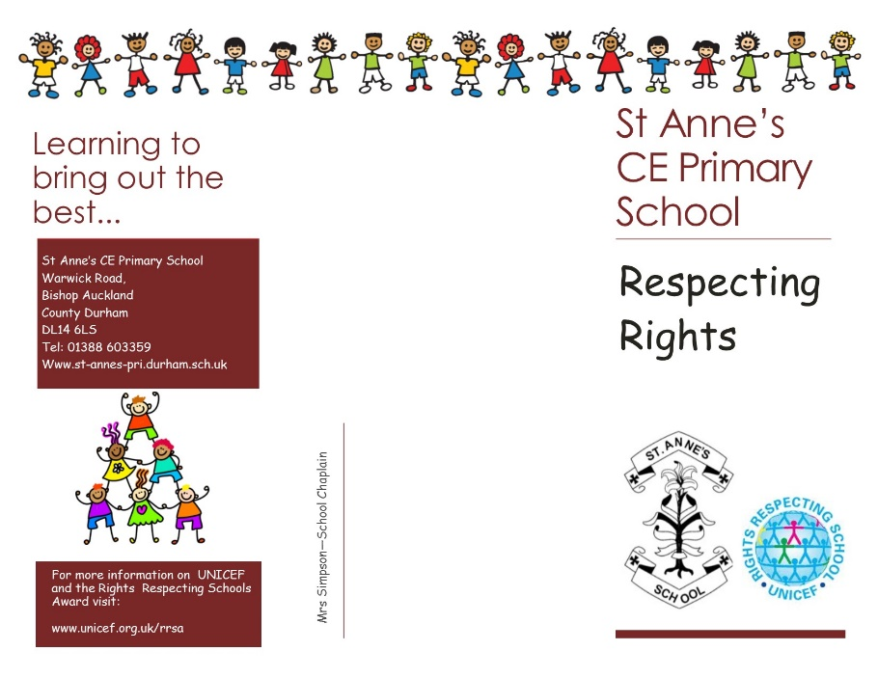
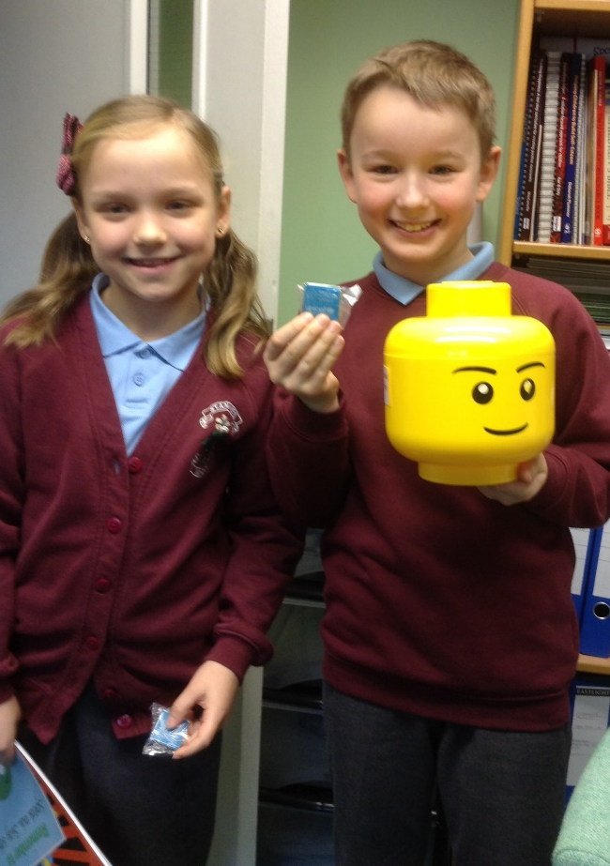
Right2B
Service

Slide 15
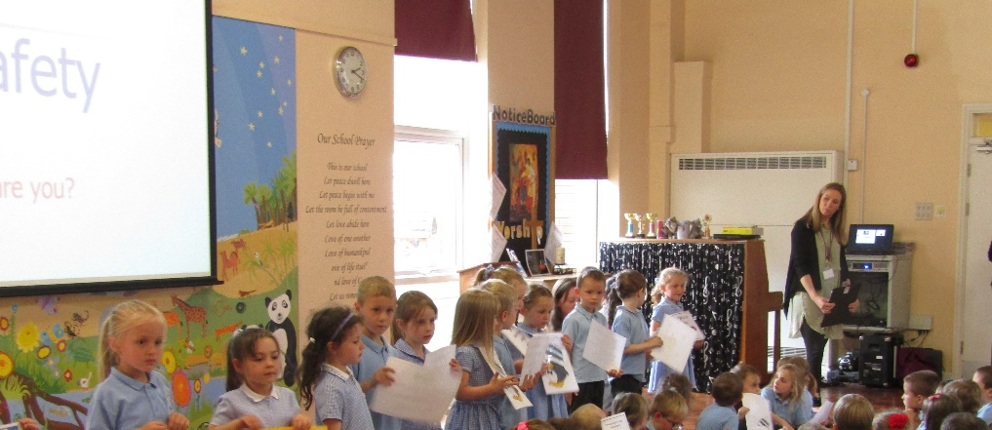
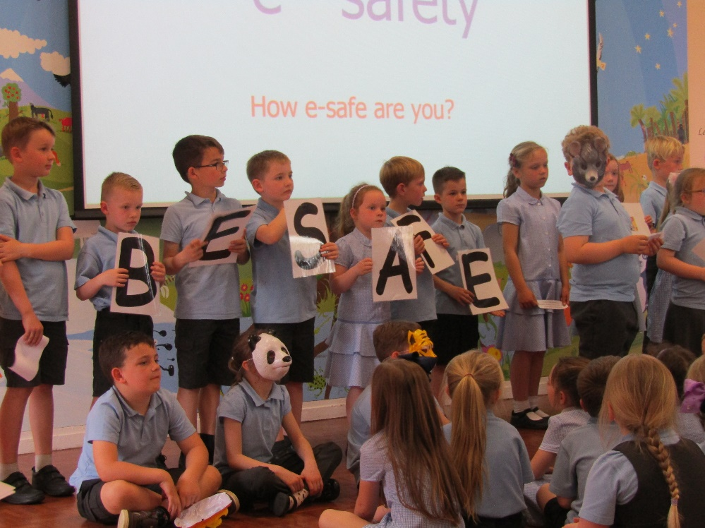
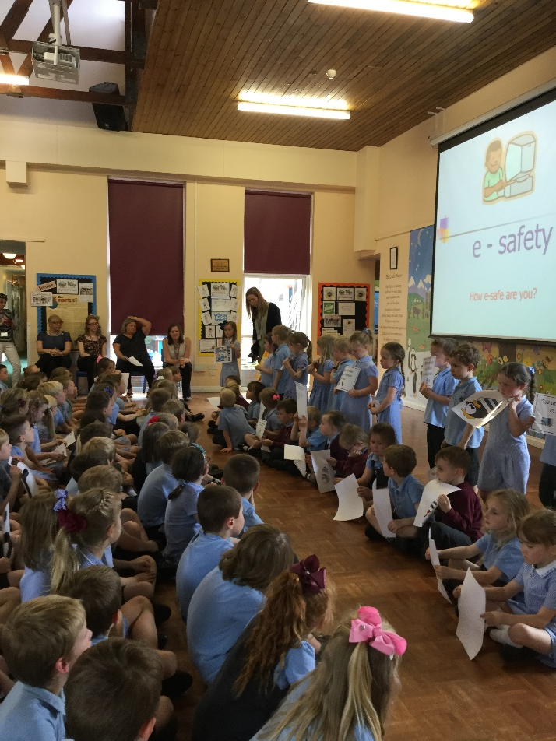
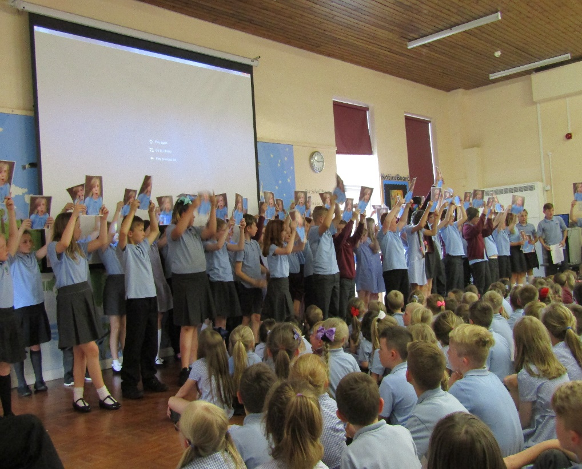
E-Safety
Wisdom
E-Safety Day!

Slide 16
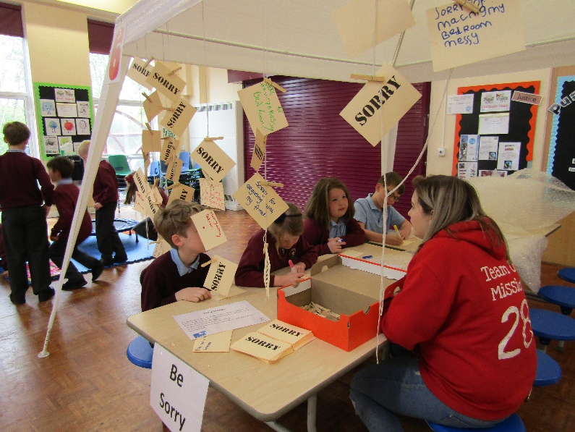
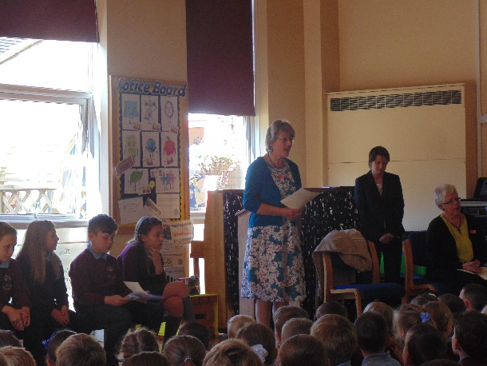
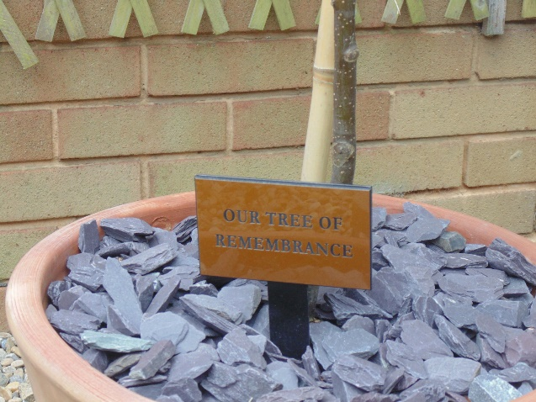
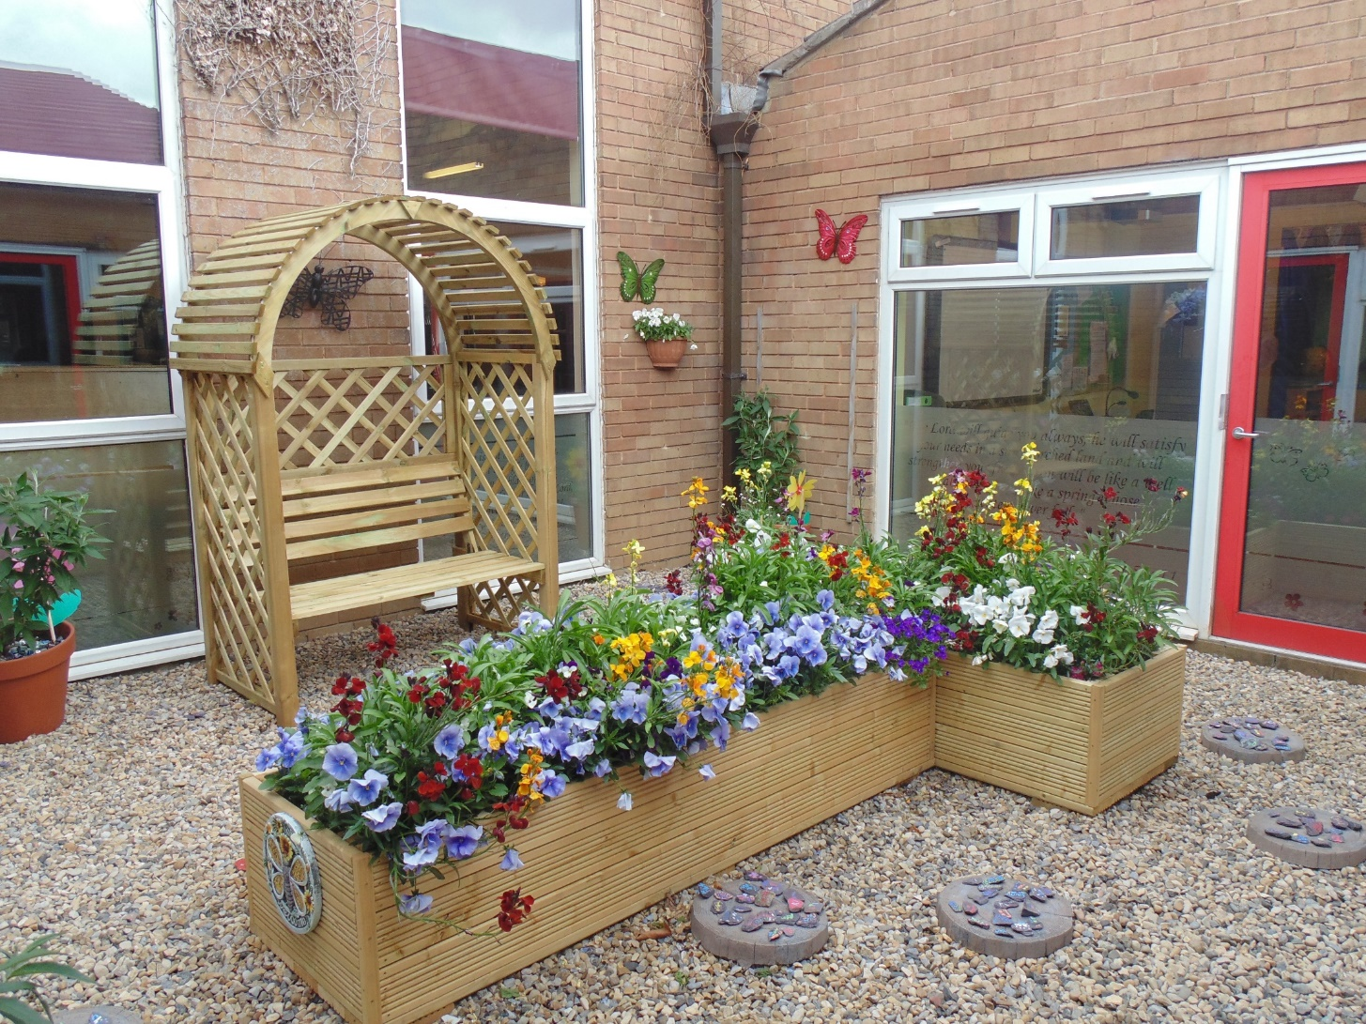
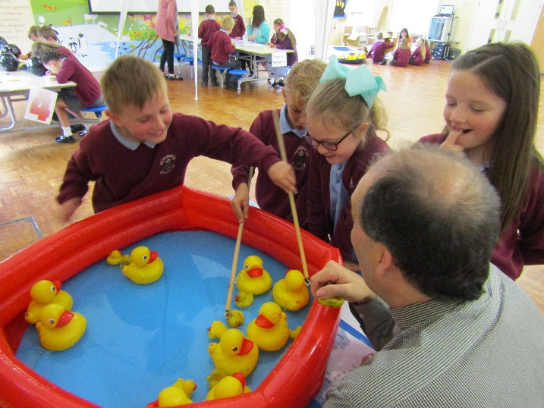
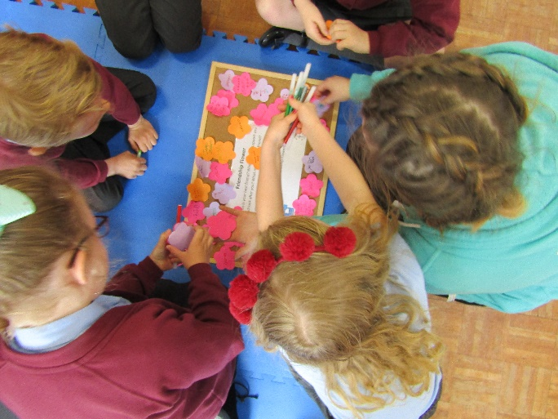
Chaplaincy & Charities Team

Slide 17
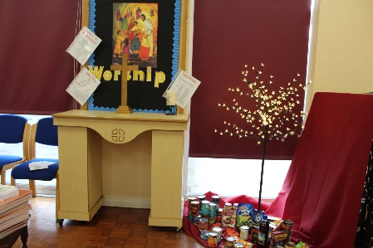
Chaplaincy & Charities Team
Service

Slide 18
Chaplaincy & Charities Team
Forgiveness

Slide 19
Chaplaincy & Charities Team
Thankfulness

Slide 20
Young Church Leaders
Service

Slide 21
FairtradeTeam
“And what does the Lord require of you? To act justly and to love mercy and to walk humbly with your God.”
Micah 6v8
Justice

Slide 22
JRSO/JPACT
Service

Slide 23
Junior Management Team
Pupil Voice
Report to Governors Summer 2017
Service

Slide 24
Knowledge and skills
Real opportunities
Raised self-esteem
Responsibility and leadership
Networking
Feel like they can make a difference
Presentation skills
IMPACT
Values
Confidence to question
Social skills
Positive attitudes
Ownership of their local community
Increased confidence
Trust and respect
Informed choices
Pride in their school

Slide 25
Real opportunities are offered to pupils of all abilities across a range of ages and a contribution is made to their future economic well-being.
Children readily take up the responsibilities to develop leadership skills through older pupils supporting and assisting younger learners in determining courses of action.
Pupils achieve a broad range of knowledge, skills and values, due to the relationships forged with outside agencies.
Children have a better sense of right and wrong and are able to apply these values to the wider world.
Through developing presentation skills, children verbalise their thoughts and understanding with more confidence in a range of given opportunities, within and outside of the school environment.
Pride in their group, inclusivity in activities, trust of and respect for fellow team members is fostered, equipping pupils with lifelong skills.

Slide 26
A culture of shared responsibility allows pupils to build self-esteem and an inner confidence.
Children have a strong sense of supporting their school and the local community and display ownership of it by developing links, strengthening relationships and modelling the application of Christian values.
Pupils gain a heightened awareness of the difference they can make through promotion of the Christian stewardship of the planet and support for charities, local and further afield, generating a sense of moral pride and a foundation for the diverse world outside of school.
Children are confident to respectfully question the world around them and the integrity of information shared.
Pupil voice has contributed much to curriculum enrichment, to rising standards regardless of starting points and to the awards the school has achieved
Through nurturing the qualities to become resourceful, independent young adults who recognise their own worth and that of others, positive attitudes are encouraged and they are able to make more informed choices as members of society.

Slide 27
The views, concerns and successes of all children are given high priority and used to guide strategic direction, as pupil voice provides the framework to communicate and embed our values across the school and wider community. Pupils build a deeper understanding of the impact each value holds, allowing them to be transferred into useful and meaningful lifestyle choices and demonstrating that the inclusive Christian values and moral purpose is a reality and actually lived out through actions.

