Slide 1
Welcome

Slide 2
Prayer

Slide 3
Hymn
Cathedral Choir & Organ

Slide 4
Lectio Divina
Matthew 11: 28-30

Slide 5
Bishop Paul
‘Keeping our eyes lifted up’ Sustaining and developing vision through difficult times.

Slide 6
Breakout Rooms

Slide 7
Coffee Time

Slide 8
Alan Bartlett

Slide 9
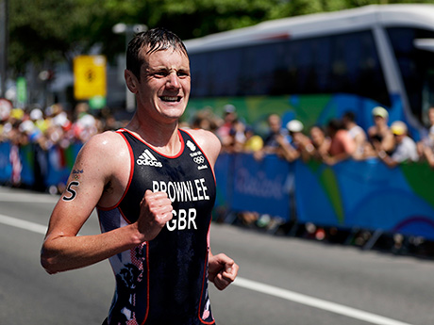
“Self-care during COVID and beyond…”
BISHOP’S CLERGY STUDY MORNING NOV 2020 ALAN BARTLETT

Slide 10
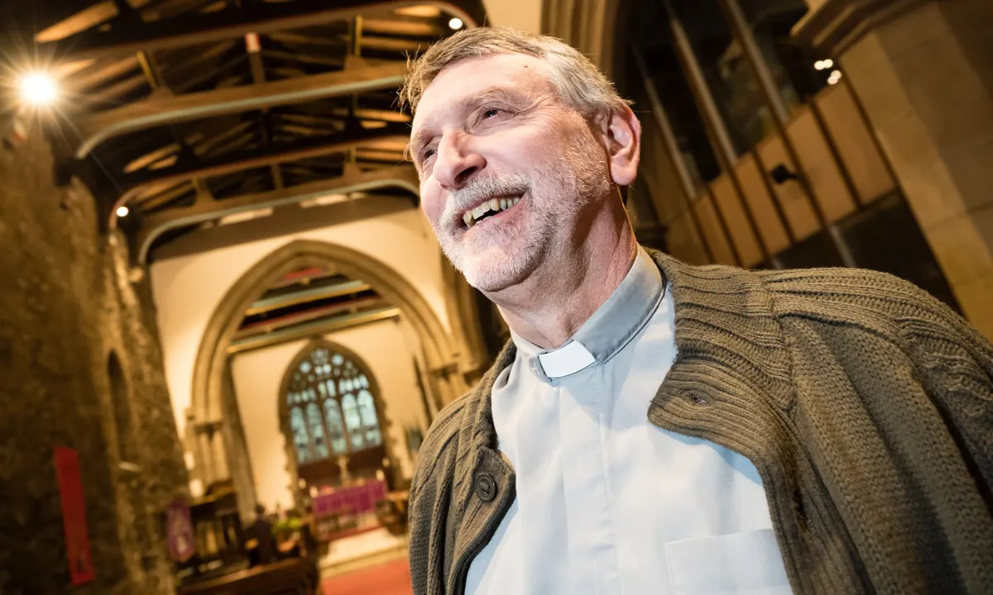
So what’s the question?
How do we as clergy flourish in ministry?
How do we survive in ministry???
BISHOP’S CLERGY STUDY MORNING NOV 2020 ALAN BARTLETT

Slide 11
So what’s the question?
“The Church is an anxious institution. That makes it dangerous. Be careful of it.”
“Parochial clergy are often one of the few professionals
still to live on the patch – this can be a huge cause of stress.”
“Vicars are the only profession to wear their faith on their sleeves.”
“The expectations
are unmanageable.”
“We are public representatives of an institution that is perceived to be failing, often deeply flawed and to many younger people, simply bigoted.”
BISHOP’S CLERGY STUDY MORNING NOV 2020 ALAN BARTLETT

Slide 12
So what’s the question…
“Clergy are one of the groups of people whom it is most difficult to persuade to take care of themselves.”
“Why do clergy, unlike almost all other professions, not have regular supervision?”
“The image of the self-sacrificing priest Is one of the deepest and most self-destructive
internalised images in existence.”
“Isolation is one of the most common problems amongst clergy.”
WHY?
BISHOP’S CLERGY STUDY MORNING NOV 2020 ALAN BARTLETT

Slide 13
So what’s the question?
Liz Graveling CHP 2020
https://www.churchofengland.org/more/diocesan-resources/ministry/ministry-development/living-ministry/living-ministry-resources
BISHOP’S CLERGY STUDY MORNING NOV 2020 ALAN BARTLETT

Slide 14
So what’s the question?
79% (of surveyed clergy) agreed they were fulfilling their sense of vocation
67% strongly agree that their work is ‘spiritually demanding’; 71% said it is ‘emotionally demanding’
BISHOP’S CLERGY STUDY MORNING NOV 2020 ALAN BARTLETT

Slide 15
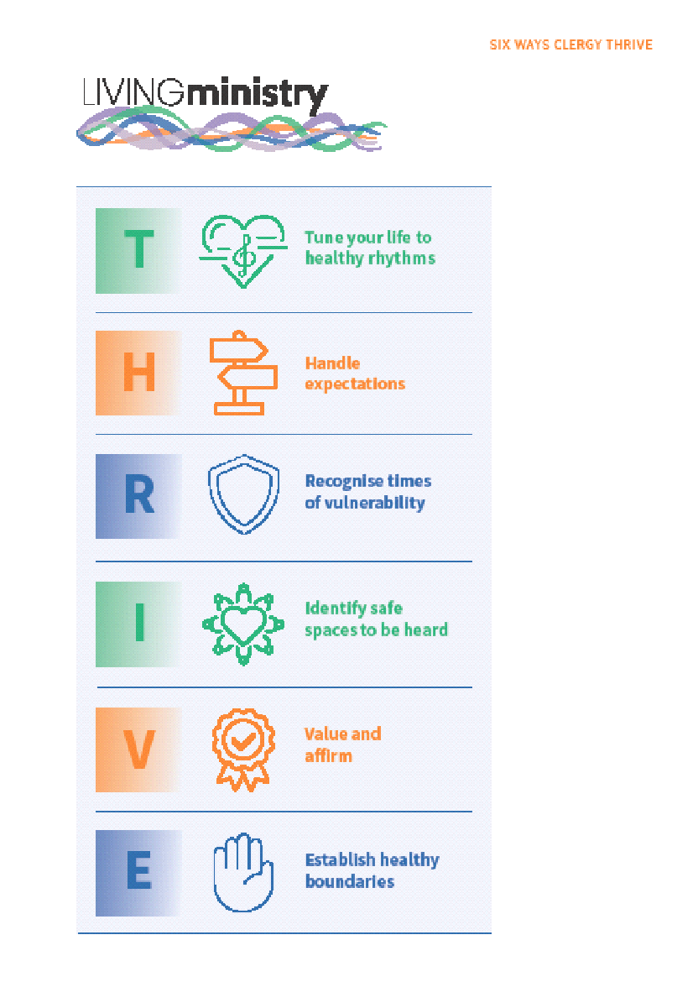
Some responses… Thrive offers 6 principles from their research that enhance wellbeing:
BISHOP’S CLERGY STUDY MORNING NOV 2020 ALAN BARTLETT

Slide 16
Some responses… Thrive offers 6 principles from their research that enhance wellbeing: Tune your life to healthy rhythms
BISHOP’S CLERGY STUDY MORNING NOV 2020 ALAN BARTLETT

Slide 17
Some responses… Thrive offers 6 principles from their research that enhance wellbeing: Handle Expectations
BISHOP’S CLERGY STUDY MORNING NOV 2020 ALAN BARTLETT

Slide 18
Some responses… Thrive offers 6 principles from their research that enhance wellbeing: Recognise times of vulnerability
BISHOP’S CLERGY STUDY MORNING NOV 2020 ALAN BARTLETT

Slide 19
Some responses… Thrive offers 6 principles from their research that enhance wellbeing: Identify Safe Spaces to be Heard
BISHOP’S CLERGY STUDY MORNING NOV 2020 ALAN BARTLETT

Slide 20
Some responses… Thrive offers 6 principles from their research that enhance wellbeing: Establish Healthy Boundaries
BISHOP’S CLERGY STUDY MORNING NOV 2020 ALAN BARTLETT

Slide 21
Some responses… Thrive offers 6 principles from their research that enhance wellbeing: Value and Affirm
BISHOP’S CLERGY STUDY MORNING NOV 2020 ALAN BARTLETT

Slide 22
Some responses… Thrive questions: ? How has the Covid-19 pandemic changed your personal and ministerial practices and affected your wellbeing? ? Which things could be impacted by a small, doable change, which is it hard to know how to tackle, and which would require significant cultural or structural change?
BISHOP’S CLERGY STUDY MORNING NOV 2020 ALAN BARTLETT

Slide 23
Breakout Rooms 2

Slide 24
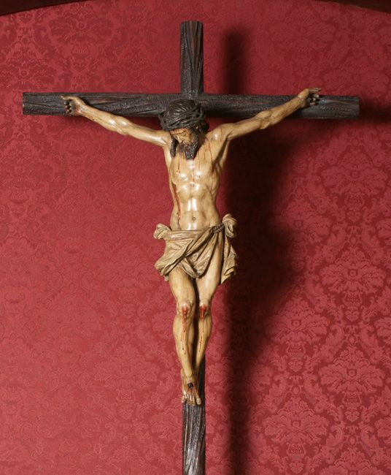
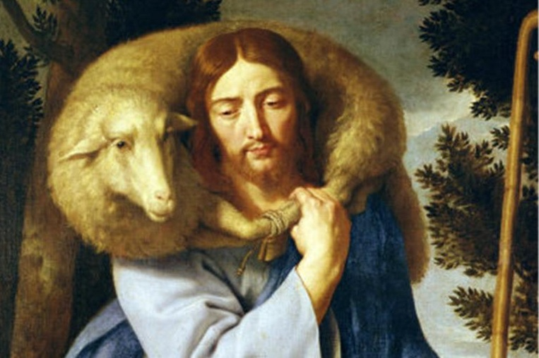
A theological tension…
‘Then he [Jesus] said to them all, ‘If any want to become my followers, let them deny themselves and take up their cross daily and follow me.” ‘ Luke9:23
“I have come that they might have, life in all its fullness.” John 10:10
BISHOP’S CLERGY STUDY MORNING NOV 2020 ALAN BARTLETT

Slide 25
A theological tension…
Q – which of these 2 deep images of Christian discipleship
resonates with you most deeply?
Q – which of these 2 deep images of Christian ministry
resonates with you most deeply?
Q – are you seeing discipleship and ministry differently? Why?
DURHAM/NEWCASTLE IME NOV 2020 ALAN BARTLETT

Slide 26
Some responses…
“If our clergy are models of Christian discipleship
and are stressed and worn out,
then what image of Christian life are we projecting?”
Some simple rules of self-care:
Remember you are a human being, not a machine – and God does not treat you like a machine.
So book quality time off each day, week, month, year, lifetime…
Remember that you are to love yourself as you love your neighbour – would you treat anyone else this way?
Remember that God calls you first to be the best “you” you can be,
and then to be good in relationships and then good as a priest – and finally good in a job…
{Francis Dewar Called or Collared. 2000 new ed.. SPCK}
Remember that you are not Jesus. You cannot do everything or solve everyone’s problems.
Even Jesus didn’t…
BISHOP’S CLERGY STUDY MORNING NOV 2020 ALAN BARTLETT

Slide 27
Prayer
Alan Bartlett

Slide 28
Song
St Nics Worship Band

Slide 30
Blessing
Bishop Paul

