Slide 1

What is an Emotionally Healthy School?
What do you see?
What do you hear?
What do you feel

Slide 2
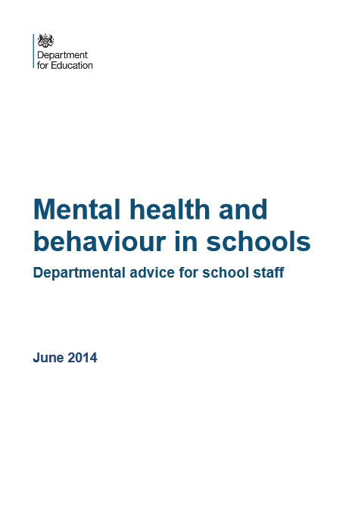
What Role do Schools play?
https://www.minded.org.uk/login
Mina Fazel The Lancet 2014 – universal, targeted intervention from schools, identification of mental health needs that require specialist services.
Behaviour’s that prevent learning likely to have their root in mental health
Primary – attachment, oppositional defiance
Secondary – anxiety and depression
Research into school interventions give mixed messages on impact.
Take away the stigma gives a positive impact for all.

Slide 3
How are schools helping young people?
Comprehensive PSHE programme including mental health
Intervention programmes for children, for example circle time, friendship groups, circle of friends, nurture rooms, Lego therapy
Staff trained to support pupils that are displaying specific mental health needs
Mindfulness
Peer massage
Peer mentoring schemes
Access to arts for emotional expression
Advice and support services for children’s emotional well being, counselling services.
Parental support – Solihul training
Thrive

Slide 4
Thrive Approach
Gives an understanding of how we develop socially and emotionally from birth through to adulthood.
Understanding what healthy child development looks like in terms of behaviour and learning and clarifies what the role of adults should be in facilitating a child’s development at each of the different stages.
Programme to interpret children’s behaviour, enabling us to identify the particular developmental needs being signalled by their behaviour and to choose appropriate, targeted interventions designed to meet those needs.

Slide 5


Resilience – A set of skills that can be taught
Positive thinking styles

Slide 6
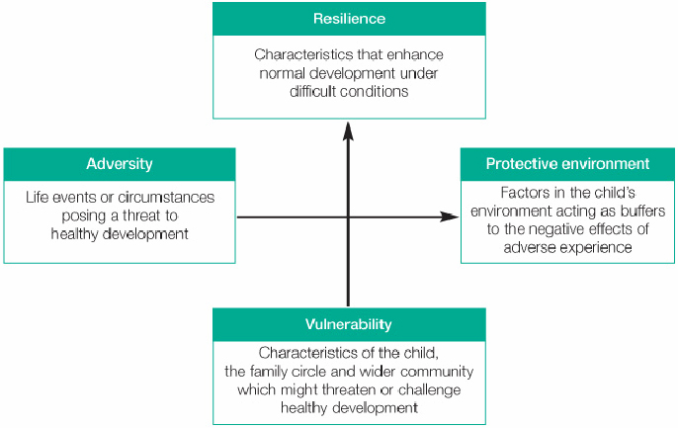
Resilience Matrix
Notes:
Seligman 3 positive things each day – lots, none, moderation from mindfulness book

Slide 7
Coping Activities
Healthy |  | Unhealthy | Okay in Moderation
Looking at artwork | Community Service | Avoiding people | Buying something nice
Dancing | Spending time with friends and family | Avoiding situations | Computer/tablet/phone time
Playing Music | Listening to music | Bingeing on sweets | Food
Eating a healthy meal | Taking care of your pet | Blaming others | Personal grooming
Exercising | Studying | Cutting or self harming | Sleeping
Listening to music | Writing | Drinking | Social media
Reading | Cinema with friends | Isolating yourself from friends | TV or movies

Slide 8
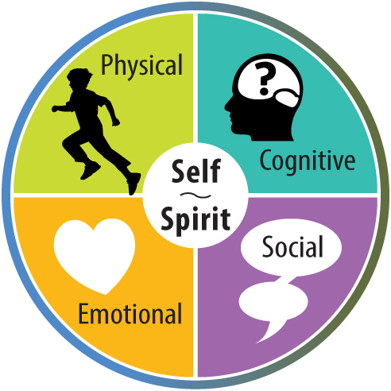
The Wells of Wellbeing

Slide 9
Resources
http://my.northtyneside.gov.uk/sites/default/files/web-page-related-files/S1%202%20School%20Guidance%20Resource%20list%20MH.pdf
The Resilient Classroom https://youngminds.org.uk/media/1463/the_resilient_classroom-2016.pdf
Mindfulness for Teen Anxiety https://www.newharbinger.com/mindfulness-teen-anxiety

Slide 10
“There is nothing either good or bad, but thinking makes it so”
Shakespeare

Slide 11
“People are not worried by things, but by their ideas about things. When we meet with difficulties, become anxious or troubled, let us not blame others, but rather ourselves, that is, our ideas about things”
Epictetus
"

Slide 12
“ My life has been full of terrible misfortunes, most of which never happen”
Montaigne

Slide 13
“Nothing in life is to be feared, it is only to be understood”
Madame Curie

Slide 14
“Present fears are less than horrible imaginings”
Shakespeare

