Slide 1
Northumbria Primary Mental Health Worker Team presentation
Newcastle & Durham Diocese of schools
Mental Health in Schools Conference 5.7.17
Notes:
Introductions –role & expereince

Slide 2
Aims of presentation
To provide an over view of the Emotional Health & Well Being Transformation plans across Northumbria Health Care Trust
To explain the PMHW role in supporting schools in this agenda
To provide a summary of the Northumbria PMHW core offers
To discuss the teams acceptance criteria & referral pathways

Slide 3
National challenges for schools
Lack of information
Complex referral systems
Increasing demands
Escalating waiting times
Inequalities according to need & post code
Lack of information on numbers of children seen, costs and outcomes
Children falling through the net
Duplication of provision
Large ‘hidden demand’
Investment focussed on specialist services
Services chronically underfunded & under resourced
Notes:
On service offers/ referral criteria/what school can do to help

Slide 4
What are children & young people saying....
To be able to turn to those adults they know for help
Some lack confidence or skills
More preventative & lower level support before the crisis
Reduced waiting times
Less travel to support
More anonymity
GPs don’t understand or take them seriously
Don’t want to tell their story more than once
Want easy access to advice , guidance & support

Slide 5
Key messages from parents /carers
Lack of information and understanding
Recognition of help needed or what’s available
Professional help not consistently available
Experiences of stigma & shame
Isolation
Worry about future impact e.g. employment/university
Negative impact of parents exclusion from assessment and treatments
Stigmatising venues

Slide 6
Local challenges in Northumberland & North Tyneside
Northumberland-
significant resources invested into more specialist services
fewer resources in universal and preventative services
access to the specialist services was poor
children waiting for long periods
fragmentation of services
North Tyneside –
gaps identified in universal services
pressue identified on specialist CAMHS
needs could be more appropriately managed in universal
access to CAMHS service identified as an issue (NT Youth Council)
a recognition of need to reduce waiting times from 12 weeks to 6
Notes:
a recognition that the health and care system needed to
reshape services

Slide 7
Developing a national sustainable model
Resource is currently limited
Reduce demand on current systems
To reduce the burden of mental and physical ill health
Need for effective planning, development & monitoring across sectors
Increase capacity in the system
Recognising ‘untapped potential’ : parents, schools , youth
workers, residential staff
Notes:
(30 billion funding gap)
make CYP more mentally healthy & well through positive promotion & prevention strategies

Slide 8
Resilience, prevention and early intervention
Promoting healthy lifestyles for C&YP
CYP need to be kept healthy
Tackling risk factors that lead to problems
Investment in primary prevention
Community psychology

Slide 9
A way forward : Future in Mind (2015)
An integrated whole system
Promoting resilience, good mental health and wellbeing
Prevention and early intervention
Improving access to effective support –a system without tiers
Care for the most vulnerable
Joined up with clear pathways of care
• Development of the workforce - skills, competencies and experience
Transparency and accountability of resources
Notes:
2015 Future Mind report with recommendations from a taskforce co-chaired by NHS England and the Department of Health –aim of report that would set out what needs to be done to improve how children’s mental wellbeing can be supported and, when in distress and ill, receive good, timely care. Each local area to develop 5 year local transformation plans from 2015-2020

Slide 10
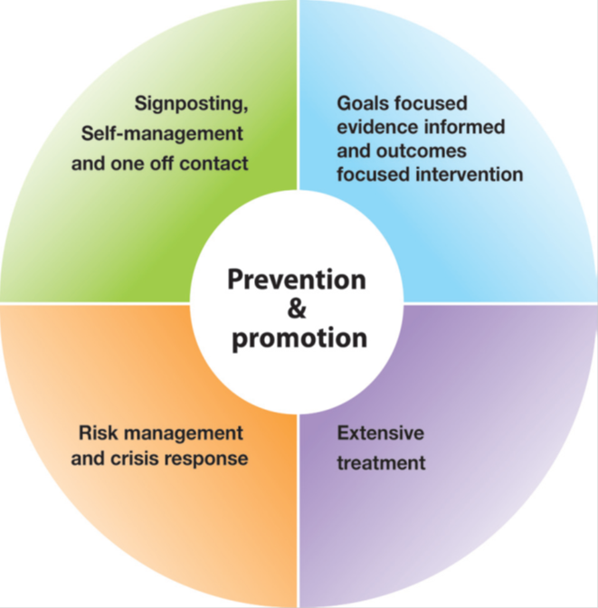
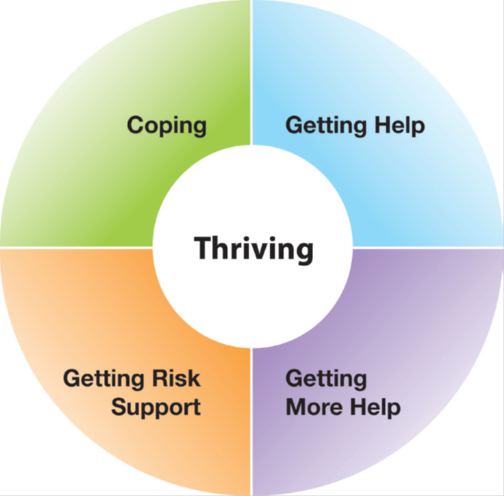
The Thrive Model
Notes:
THRIVE Model has been developed by The Tavistock and Portman NHS Foundation Trust and the Anna Freud Centre. It is gaining national recognition as a useful model moving away from the service led Tiered model to a new conceptualisation of services based for the needs of children and young people.
. The strategy, which is agreed across all commissioner and provider partner organisations, is designed to deliver our vision for services; in doing so, it will shift the focus of service provision in the county to early intervention and prevention where that is possible, whilst maintaining the now well performing specialist service provision.
The THRIVE model conceptualises four groupings for young people with mental health issues and their families, as part of the wider group of young people who are supported to thrive by a variety of prevention and promotion initiatives in the community.
The model is predominantly a health model of evidence based intervention and needs to be recognised in the context of communities where people will access a range of health and social care services including education and employment.
THRIVE Model has been developed by The Tavistock and Portman NHS Foundation Trust and the Anna Freud Centre. It is gaining national recognition as a useful model moving away from the service led Tiered model to a new conceptualisation of services based for the needs of children and young people.
The THRIVE model conceptualises four groupings for young people with mental health issues and their families, as part of the wider group of young people who are supported to thrive by a variety of prevention and promotion initiatives in the community.
The model is predominantly a health model of evidence based intervention and needs to be recognised in the context of communities where people will access a range of health and social care services including education and employment.
Coping –promotion of resilience to build the ability of a community, to prevent , support & intervene successfully in MH issues. To draw on the strengths of the families /communities & schools.
Getting help –approach based on best available evidence of what works, with whom & in what circumstances. Use of monitoring outcomes. Provision to be provided with health as the lead provider

Slide 11
Links with other statutory guidance for schools
Mental health & behaviour in schools Departmental advice for school staff (March 2016) It provides advice on how to :-
Promote positive mental health
Identify pupils likely to need extra support
Strengthen pupil resilience
Support children with emotional and behavioural difficulties
Where and how to access community support
How and when to refer to the Child and Adolescent Mental
Health Services (CAMHS)

Slide 12
SEND Code of Practice: 0 to 25 years
Social, Emotional & Mental Health (also called SEMH) is one of twelve kinds of Special Educational Need & Disability identified in the new national SEND Code of Practice 2014.
‘The 2014 Code says:
‘ Children and young people may experience a wide range of social and emotional difficulties which manifest themselves in many ways. These may include becoming withdrawn or isolated, as well as displaying challenging, disruptive or disturbing behaviour. These behaviours may reflect underlying mental health difficulties such as anxiety or depression, self-harming, substance misuse, eating disorders or physical symptoms that are medically unexplained. Other children and young people may have disorders such as attention deficit disorder, attention deficit
hyperactive disorder or attachment disorder’.

Slide 13
A vision for services
Northumberland & North Tyneside
Emotional Health & Well Being Strategy
Northumberland-
We will promote & improve the emotional health & well being of children & young people by building reliance, realising potential & providing easy access to the right service when required.
North Tyneside –
We aim to establish prevention & early intervention at the heart of the Boroughs family & children's services & this will address the critical challenge of rising demand for services & reducing resources .

Slide 14
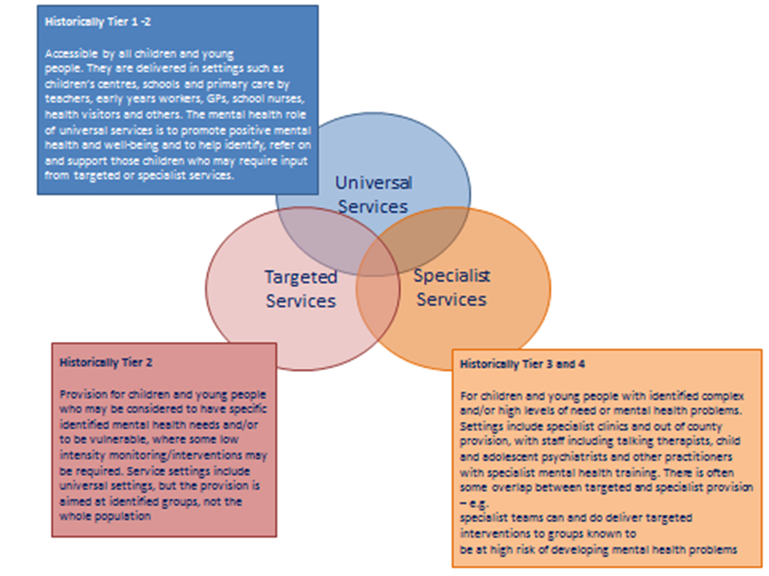
Current Mental Health service configurations
Notes:
Targeted Northumbria & specialist NTW –challenges & opportunities
Current links with cyps –weekly referrals meeting & case consultations

Slide 15
The PMHW role in the Transformation plans
To raise awareness of the emotional health and well-being of children and young people across the children’s workforce.
To deliver training & up skilling the workforce in promotion & prevention approaches
To act as a visible link between schools & specialist mental health services
To facilitate improved access to most appropriate service to meet needs
To provide early interventions and support to universal services
Notes:
Northumberland Transformation report (2016) The programme will cost £312,000
Largest single investment of the planSignificant financial investment to increase capacity of the PMHW team

Slide 16
The role of schools in the Transformation plan
North Tyneside
Emotionally Healthy Schools Resource Pack –includes what difference can schools make. How can children and young people look after themselves. What skills and training do staff need. Where can you go for help and support.
Mental Health champions in schools
Northumberland
Funding is available to support educational setting programmes
Support to the ‘Thrive’ programme focussing on attachment in schools
Mental health champions in schools
Improved access to information on self help & services for pupils & staff

Slide 17
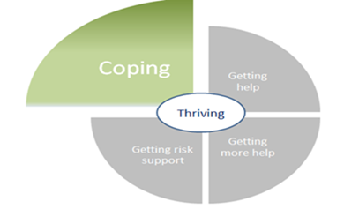
Coping health promotion & early intervention
Providing schools with experienced health input to support decisions about help & to determine needs
PMHWs will ensure the coordination of care and early health assessments
Awareness raising training

Slide 18
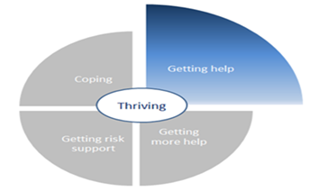
Getting help
Improving accessibility through direct referrals from
schools
Targeted interventions : consultation & direct work
Development of a single point of contact to mental health providers
Attendance on locality teams / hubs
Awareness will be promoted to ensure early intervention is offered

Slide 19
The Northumberland PMHW team
Multi disciplinary team
Professional backgrounds (social work , mental health nursing , Occupational Therapy, Paediatric Nursing)
Extensive CAMHS /Post qualifying experience
Designated locality posts across 4 areas
1 FT band 7 PMHW Lead
4 FT band 6 PMHWs
2 PT administrators
1 PT & 1 FT PMHW appointed
Recruitment plans – 2 further FT PMHW posts

Slide 20
The North Tyneside PMHW team
Multi disciplinary team
Professional backgrounds (social work , mental health nursing , Paediatric Nursing)
Extensive CAMHS /Post qualifying experience
1 ft band 7 lead
1 ft band 6 PMHW
2 pt band 6 PMHWs
Recruitment plans for 1 vacant post

Slide 21
Acceptance Criteria in Northumberland
Our remit -mild to moderate emotional wellbeing and mental health problems
The following presentations would be eligible for input from the Service:
Anxiety, depression, stress and or other mood disorders, e.g. low self-esteem
Simple Phobias
Self harm – where this is mild to moderate
Adjustment reactions
Mild to moderate emotional / behavioural disorders (impacting across all areas of child's life)
Referrals will be accepted when:
The issues are resolving despite first level interventions from universal services
The problem is mental health focussed
It is having a significant impact on the child’s general functioning
- The difficulties are present across different settings
Notes:
Communication of service expectations is helpful (eg waiting times & process – young minds
Wait times before 12 weeks –current 7/ 8 weeks aim below 6 weeks

Slide 22
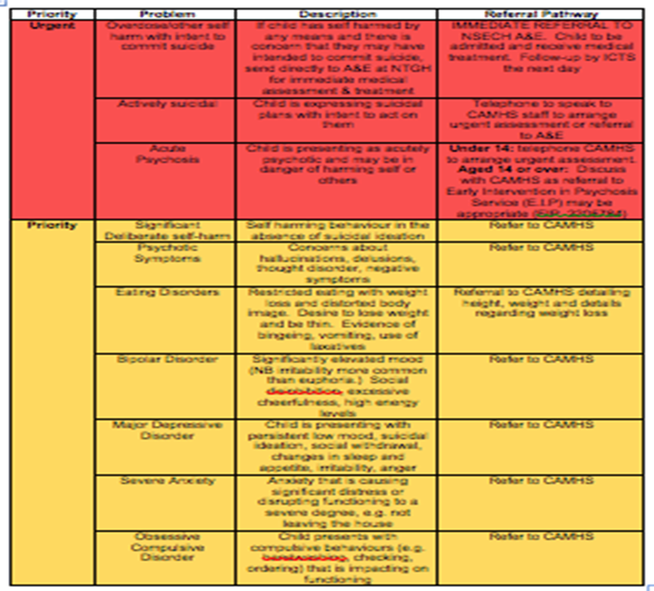
Acceptance Criteria in North Tyneside

Slide 23
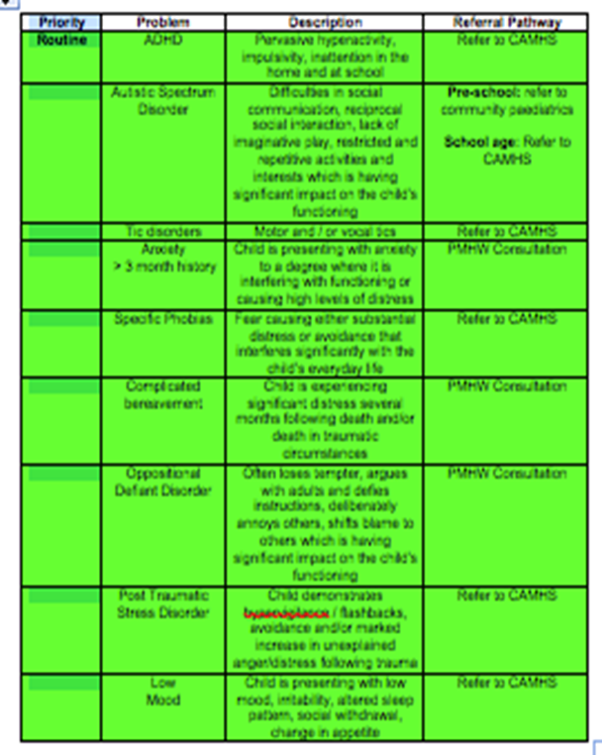
Acceptance Criteria in North Tyneside

Slide 24
Referral Pathways
Who can refer:
GPs, PHSNs, Health visitors, Schools (Head teachers /SENCOs) , Educational Psychologists, Paediatricians, Social Workers, Early Help workers, Family Support workers, Voluntary organisations in Northumberland only
Refer to us direct:
Referrals are accepted from professionals currently working with young children and adolescents Service referral form to be completed by the referrer
Via multi-health agency referrals meeting:
In North Tyneside daily referrals meetings
In Northumberland weekly with team & School Nursing Service & CYPS
Via the Hub:
A member of the PMHW team attend the Hub Meetings and the Hub Triage Meetings and accept referrals that are appropriate to a targeted mental health service
Notes:
No current self referral system in place –consideration for the future
Future change to consultations being the first point of access & referrals either direct or hubs – as understanding of PMHW & CYPS referrals & remits still unclear
Have considered self referrals could be something to revist

Slide 25
The aims of consultation
A dedicated named contact point for every school , primary & social care provider
To improve understanding of children & young peoples mental health needs by promoting the use of positive mental heath strategies
To support our partners to identify appropriate pathways of care to meet the mental health needs of a child/young person
To discuss & provide timely advice on the management of cases, including consultation, co-working or liaison
School development plans –
The role of the mental health in schools champion –
A specific individual responsible for mental health in schools
to provide a link to expertise and support to discuss concerns
To identify issues & make effective referrals

Slide 26
Consultation Role
Northumbria Trust have complied service consultation arrangements agreed at Child Health Board & CAMHS Operational board North Tyneside
Benefits, definition, responsibilities, when to consult, booking in systems, who can access, expectations of all parties.
An agreed pre-consultation preparation tool for consultees
Agreed recording & data collection systems
In North Tyneside –
Daily telephone consultation
Face to face with professionals based in clinics & locality hubs
Advance face to face with professionals , child & family if required (joint appointments)
In Northumberland -
Weekly telephone consultations
Future plans to develop the face to face roles as above
Notes:
Transformation plan suggests …..a key role for mental health services to …all have our contact numbers, telephone consultation line, referral form & acceptance criteria
Increasing frequency of telephone consultations , face to face with professionals & children & families. –with non open cases –so case responsibility remains in universal service

Slide 27
Direct clinical role
Children and young people aged up to 18 years who fit our acceptance criteria
Early intervention / prevention focus
Delivered in a variety of community settings
Duty system in North Tyneside
Initial mental health assessments
Brief Interventions based on best available evidence in Northumberland
Outcome measures & patients satisfaction questionnaires
Discharge or signpost to appropriate agency
Notes:
home, schools, children’s centres, GP surgeries)
Outcome measures developing .
Children seen variety of venues
Weekly clinical formulation meetings / case consultations with CYPS
Monthly clinical & case management supervision
CBT/SELF HELP/PSCYHOEDUCATION/SFBT /FAMILY WORK
Annual Northumbria Trust appraisals / Northumbria Safeguarding supervision
Monthly Operational meetings

Slide 28
Teaching & Training
Aims –
To improve the skills , knowledge & skills of the universal workforce
To help to identify problems early
To be aware of how to help /intervene
When to worry
How to refer on to targeted & specialist services
Current sessions –
Mental Health Awareness
Child and adolescent development (brain development)
Child and adolescent mental health and wellbeing
Attachment –healthy relationships
Exam stress
Worries & anxiety
Low mood & Depression
Self harm
Notes:
Offers to professionals & CYPS in schools
All are based on current research & best available evidence base Other sessions available-

Slide 29
Liaison Role
PMHWs attend multi agency Locality Hub meetings
Supporting schools to develop a whole –system approach to resilience
Support with the development of the Mental Health Champions
Ensuring awareness of early intervention services available
Presence on Early Help /TAF /Core group Meetings
Notes:
the Northumberland Emotional Health & Wellbeing of C&YP strategy group , Mental Health Champions in Schools & Early Help & Early Intervention Sub Committee
Opportunities to be flexible innovative & creative depending on local need

Slide 30
Resources for schools
www.youngminds.org.uk.
www.moodjuice.scot.nhs.uk/
https://www.minded.org/
www.minded.e-lfh.org.uk/families/
www.rcpsych.ac.uk
Family lives.org.uk
www.fivewaysofwellbeing.org
www.epicfriends.org.uk
www.moodcafe.co.uk
https://www.youtube.com/watch?v=aaTDNYjk-Gw
https://www.youtube.com/watch?v=UPQak4vxoRE
www.mental.health.org.uk
www.mind.org.uk
www.time-to-change.org.uk

Slide 31
Thank you for your time – any questions?

