Slide 1
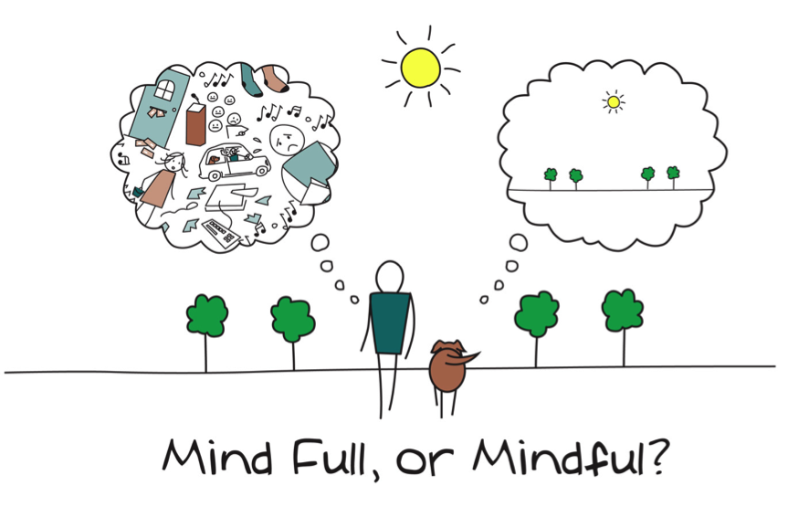
MINDFULNESS
Most impact
Least resources
The key is to be able to explain the actual neuroscience involved.
Notes:
When you explain step by step, how it works and how it effects your brain, and give people a chance to experience it, even the most cynical, anti-self-awareness agitator can't help but see that they will be better off practicing this skill.

Slide 2

The Brain
The medial prefrontal cortex, along with memory regions such as the hippocampus.
Major breakthrough 2007 neuroscientists
Two distinct networks
Default network or Narrative circuit
planning, worrying, ruminating.
Thinking about yourself and others, your history, past, future an intricate web a giant tapestry.
Notes:
It is the network we use most of the time – cool breeze – take you to winter and skiing. Nothing wrong, but not good to be your only setting.This is when we start default thinking about what we are making for dinner – nobody will like it, one child vege.

Slide 3
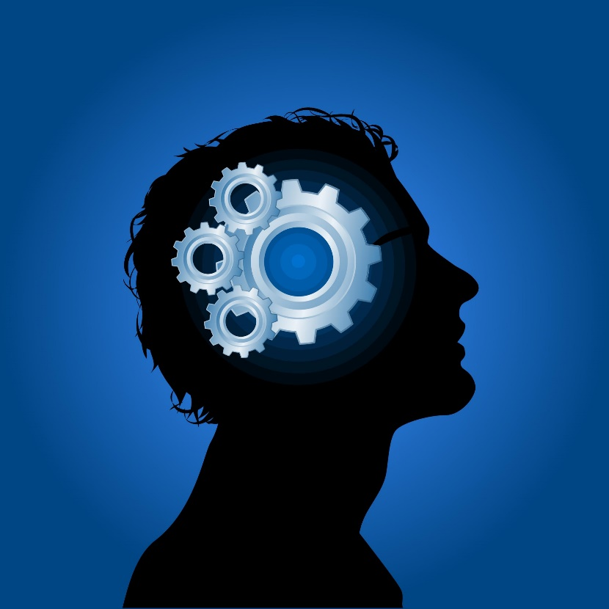
Activity
Think about your own Default network, narrative circuit.
When you are travelling to work in a morning what setting are you using?
When you go about your everyday life what setting do you use?
Grade yourself 1-10
10 being I am thinking, planning what I need to do all of the time.
1 being I think and plan, create narratives hardly ever and my mind is in a restful state most of the time.

Slide 4

The Brain
Activates Insular and anterior cingulate cortex
2. Direct Experience
Experiencing sensations coming into your body in ‘real time’ not thinking about the past or the future, yourself or others.
Notes:
In this state your mind and body experience so much more, you are feeling the cool breeze, the warmth of the sun on your skin, the glass of cold wine has more taste.

Slide 5
Inversely Correlated
Sadly, even a cold beer doesn't taste as good in this state.
Narrative and
Direct experience, are inversely correlated.
That is you don't see as much (or hear as much, or feel as much, or sense anything as much) when you are lost in thought.
Notes:
In other words, if you think about an upcoming meeting while you wash dishes, you are more likely to overlook a broken glass and cut your hand, because the brain map involved in visual perception is less active when the narrative map is activated.

Slide 6
Mindfulness
When you focus your attention on the here and now you stop the narrative circuit
This explains why if your narrative circuitry is going crazy worrying about an event it helps to take a deep breath and focus on the present.

Slide 7
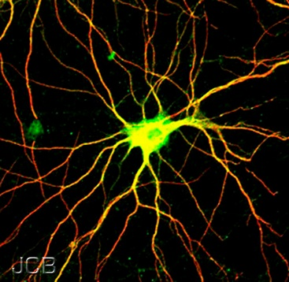
Two Thinking Patterns
Narrative Circuitry - Fast, planning, reaching for memory and projecting possibilities – often don’t happen and can be negative
Direct Experience – the hear and now, calms the brain, you can think more rationally without making assumptions
Notes:
The narrative circuitry is used for planning, goal setting, and strategizing.
Direct experience helps you see the world more directly, which enables more sensory information to be perceived. Helps you get closer to the reality of an event. You perceive more information, as well as more accurate information about these events. Noticing more real-time information makes you more flexible in how you respond to the world. You also become less imprisoned by the past, your habits, expectations or assumptions, and more able to respond to events as they unfold.

Slide 8
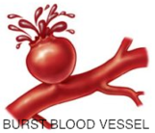
Mindfulness
The trick is being able to identify the two patterns and being able to change from one to the other.
Most people follow the narrative path most of the time. This can be extremely detrimental to their well-being and their physiology.

Slide 9
“Mindfulness is not difficult the hard part is remembering to do it”
John Teasdale
If you're on the jetty in the breeze and you're someone with a good level or mindfulness, you are more likely to notice that you're missing a lovely day worrying about tonight's dinner, and focus your attention onto the warm sun instead.

Slide 10
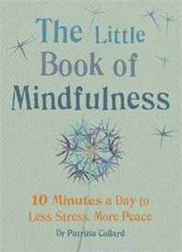
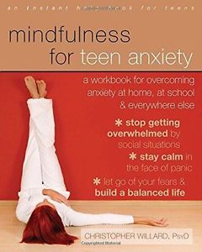
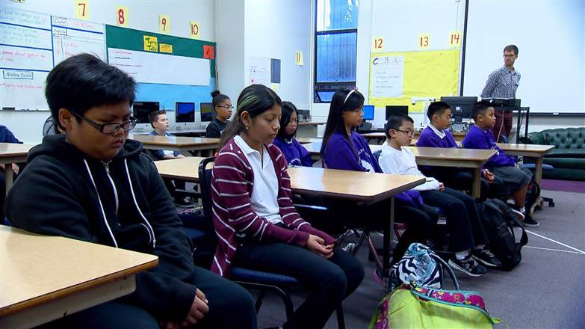
Classroom
Not easy when your thought patterns are cemented, habit for us older ones.
Children have much better chance of making the two pathways more equal.
Practice every day in the classroom for a short time – many online short breathing exercises.
Secondary – part of every day lessons. Explanation of why it is good for them.

Slide 11
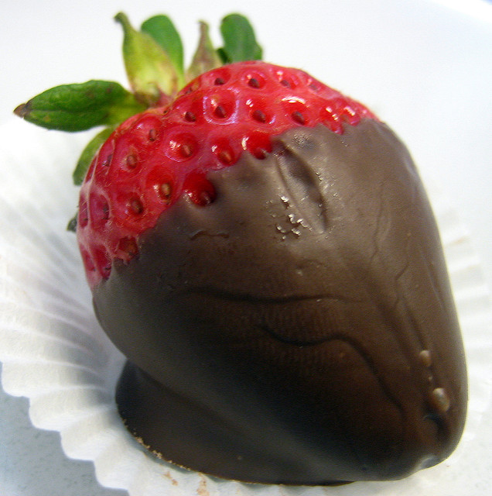
Chocolate or Strawberry
Look at your chocolate or strawberry – look at the wrapper/skin, beautiful shiny paper, bright colour, smell listen to the wrapper as you unwrap it. Or listen as you bite into your juicy strawberry. Take a nibble, swish around your mouth, feel the texture in your mouth.

Slide 12

Neuro Linguistic Therapist
To get you to sleep
Two surfaces

Slide 13
Mindfulness
Paying more attention to the present moment – to your own thoughts and feelings, and to the world around you – can improve your mental wellbeing.
"Mindfulness also allows us to become more aware of the stream of thoughts and feelings that we experience, "and to see how we can become entangled in that stream in ways that are not helpful.
This lets us stand back from our thoughts and start to see their patterns. Gradually, we can train ourselves to notice when our thoughts are taking over and realise that thoughts are simply 'mental events' that do not have to control us.

