Slide 1

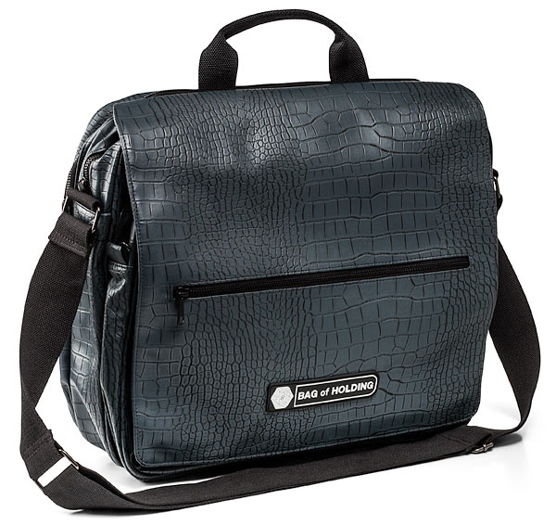

Mental Health in Schools Conference Wed 5th July 2017
Bin
Bag
Bring
Bin
Bag
Bring
Notes:
Bin, bag, bring - examples

Slide 2

Mental Health in Schools
National agenda – listening ear of the DFE
Local Agenda – local knowledge
Strategies to take back to school
Psychotherapists, experts in mental health one to one

Slide 3

Welcome Claire Wong
Minds Ahead
Carnegie Centre of Excellence for Mental Health in Schools
Leeds Beckett University

