Slide 1
Welcome New Diocesan RE Syllabus Launch Thursday 4th October 2018 Marriott Hotel

Slide 2
Margaret Gibson and Caz Weir
RE Advisors
Dioceses of Durham and Newcastle

Slide 3
Aims
Understand the rationale behind the new Diocesan Syllabus
Outline an overview of the new Diocesan Syllabus
Discuss next steps and think about the way ahead

Slide 4
This artwork was created by four KS3 pupils.
Over to you!
What do you think they were trying to say?
Notes:
Spirited Arts

Slide 5
Rationale
Five year period of the previous Diocesan Syllabus has come to an end
Changing educational landscape
Changes from the Church of England Education Office:
Statement of Entitlement (2016)
Church of England Vision for Education (2016)
Understanding Christianity (2016)
SIAMS schedule (2018)
Notes:
life beyond levels, moving away from AT1 / 2, raising standards across the phases including new GCSE and A Level specifications

Slide 6
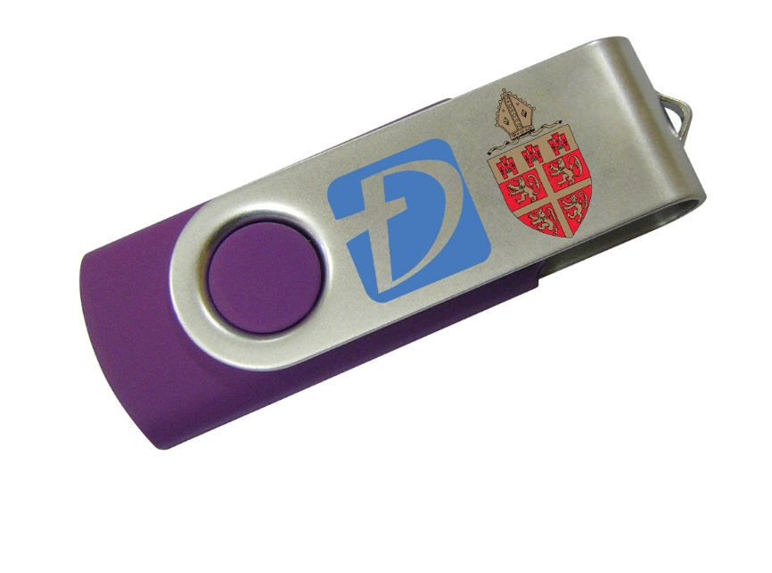
USB drive
The Diocesan Syllabus can be shared within your school but due to copyright reasons it must not be uploaded onto your school website and must not be shared externally.

Slide 7
Overview
One syllabus for 4 – 18 year olds
Christianity is taught using the Understanding Christianity resource
Based on the teaching and learning model from Understanding Christianity
Other faiths are taught discreetly
Thematic units (e.g. sacred places, festivals, rites of passage, pilgrimage, and for older students, life after death, suffering, moral decision making)
Enquiry approach
Notes:
Explain how positively UC was received and the request from primaries to teach the other faiths in the same way

Slide 8
Syllabus Content
Section A: RE in Church Schools
Section B: Requirements and Good Practice in RE
Section C: What do Pupils Learn in RE?
Section D: Assessing Pupils’ Progress in RE
Section E: Guidance

Slide 9
The principal aim of RE is to enable pupils to hold balanced and informed conversations about religion and belief.
Over to you!
What do you think this means in practice?
Notes:
Emphasise that this is the definition of religious literacy and is central to the syllabus

Slide 10
Section A: RE in Church Schools
The principal aim of RE is to enable pupils to hold balanced and informed conversations about religion and belief.
Statement of Entitlement 2016 states that RE should help pupils to:
become religiously literate
have a clear understanding of Christianity as a living world faith
understand other major world religions and world views
reflect upon their own beliefs and values.

Slide 11
Section B: Requirements and Good Practice in RE
RE and the law:
RE is a statutory requirement for all schools as part of a broad and balanced curriculum
VA schools follow the Diocesan Syllabus for RE
VC schools follow the Locally Agreed Syllabus for RE.
Notes:
Importance of the difference btwn VA and VC – syllabus vs a resource to supplement the LAS

Slide 12
Section B: Requirements and Good Practice in RE
Curriculum time and balance in line with the statement of entitlement:
at least 5% of the curriculum time should be dedicated to RE, with the aim of it being closer to 10%
in practice, this means a starting point of around 60 minutes per week for KS1 and a minimum of 75 minutes per week for KS2 and 3
RE is distinct and different from collective worship
KS1 – 3 at least two thirds Christianity*
Other faiths or world views approximately one third.
*VC schools following a Locally Agreed Syllabus that required less than two thirds Christianity should aim to enrich this

Slide 13
Section B: Requirements and Good Practice in RE
Religions to be studied:
4–5s Reception | Children will encounter Christianity and other religions and beliefs represented in the local area. | This is the minimum entitlement. Other faiths can be covered. Non-religious worldviews: may be encountered in primary and at least one example explored in secondary.
5–7s Key Stage 1 | Christianity and either Islam or Judaism.
7–11s Key Stage 2 | Christianity and either Hinduism or Sikhism (LKS2) and either Islam or Judaism (UKS2).
11–14s Key Stage 3 | Christianity and three from Buddhism, Hinduism, Judaism, Islam and Sikhism.
14–16s Key Stage 4 | Two religions required, including Christianity, leading to a GCSE qualification.
16–19s Core RE | Religions and worldviews to be selected by schools as appropriate. Minimum requirement of 10 hours of core RE across Year 12 – 13.

Slide 14
Section B: Requirements and Good Practice in RE
Good RE depends upon quality subject leadership.
The Syllabus outlines the role of the subject leader which includes:
making it a priority to develop staff expertise of all who lead and teach RE
ensuring equal status with other core subjects in staffing, responsibility and resourcing
ensuring sufficient curriculum time
reviewing, monitoring and evaluating provision and practice.
Notes:
NB – final point includes the academic flourishing of vulnerable pupils, inc those with learning difficulties (highlighted in SIAMS)

Slide 15
Section C: What do Pupils Learn in RE?
Notes:
A major part of our CPD

Slide 16
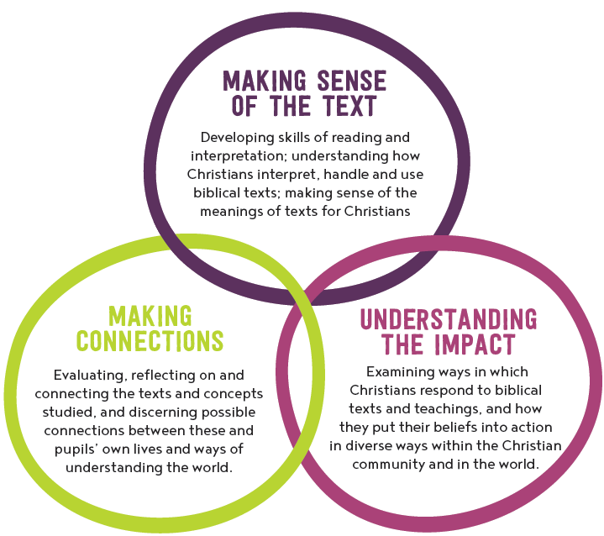
Section C: What do Pupils Learn in RE?
Understanding Christianity
Teaching and Learning Model
Notes:
Discussion re implementation of this with schools who have already started to use UC
Same pedagogy is going to be rolled out with the other faiths

Slide 17
Chat to people around you:
If you are using Understanding Christianity in your school, what impact is it having?
Over to you!
Incarnation – we will be looking for samples of work after Christmas to be used for standardisation with other dioceses
Notes:
Discussion re implementation of this with schools who have already started to use UC
Same pedagogy is going to be rolled out with the other faiths

Slide 18
Section C: What do Pupils Learn in RE?
Making sense of beliefs
identifying and making sense of core religious and non-religious concepts and beliefs;
understanding what these beliefs mean within their traditions;
recognising how and why sources of authority are used, expressed and interpreted in different ways, and developing skills of interpretation.
Making sense of beliefs
Making connections
Understanding the impact

Slide 19
Section C: What do Pupils Learn in RE? Some sample questions.
Religion/belief Thematic unit | EYFS | KS1 | LKS2 | UKS2 | KS3
Other faiths |  | Who is Jewish and how do they live? | What does it mean to be a Hindu in Britain today? | What does it mean for Muslims to follow God? | How are Sikh teachings on equality and service put into practice today?
Themes | Which stories are special and why? | What makes some places sacred to believers? | What are the deeper meanings of festivals? | How do religions help people through good times and bad times? | Why is there suffering? Are there any good solutions?
Notes:
Key question overview - examples

Slide 20
Over to you!
Key Question Overview
What excites you about these unit questions?
Which areas do you feel you might need support with moving forward?
Notes:
We will return to this at the end

Slide 21
Sample units to explore
Over to you!
EYFS | Being special: where do we belong?
KS1 | Who is Jewish and how do they live?
LKS2 | How and why do believers show their commitments during the journey of life?
UKS2 | What does it mean for Muslims to follow God?
KS3 | What is good and what is challenging about being a Jewish teenager in the UK today?
Notes:
Range of themes and faiths as well as an example of progression – KS1 and KS3 on Jewish believers

Slide 22
Section C: What do Pupils Learn in RE?
KS4:
This Diocesan Syllabus requires that all 14-16 students should pursue an accredited course, in line with the Statement of Entitlement 2016, which states that:
‘pupil achievement in RE should equal or be better than comparable subjects, and all pupils should take a recognised and appropriate qualification at KS4’.
Sixth Form:
The minimum requirement is 10 hours of core RE across Year 12 - Year 13. Students should continue the study of religion and worldviews within the provision of core RE in line with the Statement of Entitlement 2016.
Schools should also provide opportunities for those who wish to take A Level Religious Studies, alongside core RE for 16-19s.

Slide 23
Section D: Assessing Pupils’ Progress in RE
The Syllabus has end of unit learning outcomes for each unit
These feed into end of phase outcomes
Using the unit end of learning outcomes as stepping stones towards the end of phase outcomes will allow teachers to track progress
An example can be found in section D.

Slide 24
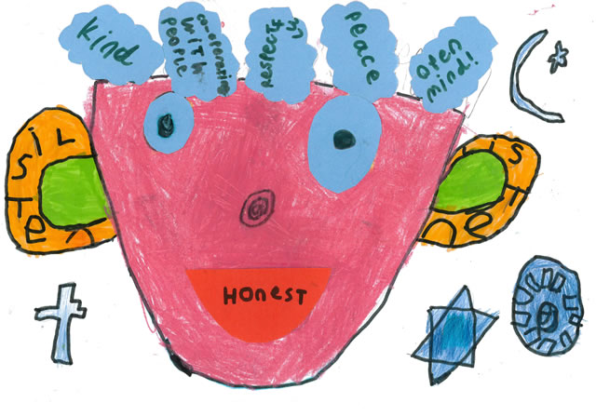
Section E: Guidance
This section includes guidance on:
promoting SMSC development in RE
exploring the links with British Values
developing skills and attitudes in RE
census information on the demographics of religion and belief in the region.

Slide 25
Next steps
Timescale for implementation:
new Diocesan Syllabus should be in place in VA schools by September 2019
CPD – Understanding Christianity training this term:
Primary: Mon 19th Nov and Fri 30th Nov
Secondary: Friday 23rd Nov – new staff, staff new to RE, non-specialist staff
Other training needs to implement the new Diocesan Syllabus?
Notes:
Exit ticket - positive/enthusiastic about, what support you need…..training need name and school

Slide 26
Next steps:
Consider your training requests and fill in the grid
Name of school: _____________________________________
What support would help your staff to implement the Syllabus?
___________________________________________________
___________________________________________________
What format would you like follow up training to take?
Whole day
Half days (afternoon e.g. 2 – 4)
Twilight sessions (e.g. 4 – 5:30)
Other? Please state: _____________________________
Notes:
Exit ticket - positive/enthusiastic about, what support you need…..training need name and school

